Slide 1



TOPIC 3
Neurons
SUPPORTED BY:

Slide 2
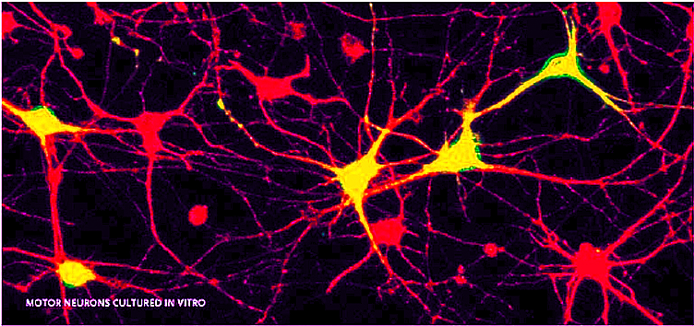
Image source: Jessell lab, Columbia’s Zuckerman Institute
Notes:
The image above shows motor neurons, cells that are part of a pathway that sends signals from the brain or spinal cord to a muscle or a gland.
These cells have been removed and are being observed in vitro, meaning in glass.

Slide 3
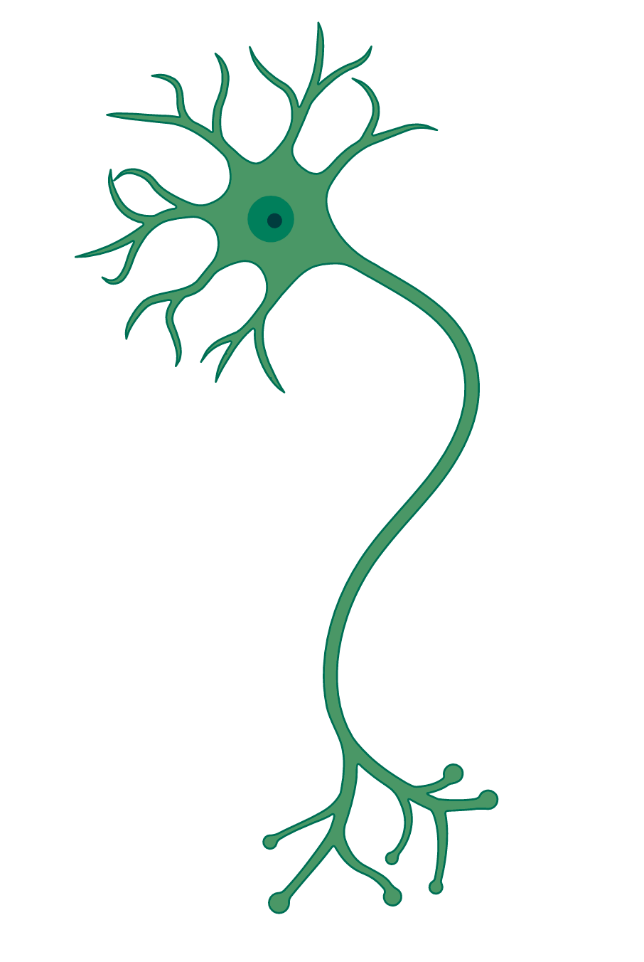
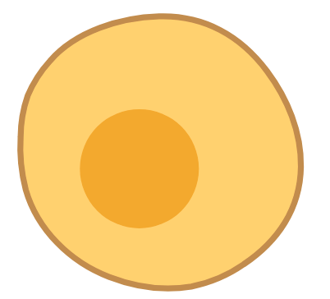
Compare and contrast cells
Body cells
Neurons
Image source: BioRender
Notes:
Refer to Activity sheet topic 3: comparing neurons
Explain activity and remind students how to use a Venn Diagram.
What’s so special about neurons? Why do they have this particular shape?

Slide 4
Body cells
Neurons
All kinds of shapes and sizes
(shape tuned to function)
Some, but not all, cells are a unit and achieve function alone
Extensions (axons + dendrites)
Don’t function alone
Some types of neurons are largest cells in human body
Communicate electrically and chemically
Have myelin
Cell membrane
Nucleus (with DNA)
Energy production
Communicate with neighbour cells
Image source: BioRender
Notes:
Similarities between cells:
All cells have a cell membrane (selectively permeable to certain substances needed for the cells function), a nucleus with the cells DNA, mitochondria, and other organelles.
They all carry out processes such as energy production with ATP
Many cells communicate with their neighbors, like neurons, endocrine system cells (system of glands that release hormones) are responsible for producing long range signals.
Differences between cells:
Neurons have extensions called axons and dendrites that allow them to communicate between each other electrically (they send electrical impulses) and chemically (sending chemicals called neurotransmitters to each other).
Some types of neurons are the largest cells in the human body. Although some are very large, other neurons can be very small.
Most neurons have a layer of Myelin wrapped around them that acts as insulation and speeds conductivity of electrical signals.
Body cells have all kinds of shapes and sizes. Their shape is tuned to their functions (e.g. white blood cells can change their shape depending on their state of activity). Neurons have a cell body surrounded by webs of receptors (called dendrites) and an axon that transmits signals to other neurons.
Neurons function involves interacting and communicating with other neurons (they don’t really function alone). Some body cells are units on their own, and achieve their functions alone. But not all, many cells communicate with their neighbors like neurons. For example, endocrine system cells, where hormones are produced and released, are responsible for producing long range signals.

Slide 5
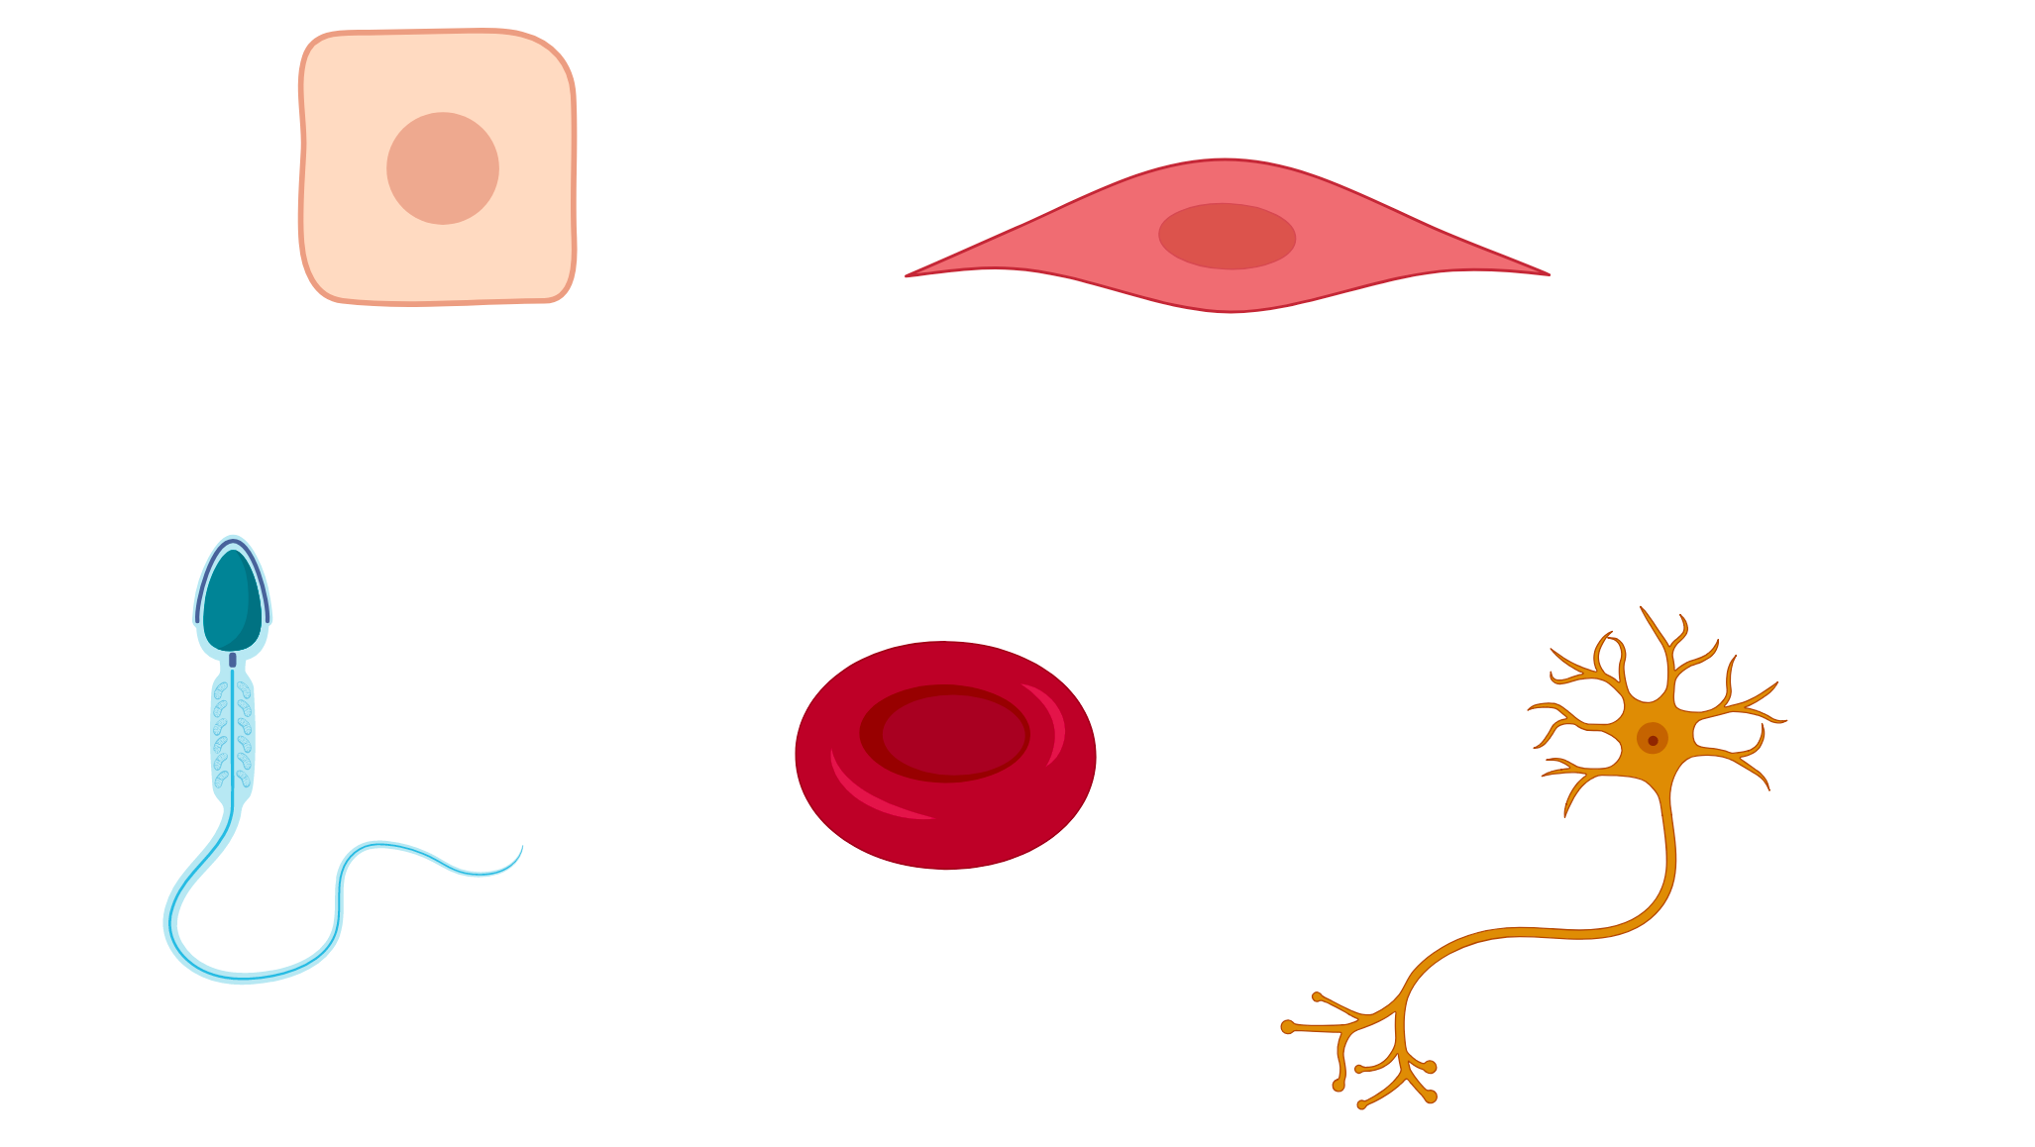
Relationship between a cell’s structure and its function
Can you name these cells and their functions?
Image source: BioRender
Notes:
There are many types of cells in our body. The human body has about 200 types of cells. Their shapes tell us information about their functions.
→ Ask students if they can name these cells and their functions?

Slide 6
Relationship between a cell’s structure and its function
Skin cell
Muscle cell
Blood cell
Sperm cell
Neuron
Image source: BioRender
Notes:
Skin cells have this shape to “stick” together, like tiles piling up to form a wall, to create a protective barrier from external environment.
Sperm cell needs a tail-like structure for swimming, so that they can reach female eggs for fertilization.
Blood cells have this shape because they need to 1) pack as much hemoglobin as possible to carry oxygen (they even expel their nucleus) 2) squeeze through capillaries
Muscle cells have this shape because they need to be flexible, contracting and relaxing with movement.
Neurons have this shape because of they role in communicating and sending messages to other neurons. They are also sometimes called Nerve cells (It can get confusing with so many names for neurons, so lets stick to neurons from now on!).

Slide 7
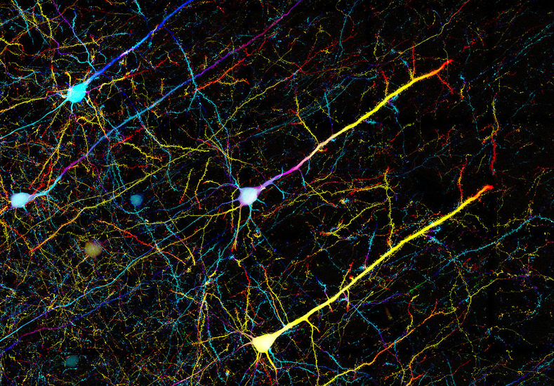
Image source: Columbia’s Zuckerman Institute
Over 86 billion neurons in the brain.
Each neuron can form up to 1000 connections with other neurons.
Notes:
The brain is made of mostly neurons. There are an estimated 86 billion neurons in the brain.
Neurons job is to send information throughout your body and mind. They send messages between themselves and across our body, specialized to communicate between each other, sending information to and from the body.
Each neuron can form up to 1000 connections with other neurons, forming on average a trillion connections between neurons in the brain.
Signals sent by neurons are extremely fast, sometimes as fast as 268 miles per hour (faster than a high-speed bullet train).

Slide 8
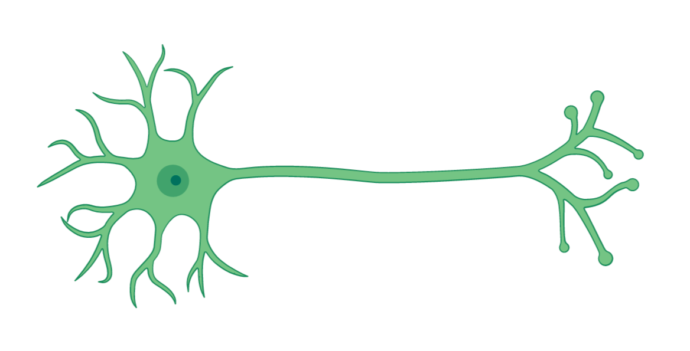
What are the different parts of the neurons? What are their functions?
D ?
B ?
A ?
C ?
Image source: BioRender

Slide 9
Axon Terminals (send chemical signal)
Cell body (contains nucleus)
Dendrites
(receive chemical signal)
Axon (carry electrical signals)
Image source: BioRender
Notes:
Cell body (keep cell alive and functioning, and where the DNA of the cell sits in the nucleus);
Dendrites (look like tree branches: the receivers of information into the neuron - can receive hundreds or thousands of inputs from other neurons);
Axon (if the electrical signal is strong enough, passing a threshold, it runs down the axon. Axons have different lengths and carry electrical signals to the axon terminals.);
Axon terminals (The end of the axon where the signal is then sent to the dendrites of other neurons to send information/messages).

Slide 10
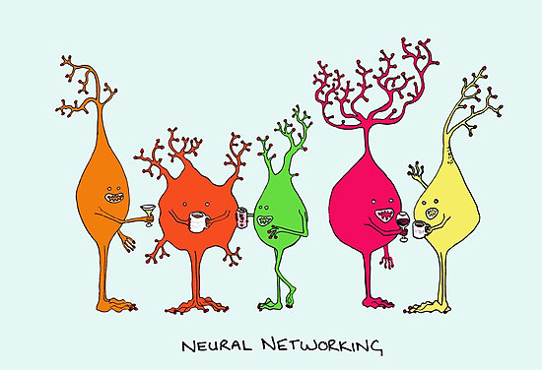
How do Neurons communicate?

Slide 11
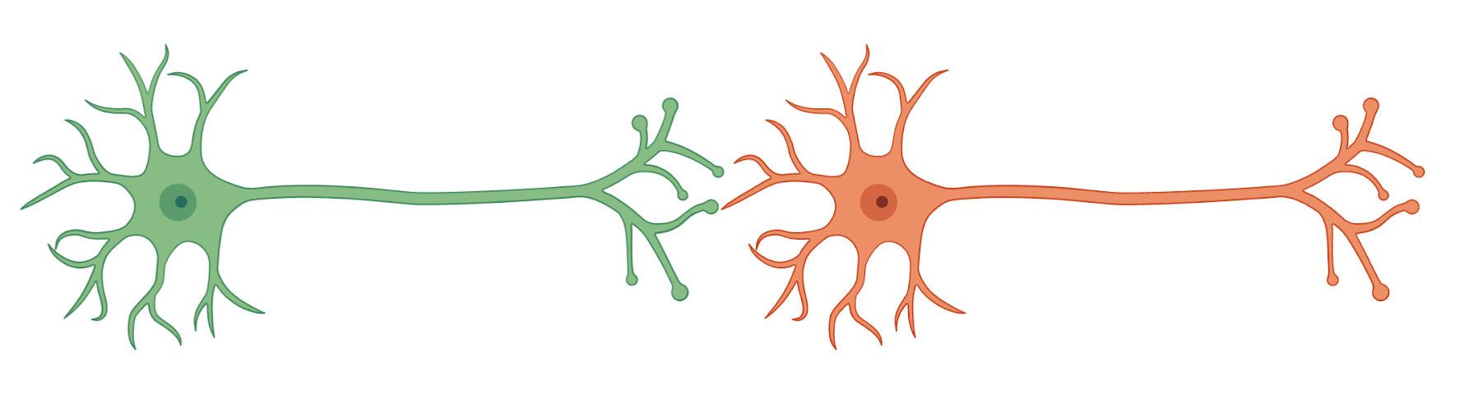
What direction might information flow between two neurons?
Image source: BioRender

Slide 12
How do neurons communicate to send messages across the brain?
Synapse (chemical signalling)
Electrical signal
Direction of communication
Signals travel down axons as an electrical signal and across synapses through chemical signaling .
Image source: BioRender
Notes:
There are two types of signals sent when neurons communicate: electrical and chemical.
A chemical signal is received in the dendrites of the neuron.
The chemicals received in the dendrites might cause a change in the electrical state of the neuron (measured in voltage). A specific level of electrical stimulation is needed to be reached in the neuron’s cell body to generate an electrical signal in the neuron, an action potential. If this threshold is reached, the electrical signal is sent down the axon of the neuron.
This signal arrives at the axon terminal and initiates a chemical signal across the synapse - the gap between the two neurons.
The chemical messengers sent between two neurons are called neurotransmitters. They are released by neurons at the synapse for the purpose of relaying information to other cells.
If enough neurotransmitters are absorbed by the third neuron, it triggers an action potential, and so on across multiple neurons.

Slide 13
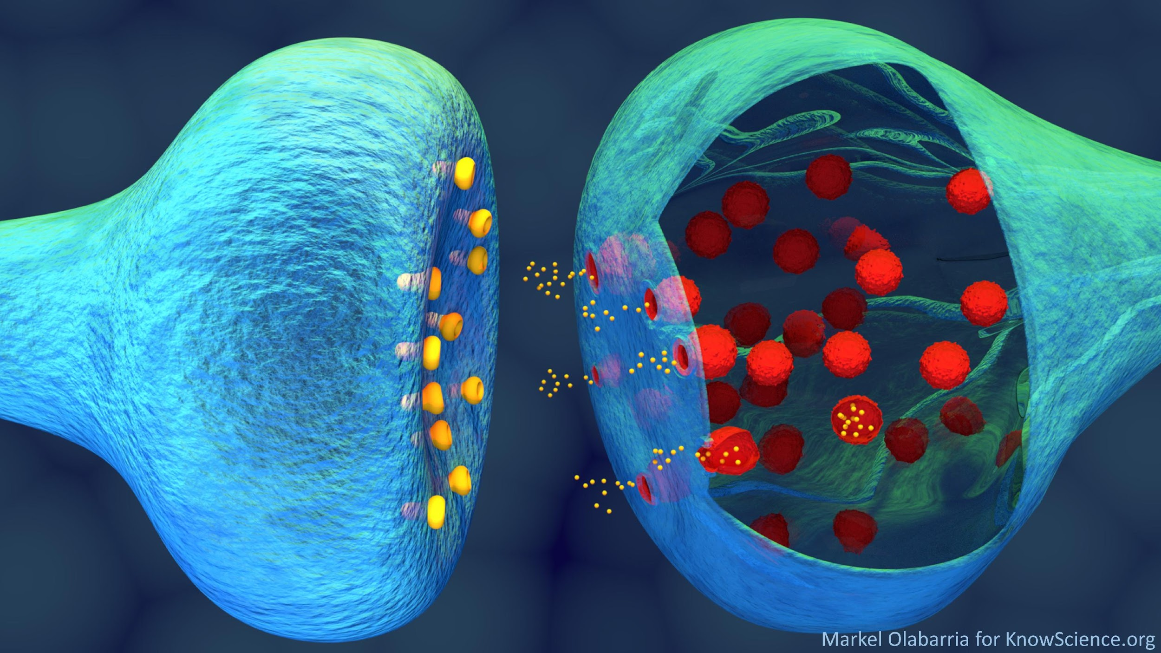
The synapse
Neurotransmitters
(Chemical
messengers)
Notes:
Synapse: A physical gap between two neurons that functions as the site of information transfer from one neuron to another.
Neurotransmitters: Chemical messengers released by neurons at a synapse for the purpose of relaying information to other cells.

