Slide 1



TOPIC 2
Brain Anatomy & Function
SUPPORTED BY:

Slide 2
Part I

Slide 3
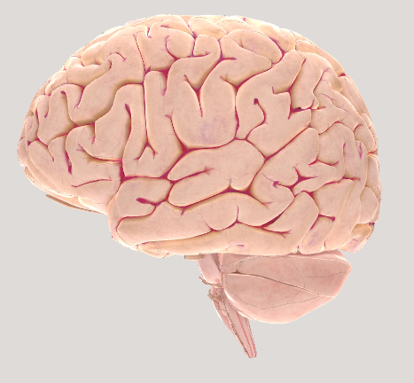
Brain Facts: Anatomy observation tool
Image source: Brainfacts.org
Notes:
Snapshot from Brain Facts anatomy tool: http://www.brainfacts.org/3d-brain#intro=false&focus=Brain
Ask students to write down everything they observe in the image of the brain, being as descriptive as possible about all the details. Discuss observations as a class.
Explain:
Different areas of the brain are specialized for different functions, allowing us to multi-task e.g. talk to a friend while we are getting dressed.
Explain that the brain takes in information from the body and outside world, and produces outputs or responses such as movements, emotions, thoughts. It controls our body, such as the functioning of our organs, our breathing, digestion, etc.

Slide 4
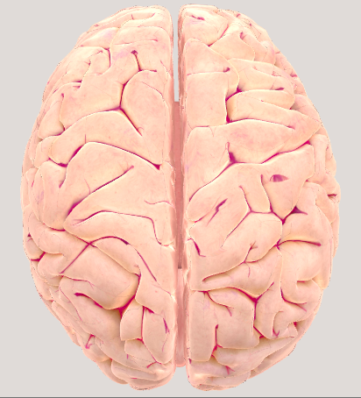
The cerebrum, divided into 2 hemispheres
Image source: Brainfacts.org
Notes:
The brain is divided into two hemispheres that are highly connected.

Slide 5
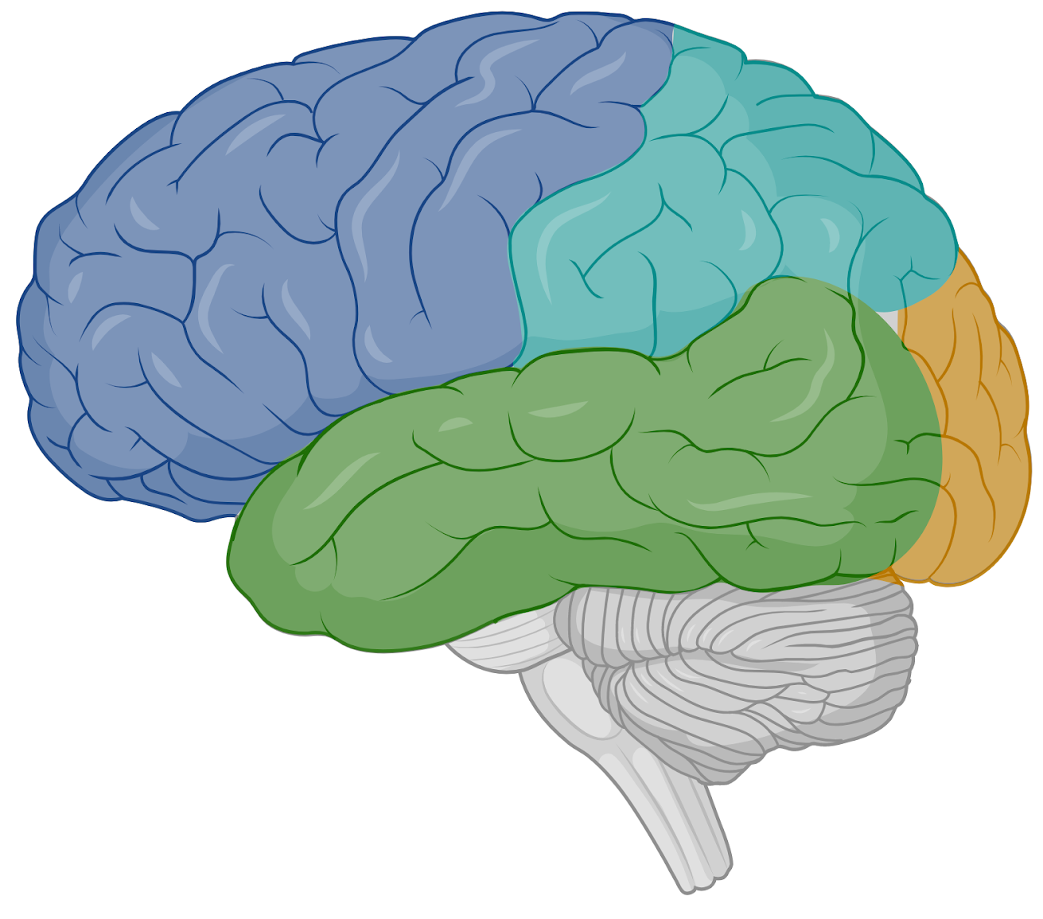
The cerebrum, divided into 4 lobes
Parietal lobe
Frontal lobe
Occipital lobe
Temporal lobe
Image source: BioRender

Slide 6
The cerebrum, divided into 4 lobes
Integrates information for different senses
Sensation of touch
Spatial thinking
Personality
Thinking
Decision-making
Speech production
Body movement
Processes visual information (e.g. recognize colors and shapes)
Interpreting auditory information
Long term memory formation
Speech comprehension
Image source: BioRender
Notes:
The frontal lobe: Responsible for thinking, planning, problem solving, and aspects of personality.
Parietal lobe: Responsible for integrating information coming from different senses (e.g. taste, vision and smell when you are eating). It also specializes in processing the sensation of touch.
Occipital lobe: Process visual information (e.g. recognizing colors and shapes)
Temporal lobe: Responsible for interpreting auditory information, for our ability to use and recognize language, for memory and emotion.

Slide 7
Cerebellum
“Little brain”
Movement coordination
Learning new motor skills / movements
Making predictions
Brain Stem
Upper areas: basic functions (sleep, respiration, heart rate, blood pressure)
Lower area: connects to spinal cord (sending and receiving messages from body)
Image source: BioRender
Notes:
Cerebellum:
Separate part of the brain, sometimes called a “little brain”, located at the very back. Involved in almost all things that the brain does. Responsible for coordinating our movements or helping us learn new motor skills (e.g. how to use a pencil to write). IT also helps us make predictions before things actually happen, so that we can react quicker.

Slide 8
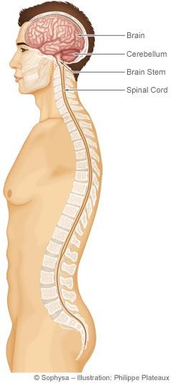
Cerebrum
Cerebellum
Brain Stem
Spinal cord

Slide 9
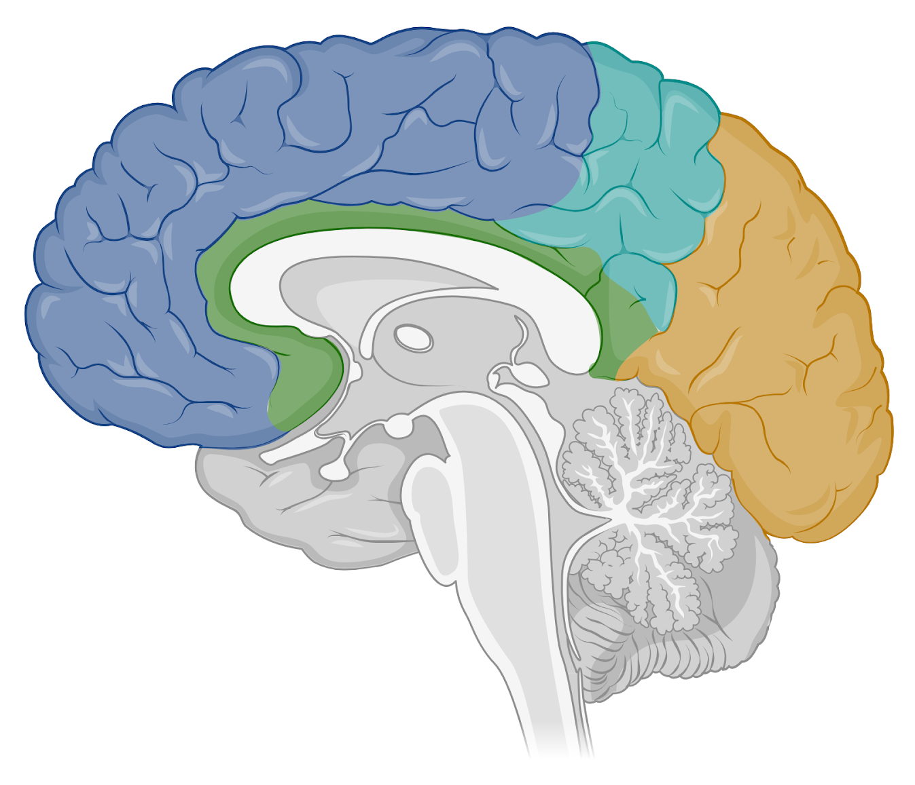
Inner view of the brain: subcortical structures
Thalamus
Relay station for messages arriving from our senses in the body to the brain
Cerebellum
Brain stem
Image source: BioRender
Notes:
Slicing the brain down the middle (gives us a sagittal view of the brain) revealing subcortical structures:
Thalamus: Integrates information that arrives from our senses e.g. from our eyes, sending information to the brain so that we can make sense of it. A relay station for messages arriving from our senses.

Slide 10
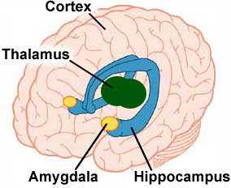
Emotions and emotion regulation
Anxiety and Fear
Combining memories with emotions
Forming and retrieving memories
Spatial navigation
Notes:
Some other internal structures:
Hippocampus: involved in forming and retrieving memories
Amygdala: Responsible for our emotions and combining memories with emotions.
Image source: https://medivizor.com/blog/2017/02/09/amygdala-stress-heart-attack/

Slide 11
Making models of the human brain!
Create 2D or 3D models of the human brain using a range of arts and crafts materials.
Ensure the structures or areas of the brain are proportional to each other.
Each subgroup should ensure that the following structures are identified and labelled:
Subgroup 2
Identify and label: cerebrum, thalamus, brain stem
and cerebellum
Subgroup 1
Identify and label: four lobes, cerebellum, spinal cord
Image source: BioRender

Slide 12
Part 2

Slide 13
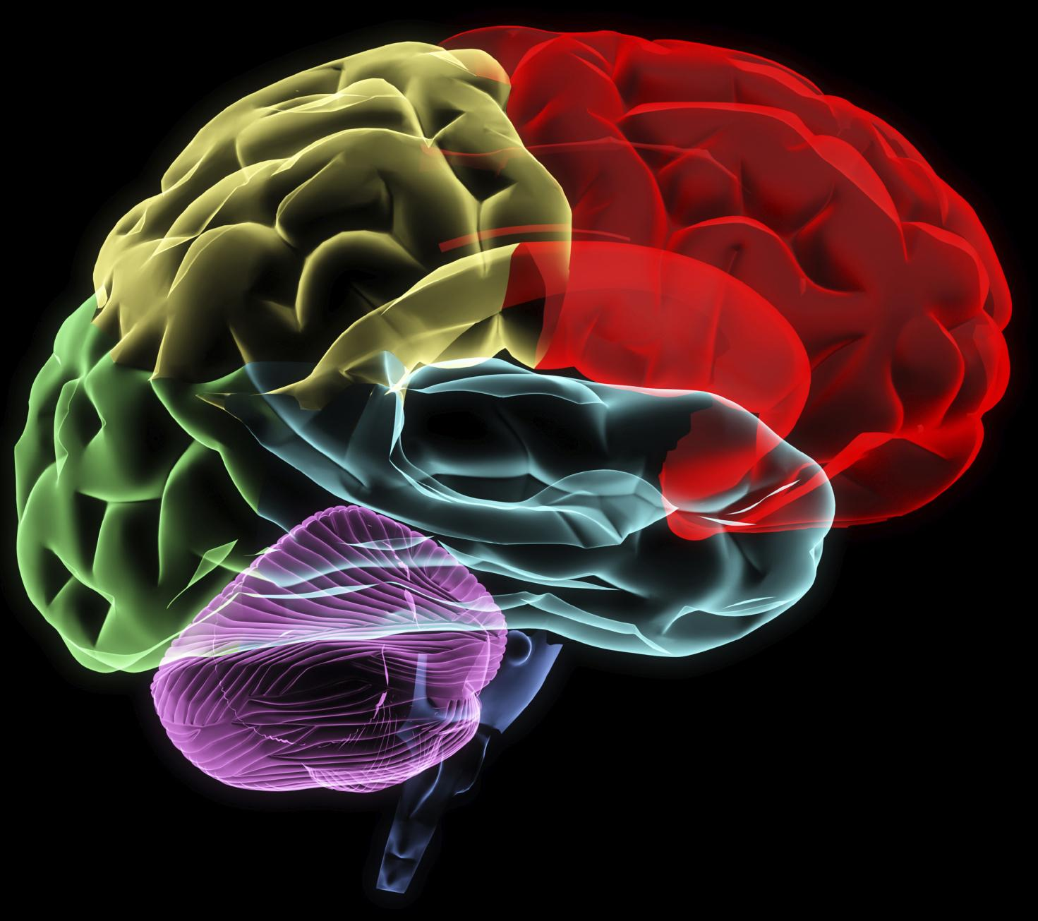
Brain Trivia!

Slide 14
Question 1:
…………...

Slide 15
Answer 1:
…………...

Slide 16
Question 2:
…………...

Slide 17
Answer 2:
…………...

Slide 18
Part 3

Slide 19
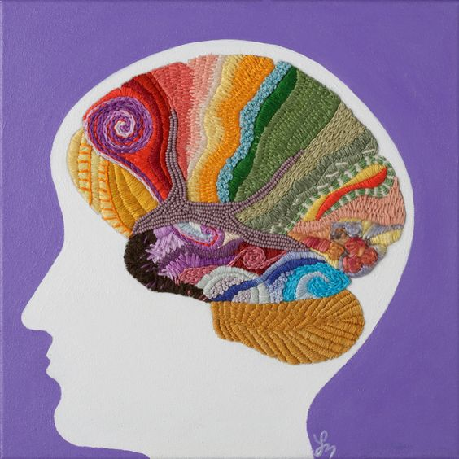
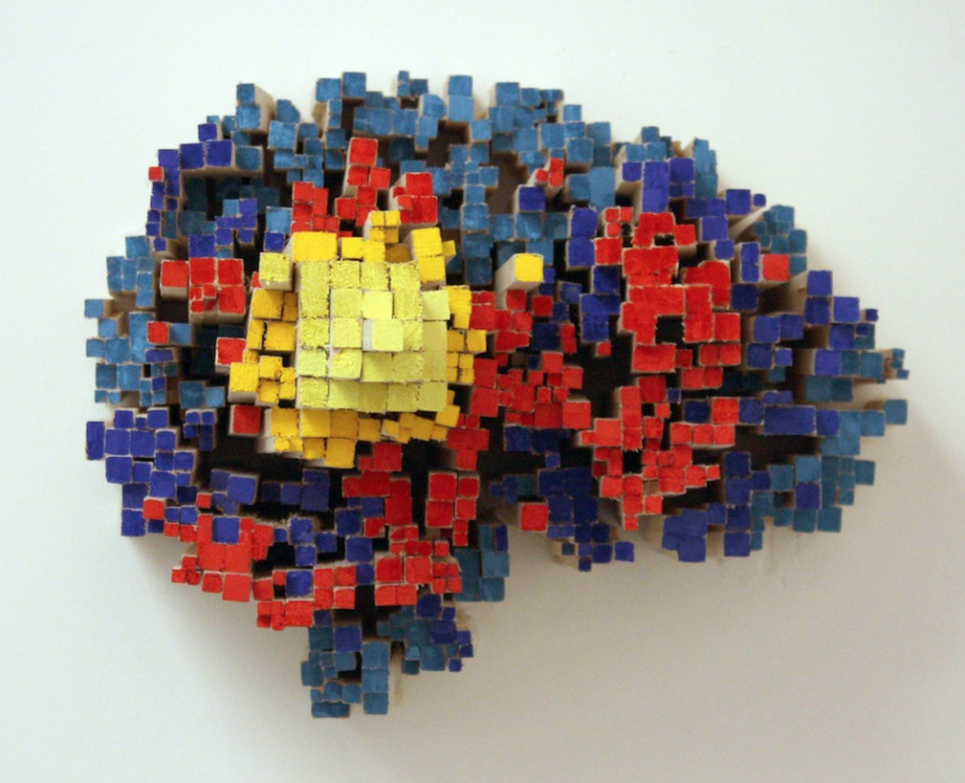
Brain Art
Laura Bundesen - Fiber Art Painting
Julia Buntaine - Sculpture

Slide 20
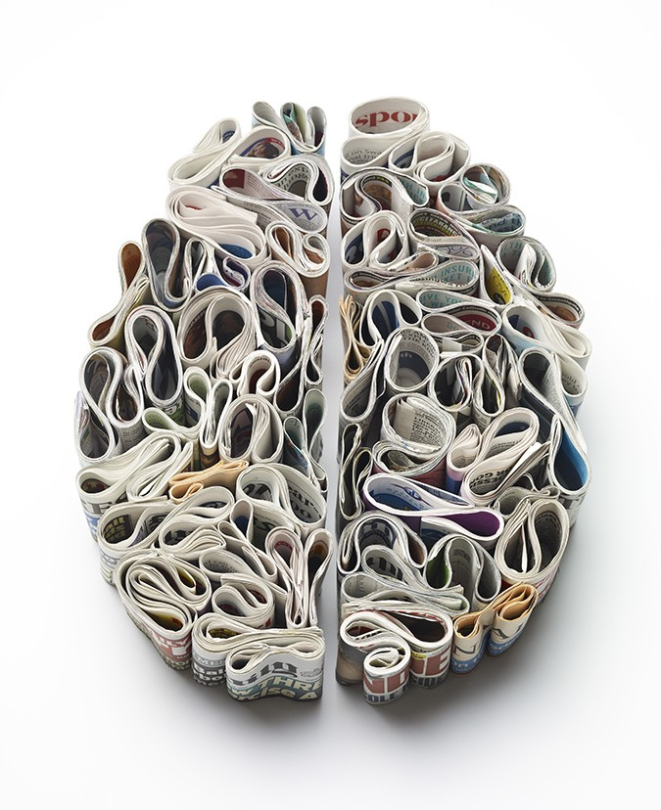
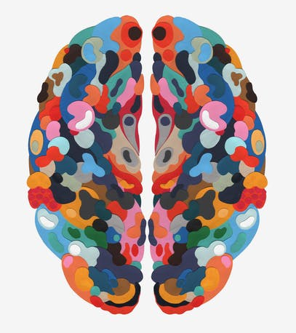
Brain Art
Merijn Hos - Collage
Kyle Bean - Sculpture

Slide 21
Part 4

Slide 22
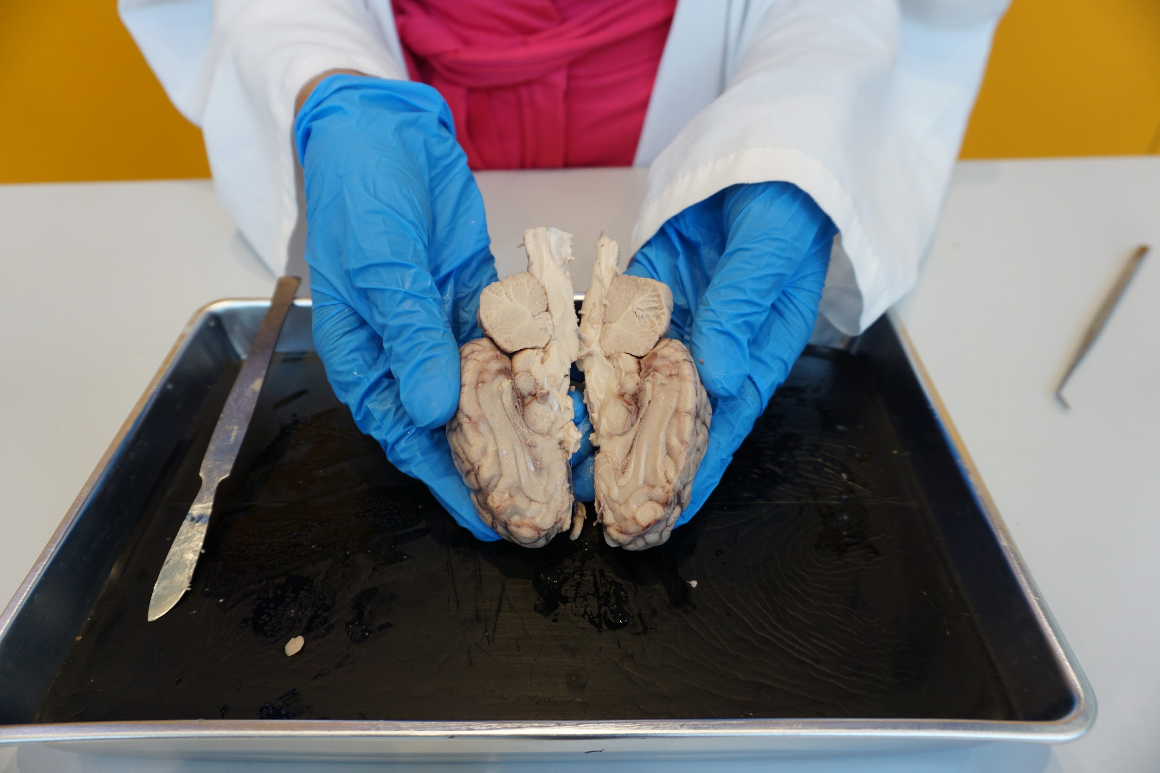
Image source: Columbia’s Zuckerman Institute
Brain Dissections

Slide 23
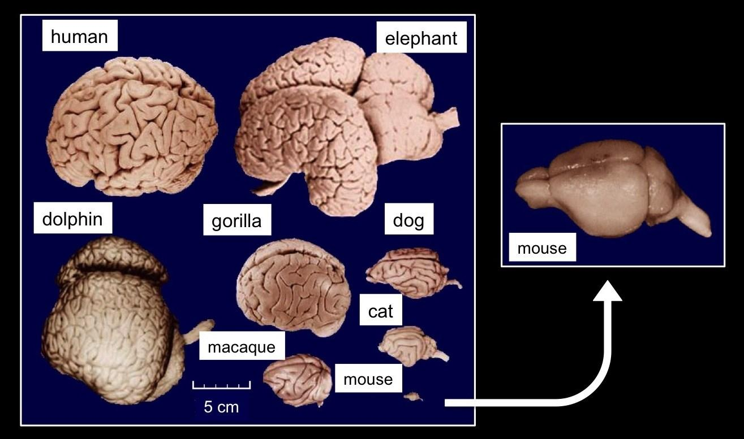
Different animals have different brain structures!
Image source: brains-explained.com - Left: brains of different animals, showing different amounts of folding at the surface (modified from Wikimedia Commons). Right: larger photo of the smooth mouse brain (credit: brainmuseum.org)
Notes:
Prompt students to take a guess at what brain belongs to what animal.

Slide 24
Different animals have different brain structures!
Image source: brains-explained.com - Left: brains of different animals, showing different amounts of folding at the surface (modified from Wikimedia Commons). Right: larger photo of the smooth mouse brain (credit: brainmuseum.org)
Notes:
Brains across species have many similarities, and that is one of the reasons why we conduct animal research, so we can learn more about our own brains. The brain structures however, also have many differences.
Ask students why they think different animals have different brain structures?
Explain how the structure of the brain is related to its function and how the different areas have different sizes depending on what the animal needs to be able to do or what is important for them to survive. This is mostly noticeable in the sensory systems in the brain, where animals who use some senses more than others, have larger areas of the brain dedicated to that sense. For example, humans have a large occipital lobe - area dedicated to visio - because our most used sense is vision. Dogs use mostly smell as their primary sense, so they have a more developed olfactory system.

Slide 25
Image source: Brainfacts.org
Image source: brains-explained.com - Left: brains of different animals, showing different amounts of folding at the surface (modified from Wikimedia Commons). Right: larger photo of the smooth mouse brain (credit: brainmuseum.org)
Notes:
What do you notice what is similar or different about the human & animal brains?
Do those differences matter in how the animal acts or thinks? In what ways?
Every brain is adapted to what the animal needs to be able to do (olfactory bulbs) vs cortex (figure out how to make a fire to cook your food)

Slide 26
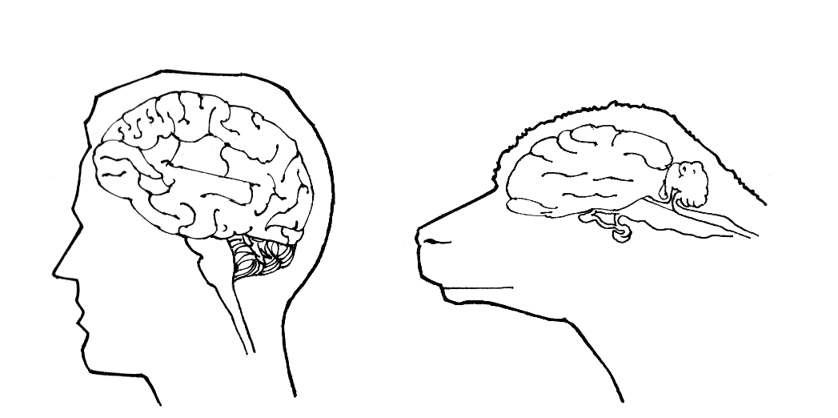
Notes:
Differences between a sheeps’ brain and a human brain? Continue to next slide for more images.

Slide 27
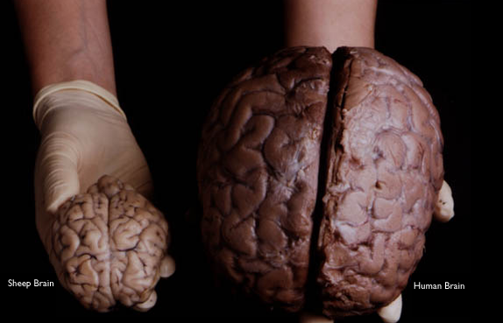
Image source: 1998 The Exploratorium
Notes:
Ask students to identify immediate differences that they observe when comparing sheep and human brains.
E.g. texture, size, position of the spinal cord (horizontal in a shape brain because of their body posture vs vertical in the human body)

Slide 28
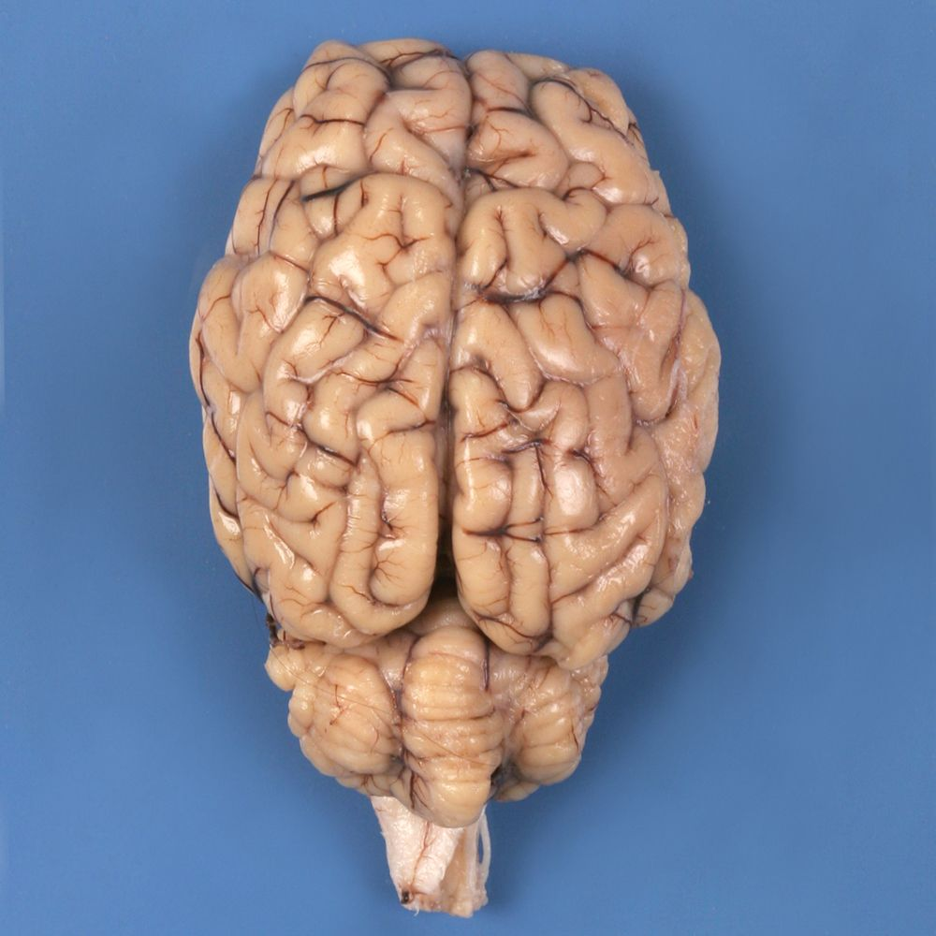
Sheep brain dissection
Image source: www.carolina.com
Notes:
Explain to students that they will be conducting a sheep’s brain dissection today.

Slide 29

Dissection Instructions
Materials
Sheep brain
Dissection tray
Gloves
Scalpel
Safety
Always have your gloves on when touching the brain.
Always cut away from your hands and body.
Always place the brain on the train when cutting it.
Notes:
Go through the materials that students have on their tables.
Explain that Sheep brains were previously stored in a preservative solution.
Safety: Ensure students know how to safely use the scalpel - they should always cut away from their hands and body, and should always have the brain on the tray when cutting.

Slide 30
Procedure:
Write a dissection log: a step by step record of your dissections. You can include labelled diagrams, sketches or photographs.
Examine the exterior of the brain from all angles.
Identify structures:
The four lobes
Cerebellum
Brain stem
Write down all your observations: e.g. characteristics of the brain (texture, color, shape), structures identified.

Slide 31
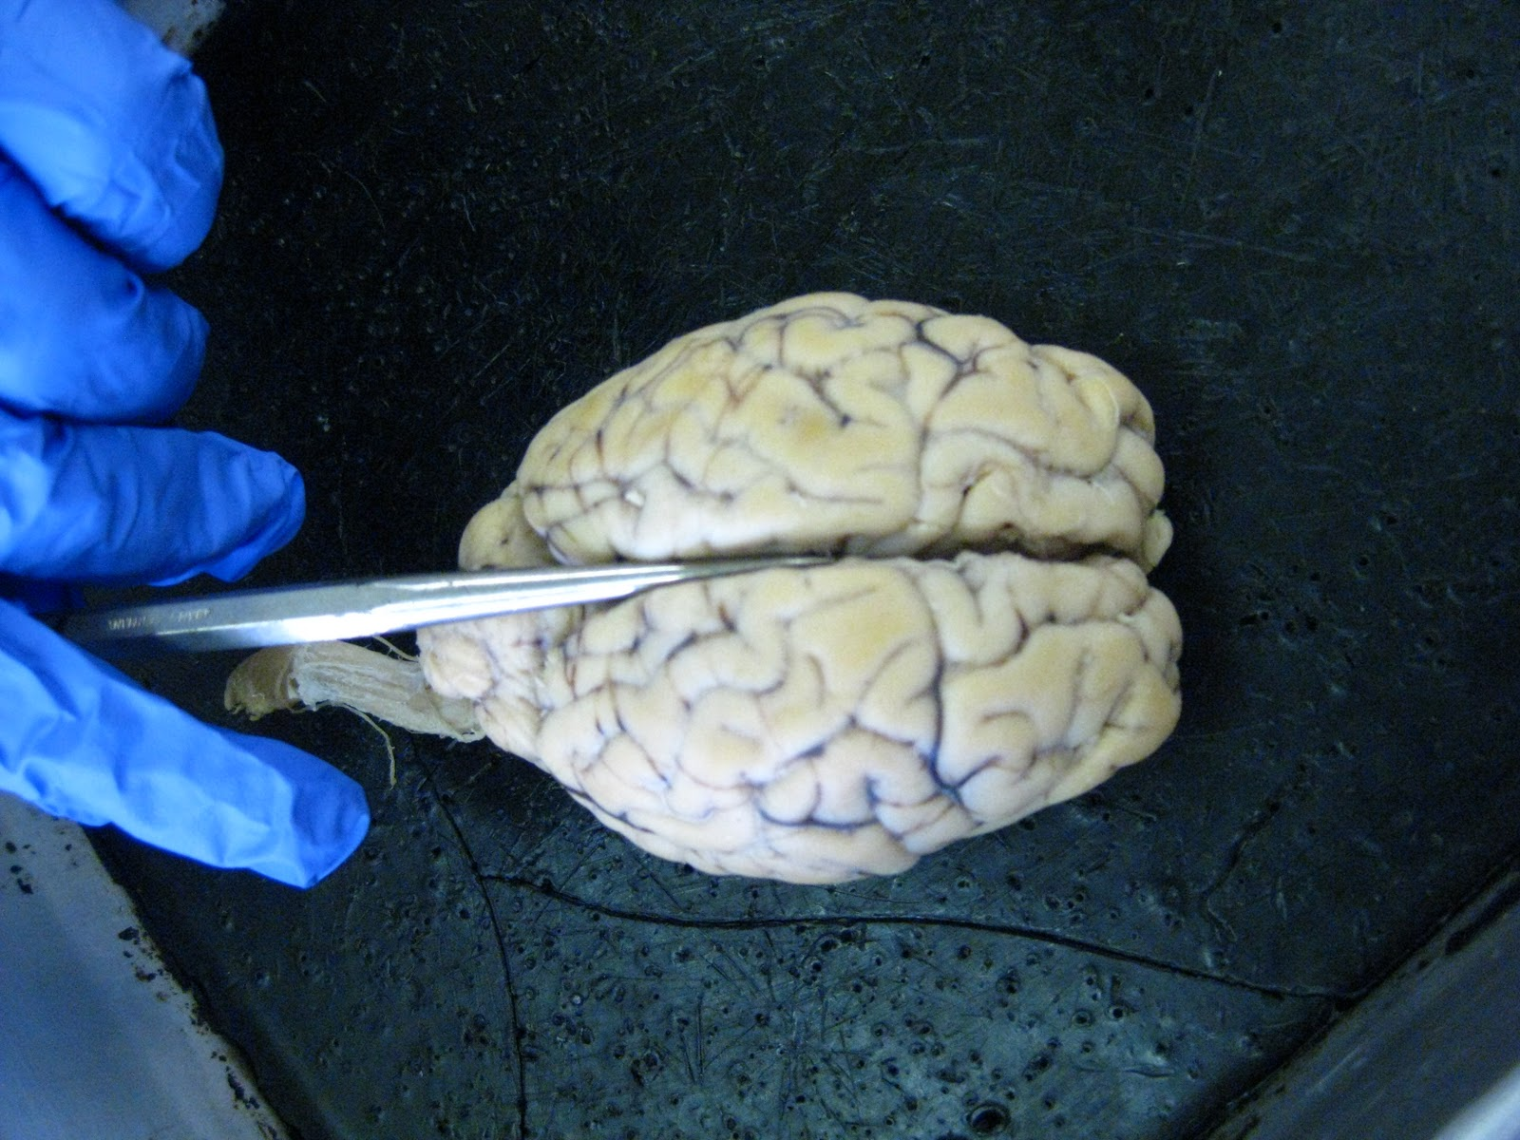
4. Hold the brain flat and cut along the middle length (see image).
5. Identify internal structures such as:
Thalamus
Corpus callosum (connecting both hemispheres)
Image source: sheepforbrins.blogspot.com

Slide 32
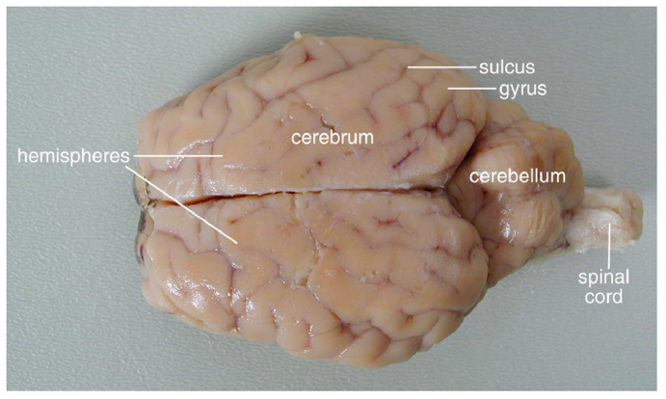
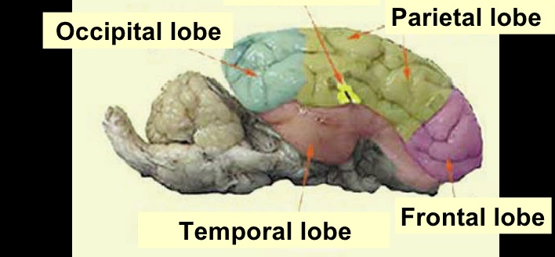
Image source: homesciencetools.com

Slide 33
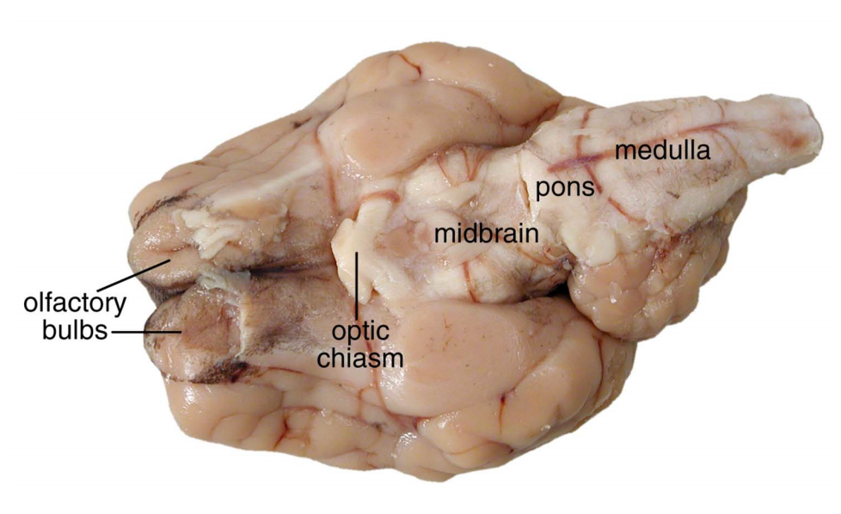
Image source: homesciencetools.com

Slide 34
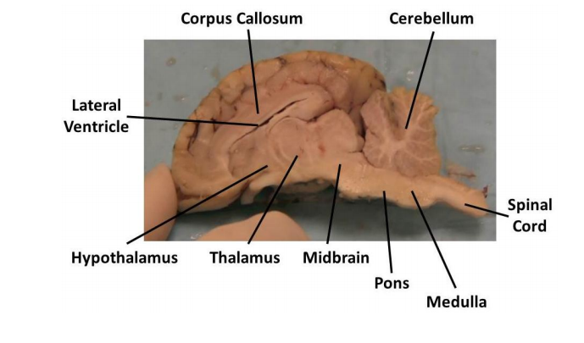
Brain stem
Image source: tufts.edu/greatdiseases

Slide 35
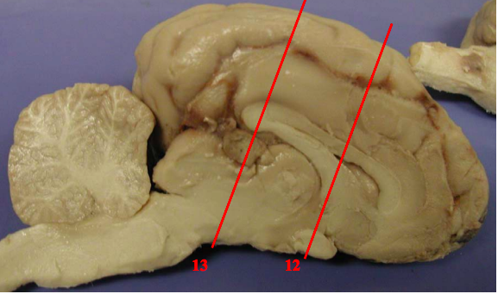
6. Make two vertical cuts through the middle of the brain as shown in the figure below and take notes of any observations or key structures identified.
Image source: psych.hanover.edu

Slide 36
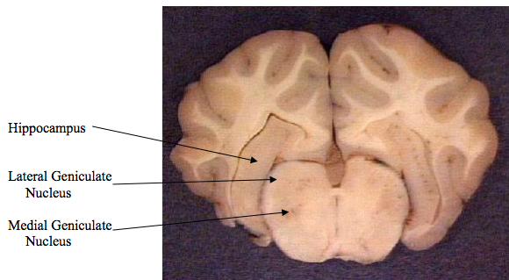
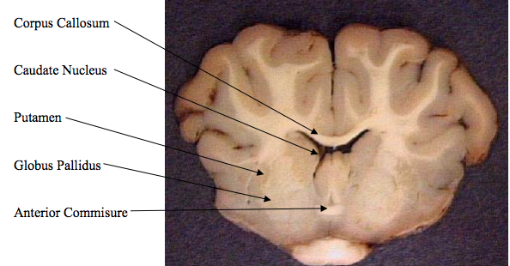
Image source: psych.hanover.edu
Notes:
Here you can point to the hippocampus and the corpus callosum, two structures studies in class.
You can also point to the lateral (and medial) geniculate nucleus, structures that are part of the thalamus.

