Slide 1

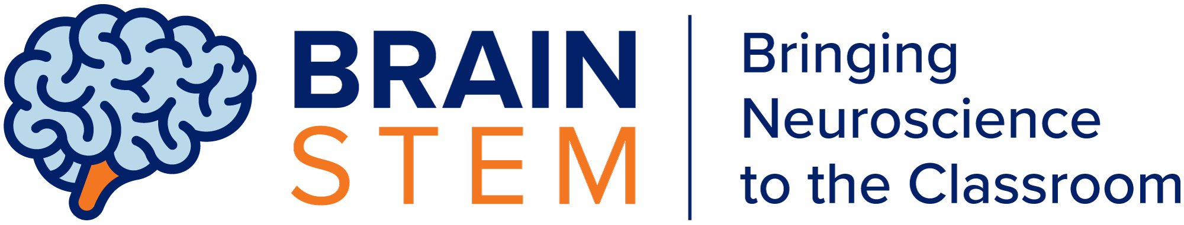

TOPIC 1
Introduction to Neuroscience
SUPPORTED BY:

Slide 2
Part I

Slide 3
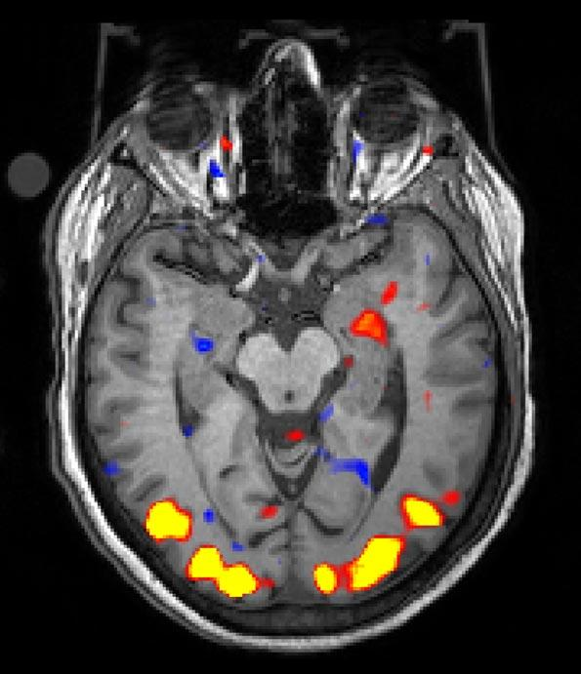
Image source: Hillman lab/Columbia’s Zuckerman Institute
Neuroscience is the field of science that studies the structure and function of the nervous system (which includes the brain) of different species
Notes:
Hillman Lab at Zuckerman Institute: Image shows regions activated by a visual stimulus (yellow/red), shown on a functional magnetic resonance imaging (fMRI) scan.

Slide 4
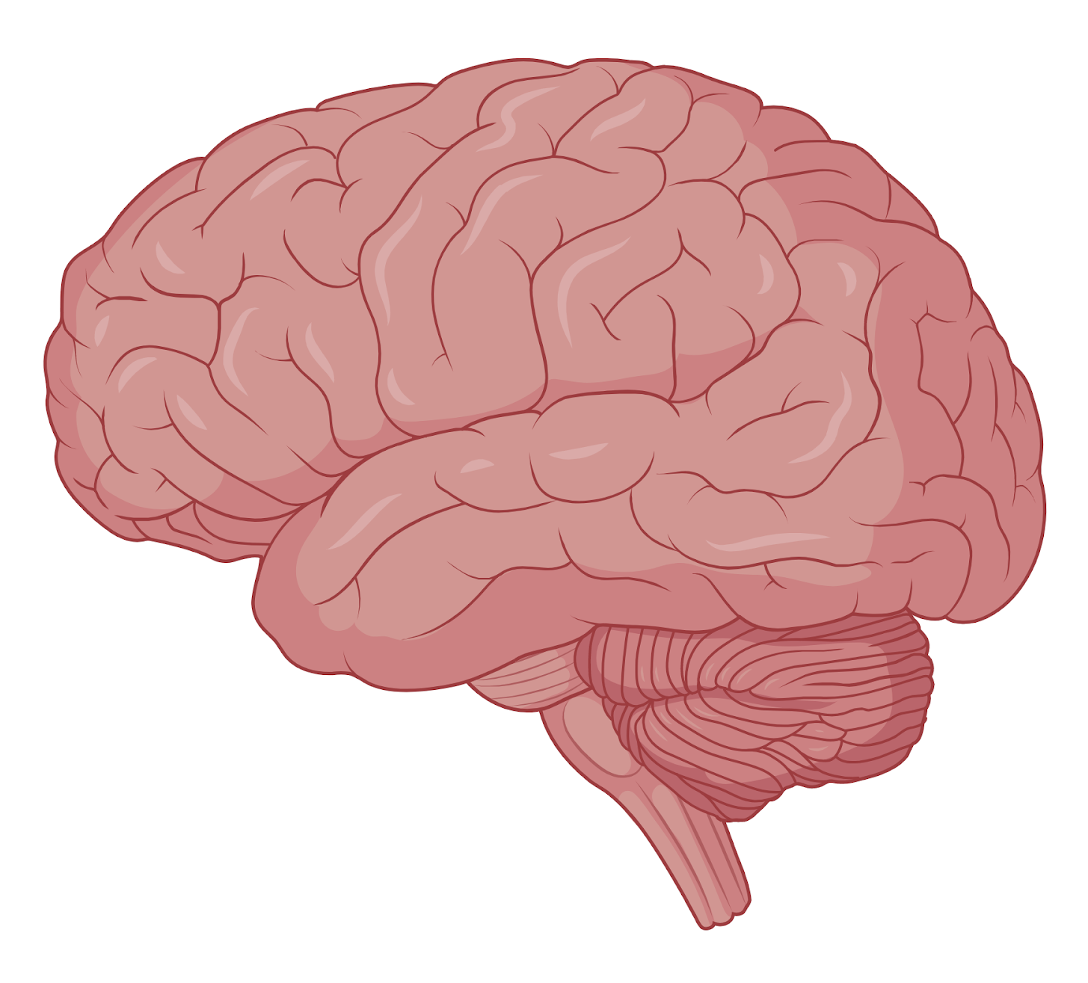
How do we study the brain?
Image source: BioRender
Notes:
Prompt students to think about how we might study the brain. Allow students to give suggestions first and generate a class discussion.

Slide 5
Scientific Inquiry: The process for scientific research
Ask a question
Make a hypothesis
Conduct an experiment
Analyze data
Draw conclusions
Make observations and ask questions that can be tested through scientific methods.
Based on observation and previous research, make a prediction or explanation that can be tested with scientific methods.
Select the methodology and tools that can be used to test your hypothesis and design an experiment.
Analyze the data collected through your experiment.
Summarize the data collected and form conclusions that relate to your hypothesis. Write a report.
Notes:
Describe the scientific inquiry method.

Slide 6
What do neuroscientists study?
How teenagers learn
Bird song
How we make decisions
How animals store and recall memories
What are the causes of sicknesses, such as Alzheimer’s disease
Why you get annoyed with your neighbour chewing, but not yourself
How we control our muscles
Behaviors of electric fish
Notes:
Prompt students to think what neuroscientists study. One by one, ask students to give a show of hands to which of these answers they think are true.
Tell students that you will tell them the right answers at the end of the presentation.

Slide 7
Neuroscientists are asking questions and conducting research to understand critical aspects of the brain...

Slide 8
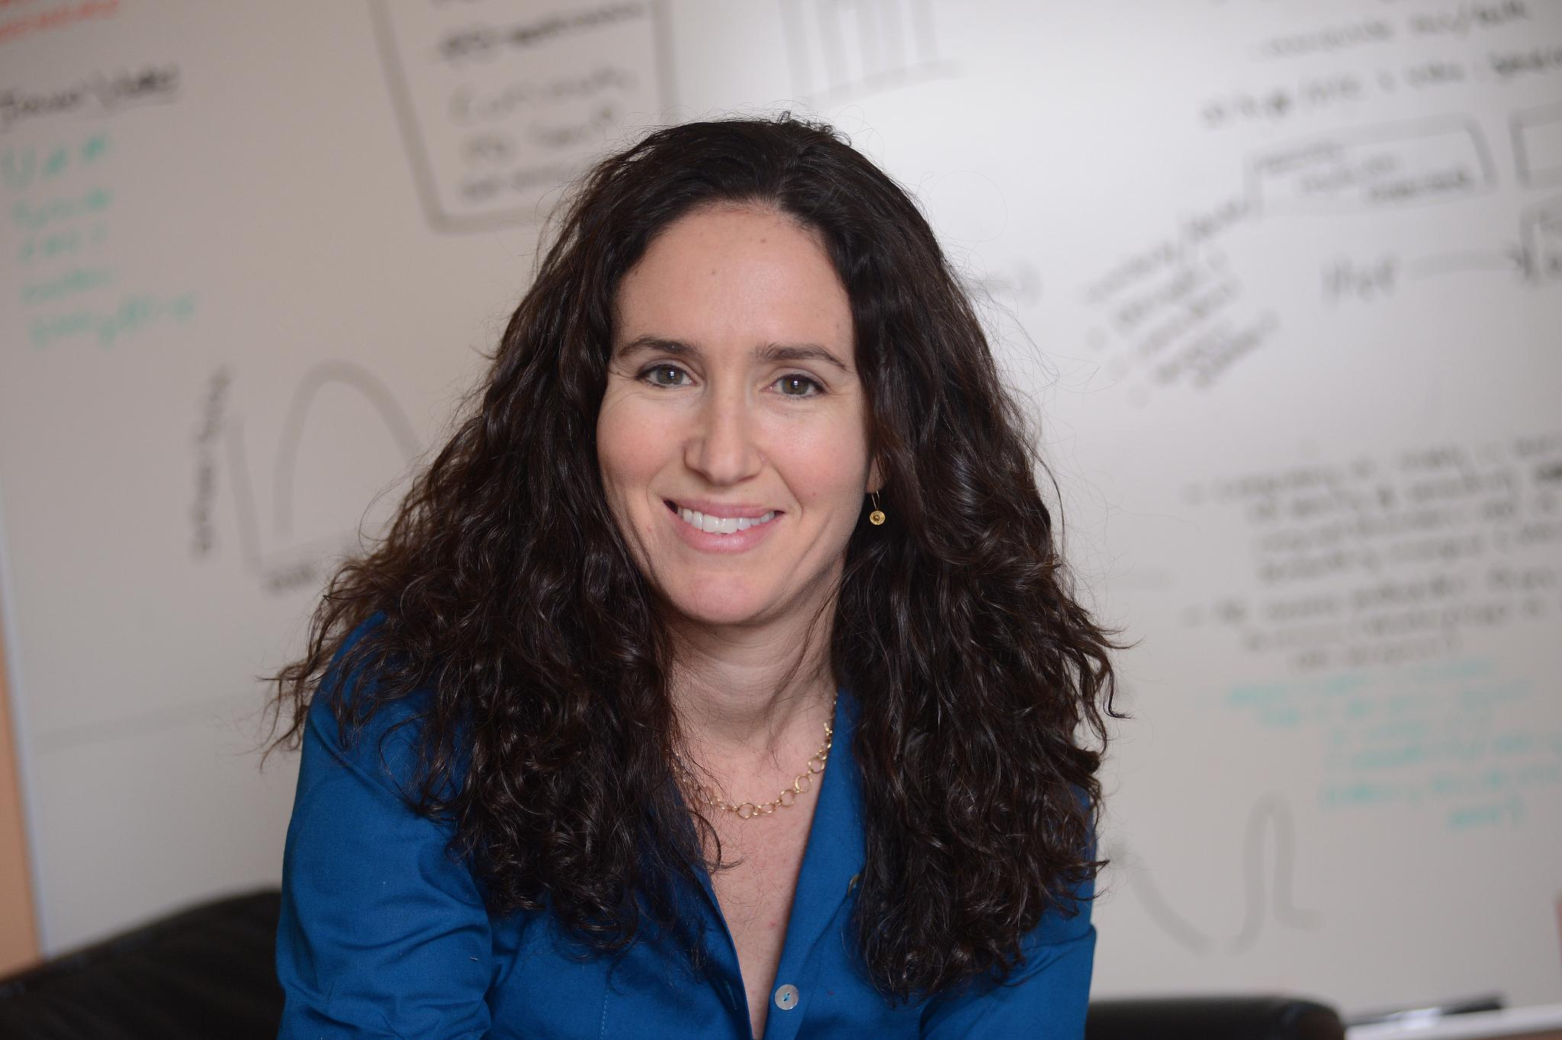
In Daphna Shohamy’s lab, scientists study learning
Scientists study how learning occurs during adolescence, and how it differs to the way adults learn and form memories.
Image source: Eileen Barroso for Columbia University

Slide 9
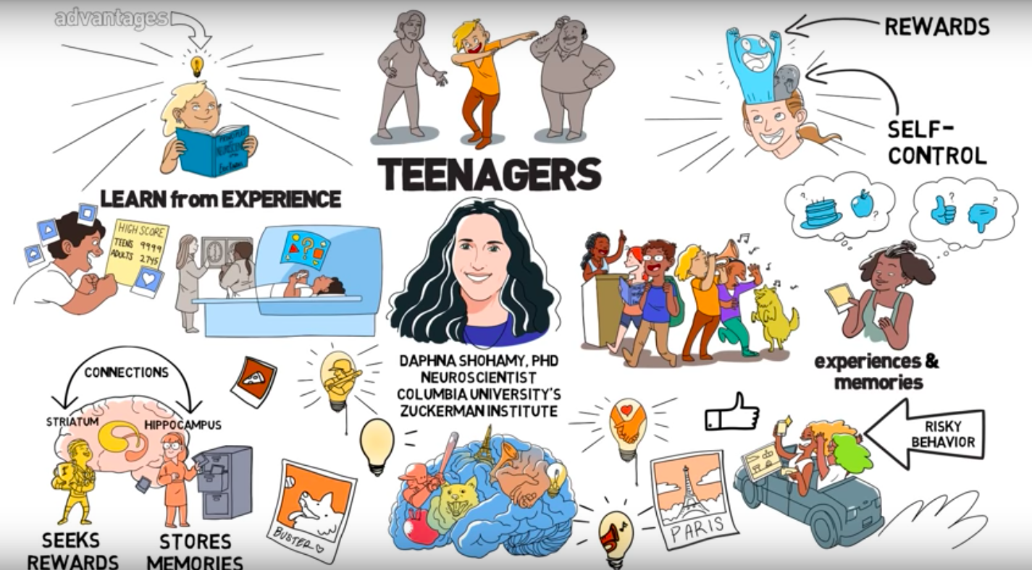
They use imaging tools to capture and image brain activity while teenagers (compared with adults) are performing learning tasks.
https://www.youtube.com/watch?v=1GSvzgrBKaM&t=3s
Some of the results reveal that teenagers learn more from experience and may have an increased sensitivity to rewards.
Animation by Skeptisketch
Notes:
Video animation: https://www.youtube.com/watch?v=1GSvzgrBKaM&t=3s
Article: https://zuckermaninstitute.columbia.edu/brain-study-reveals-how-teens-learn-differently-adults
Research paper published in Neuron journal: https://www.cell.com/neuron/fulltext/S0896-6273%2816%2930524-4

Slide 10
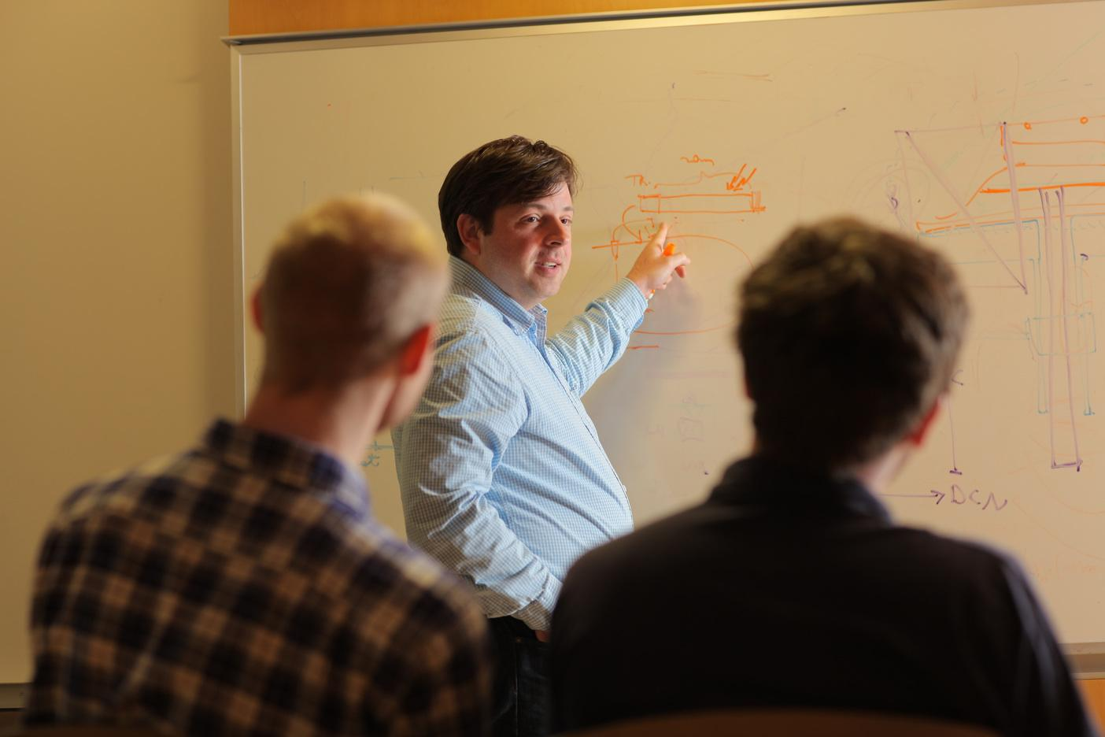
In Attila Losonczy’s lab, scientists study how memories are formed
They ask which specific cells in the brain (and what connections they form with other cells), have a role in memory.
Image source: John Abbott for Columbia University’s Zuckerman Institute
Notes:
Video link: https://youtu.be/qyZdbv8OuYo
Article: https://zuckermaninstitute.columbia.edu/scientists-watch-activity-newborn-brain-cells-mice-reveal-they-are-required-memory
More about Dr. Losoncyz: https://zuckermaninstitute.columbia.edu/attila-losonczy-md-phd

Slide 11
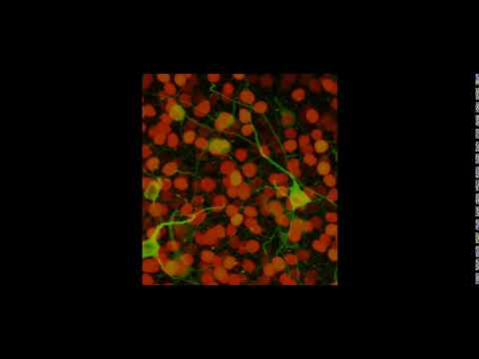
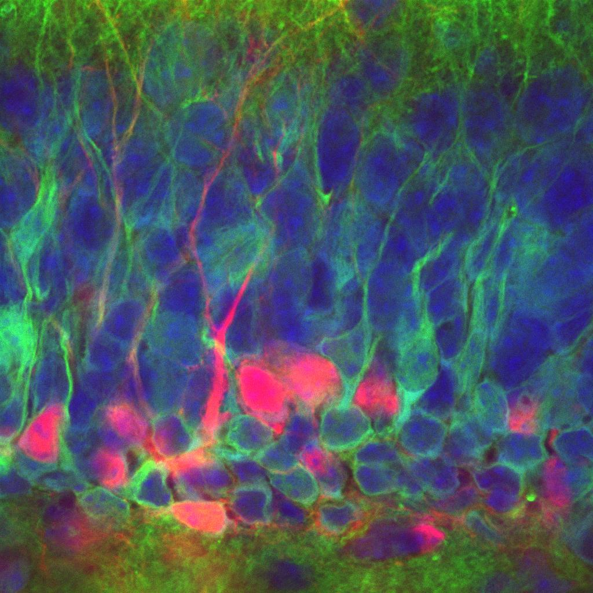
To answer their questions, they use advanced microscope technology to map individual cells that are firing in the brain of mice as they form new memories while navigating in a virtual reality world.
Their microscopes use a laser to detect the activity of neurons that have been marked with a fluorescent dye.
Image source: Losonczy Lab at the Zuckerman Institute
Notes:
Images from Losonczy Lab/Columbia University's Zuckerman Institute
Cells in the hippocampus region of mice. Cells of a brain region called the dentate gyrus. Newborn cells are labeled in red, shown here integrating into mature cells' existing cellular circuitry. Recent research from the Losonczy lab has revealed the critical importance of these newborn cells in encoding memory.
Article:https://zuckermaninstitute.columbia.edu/scientists-watch-activity-newborn-brain-cells-mice-reveal-they-are-required-memory
Dr. Losonczy profile: https://zuckermaninstitute.columbia.edu/attila-losonczy-md-phd
Video link: https://www.youtube.com/watch?v=MPoJ8NGjnCo&amp=&feature=youtu.be

Slide 12
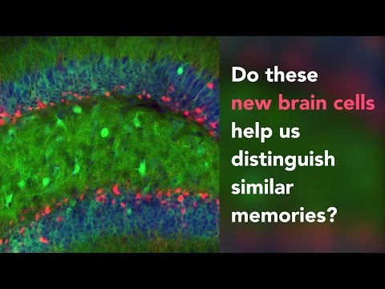
Video source: Losonczy lab/Columbia’s Zuckerman Institute
Notes:
Video link: https://youtu.be/qyZdbv8OuYo
Article: https://zuckermaninstitute.columbia.edu/scientists-watch-activity-newborn-brain-cells-mice-reveal-they-are-required-memory

Slide 13
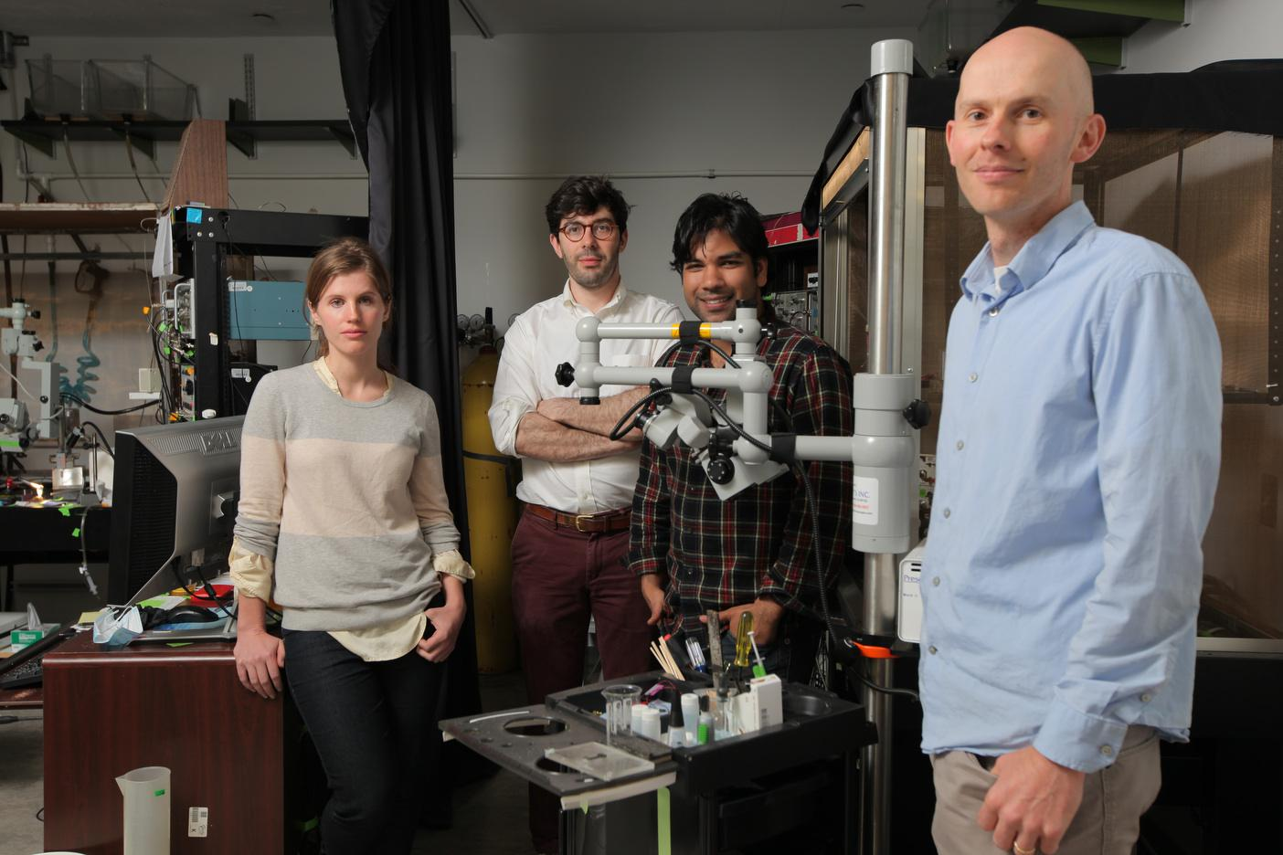
In Nathaniel Sawtell’s lab, scientists ask how we make sense of our environments and things around us.
They study how animals cancel out irrelevant information arriving from the senses and focus only on information that matters.
Image source: John Abbott for Columbia University’s Zuckerman Institute

Slide 14
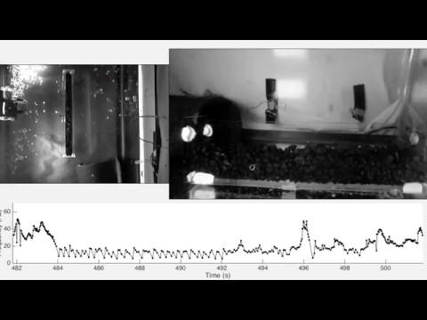
They record neural signals in electric fish to understand how the brain learns to cancel out sensory information caused by their own behavior. This allows them to focus on other things.
Video source: Sawtell lab, Zuckerman Institute
Notes:
Video capturing electric signals produced by fish to perceive the environment around them. Noises are sounds made by the fish.
More on Nate Satwell’s research with electric fish: https://zuckermaninstitute.columbia.edu/new-study-electric-fish-reveals-brain-mechanisms-distinguishing-self-other

Slide 15
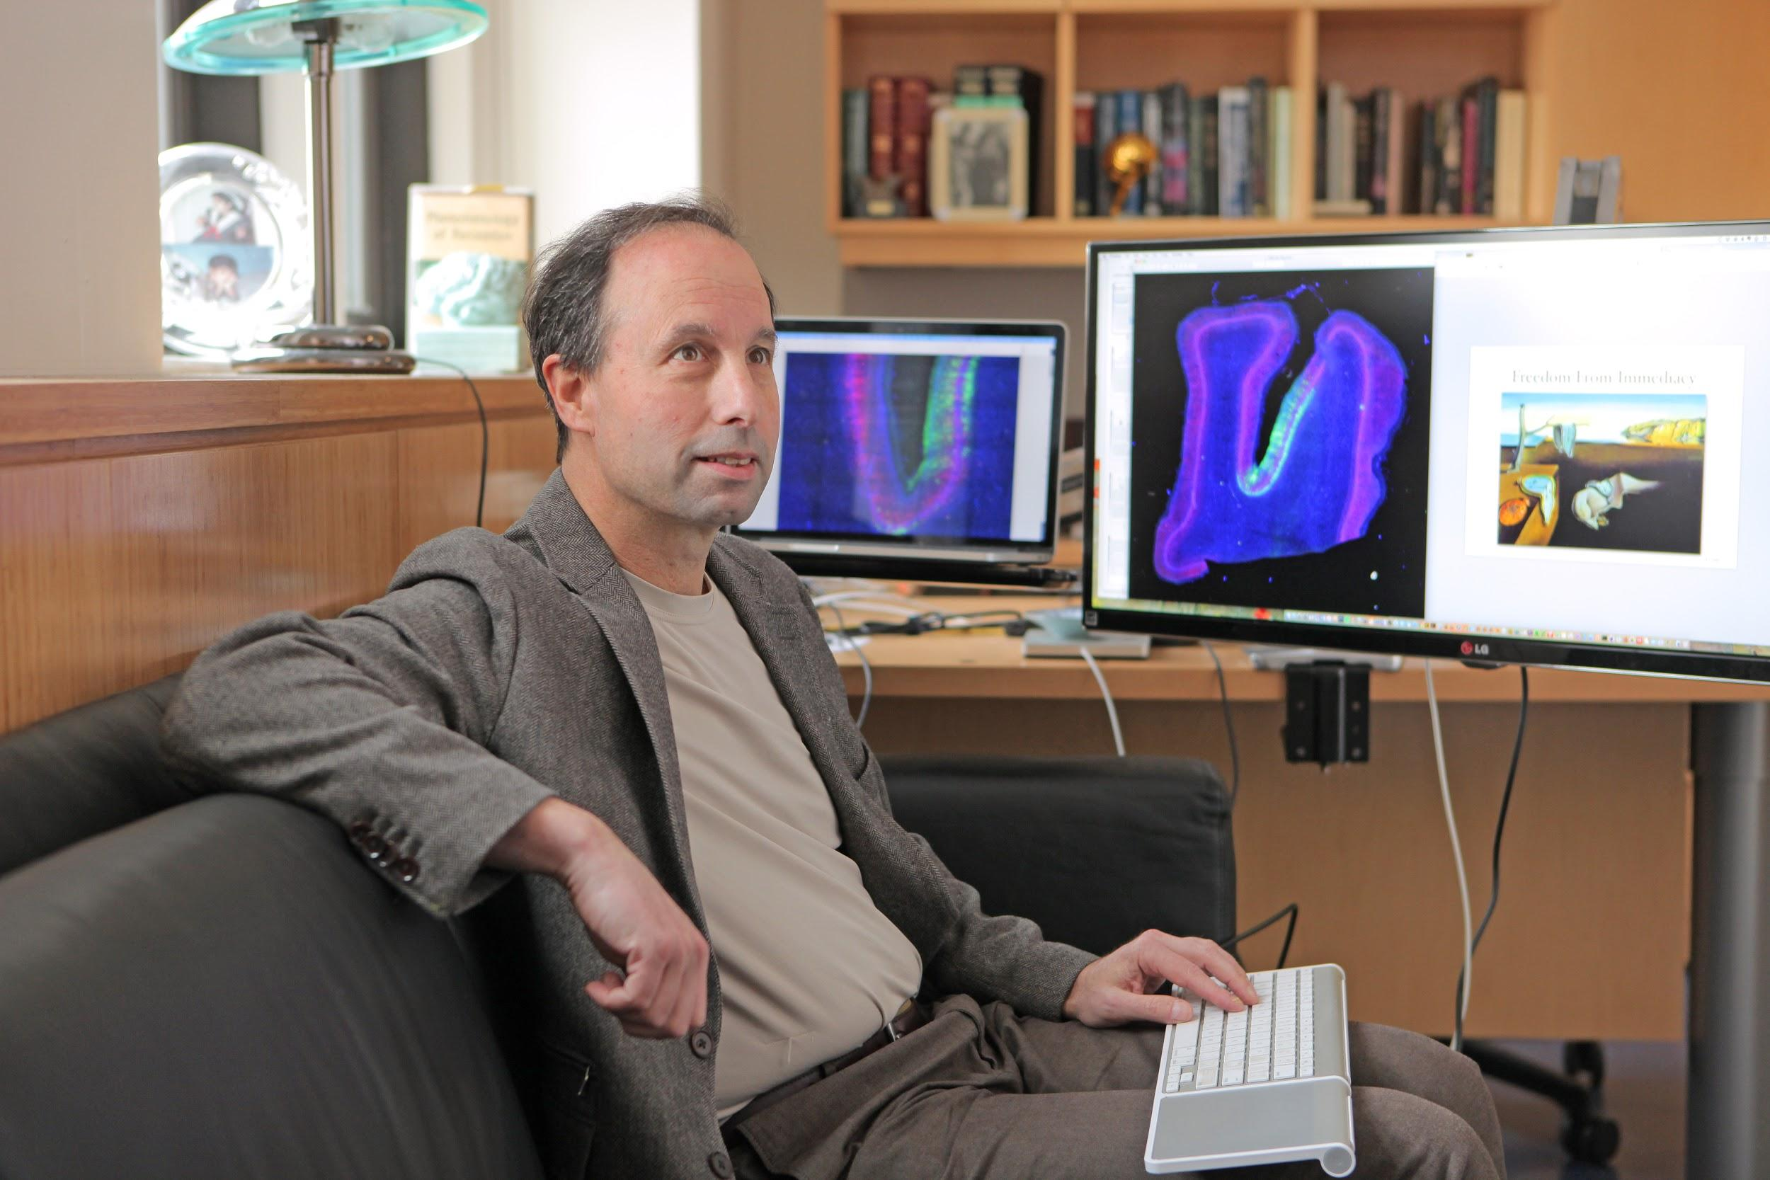
In Michael Shalden’s lab, scientists ask “How do humans make decisions?”
The goal of their research is to gain a better understanding of human cognition - the mental processes (e.g. through our thoughts) that we use to make sense of the world.
Image source: Columbia University’s Zuckerman Institute
Notes:
Optional video on Neuroscience of Decision Making: https://www.youtube.com/watch?v=ks7YesYFvRQ&feature=youtu.be
Reading: https://zuckermaninstitute.columbia.edu/naturally-rational-brain-how-people-use-and-lose-preexisting-biases-make-decisions

Slide 16
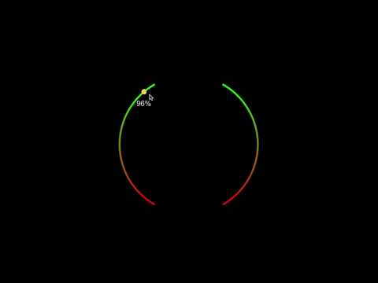
They collect data while participants play a computer game where they have to make decisions about the direction of moving dots.
Are the dots moving to the left or right?
How sure are you about your decision?
Is the computer biased to the left or right across the whole game?
How sure are you about that?
Video source: Ariel Zylberberg/Shadlen lab//Columbia’s Zuckerman Institute
Notes:
Video of task (https://www.youtube.com/watch?v=aq1zGBYpsv8) : The central question, the researchers of this study asked, was whether, or to what extent, that prior knowledge would be modified if someone is presented with new or conflicting evidence. To find out, the team asked human participants to watch a group of dots as they moved across a computer screen, like grains of sand blowing in the wind. Over a series of trials, participants judged whether each new group of dots tended to move to the left or right — a tough decision as the movement patterns were not always immediately clear. As new groups of dots were shown again and again across several trials, the participants were also given a second task: to judge whether the computer program generating the dots appeared to have an underlying bias. Without telling the participants, the researchers had indeed programmed a bias into the computer; the movement of the dots was not evenly distributed between rightward and leftward motion, but instead was skewed toward one direction over another.

Slide 17
Their research shows that the brain is constantly updating as information comes in until it is time to make a decision.
The brain is constantly asking questions!
? ? ? ?
? ? ? ?
? ? ? ? ? ? ?
Image source: BioRender
Notes:
Optional video on Neuroscience of Decision Making: https://www.youtube.com/watch?v=ks7YesYFvRQ&feature=youtu.be

Slide 18
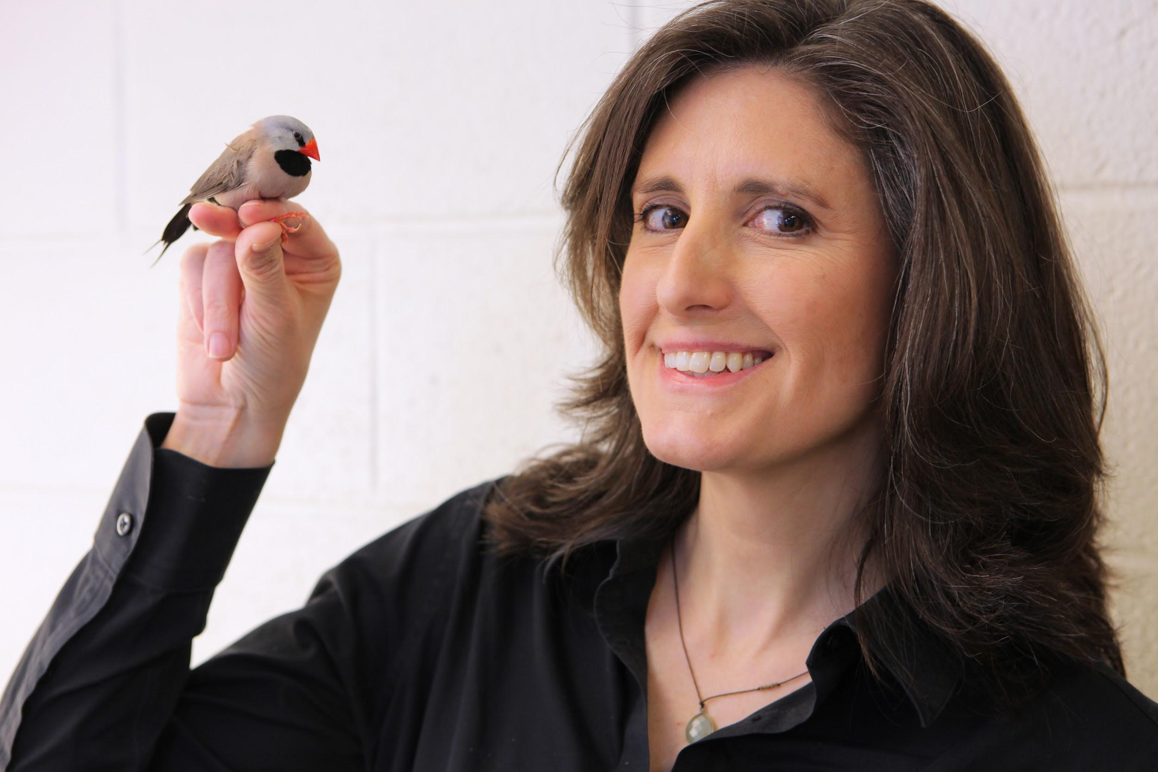
In Sarah Woolley’s lab researchers study how humans develop speech and learn languages.
They work with songbirds because these birds, like humans, have the amazing ability to learn vocal sounds at a very young age.
Image source: John Abbott for Columbia University’s Zuckerman Institute

Slide 19
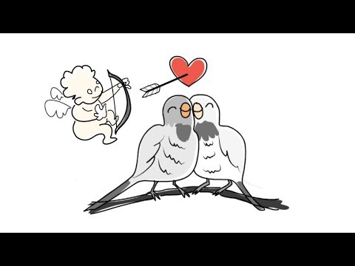
Songbirds can copy songs of adult birds and practice them to perfection at a critical developmental stage. By studying the brain mechanisms that allow for this, we can better understand how exposure to sounds at a young age affects the way we hear and speak as adults.
Animation by Skeptisketch
Notes:
Video link: https://youtu.be/4gnACxmMD2g
Article: https://zuckermaninstitute.columbia.edu/what-songbirds-can-teach-us-about-human-speech-and-language
More about Dr. Woolley : https://zuckermaninstitute.columbia.edu/sarah-mn-woolley-phd

Slide 20
All of the below answers are correct. Neuroscientists study diverse topics that help us understand how the brain and nervous system work.
How teenagers learn
Bird song
How we make decisions
How animals store and recall memories
What are the causes of sicknesses, such as Alzheimer’s disease
Why you get annoyed with your neighbour chewing, but not yourself
How we control our muscles
Behaviours of electric fish

Slide 21
Part 2

Slide 22
Neuroscience
Fun Facts
True or False?

Slide 23
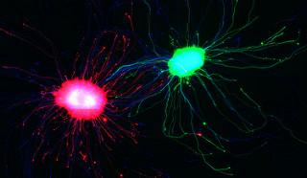
Image source: Columbia’s Zuckerman Institute
We have over 80 billion cells in our brain.

Slide 24
True!
Notes:
True! They are called neurons or nerve cells.
Image credit: Credit: Austen Stiko/Mason lab/Columbia's Zuckerman Institute

Slide 25
We only use around 10% of our brains.

Slide 26
False!
Notes:
False !
There is no scientific evidence showing that we only use 10% of our brains. We use 100%. However, different areas are responsible for different functions (such as seeing, thinking, moving). Our brain is always active, doing things that you don’t even know about, such as controlling the rhythm of your breathing or reminding you that you are hungry! Even in your sleep your brain is functioning e.g breathing, digesting, or getting ready for the next day.

Slide 27

Messages from our brain to our body travel as fast as 268 miles per hour.

Slide 28
True!
Notes:
True - faster than a high-speed bullet train.
Image source: https://inhabitat.com

Slide 29
Once we reach adult age, our brain’s structure does not change anymore.

Slide 30
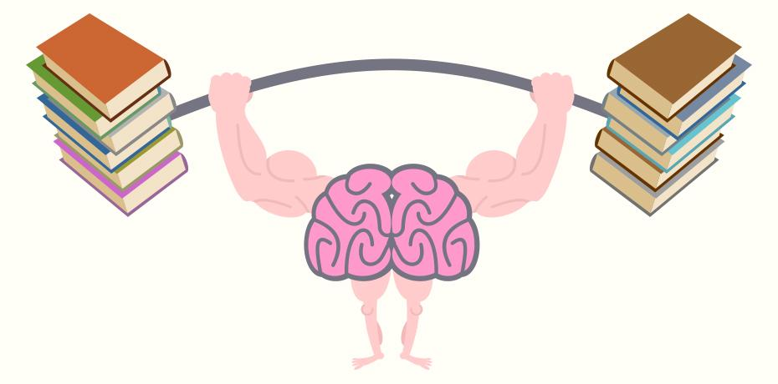
False!
Notes:
False - our brain is like a muscle that can be trained. Research shows how learning can physically change the structure of the brain throughout life. Or following injury, our brain can recover certain functions.

Slide 31
A bigger human brain is a smarter brain.

Slide 32
False!
Notes:
False!
There is no evidence that a bigger brain is related to a smarter or more intelligent person. Researchers showed that Albert Einstein’s brain was pretty small compared to average human, even though he was one of the most important historical scientists.

Slide 33

A Spermaceti whale has the largest brain in the world.

Slide 34
True!
Notes:
True - 18lbs - However, they do not have the biggest brain to body ratio. We must compare brain sizes of different species by first creating a body size comparison to the brain size. Humans and apes have one of the biggest brain to body ratios.
Fun fact: Spermaceti is a waxy substance found in the head cavities of this whale. Spermaceti is created in the spermaceti organ inside the whale's head. This organ may contain as much as 1,900 litres (500 US gal) of spermaceti. Spermaceti is thought to control buoyancy, the upwards force that pushes wales up to float, or its capacity for echolocation. Echolocation is used by animals to identify echoing sounds. Animals who used echolocation emit sounds out to the environment and listen to the echoes of those calls. This allows them to identify distances of objects or other animals.

Slide 35
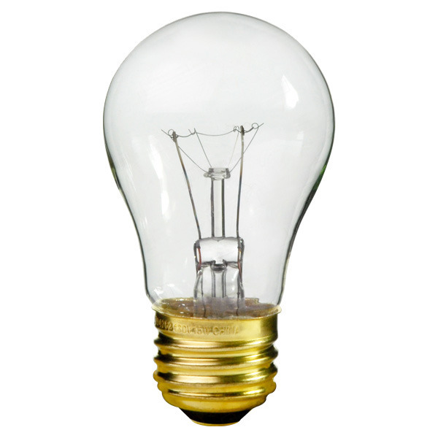
The energy used by the brain is enough to light a 25 watts bulb.

Slide 36
True!
Notes:
True - the brain generates just enough power to keep an actual light bulb lit over your head!

Slide 37
Some people have brains that are more right-sided (artistic) and others more left-sided (logical).

Slide 38
False!
Notes:
False - The brain has to sides (aka hemispheres), however, almost everything we do involves both sides (aka hemispheres). Research does show that there are a specialized functions in each side, such as the left side of the brain being more involved in language, for example. But most things involved a coordinated activity of both sides of the brain.

