Slide 1


Stroke Images
SUPPORTED BY:

Slide 2
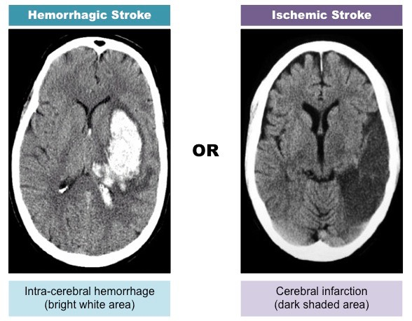
CT scan

Slide 3
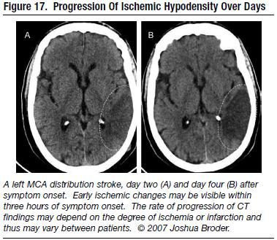
CT scan
After 2 days
After 4 days

Slide 4
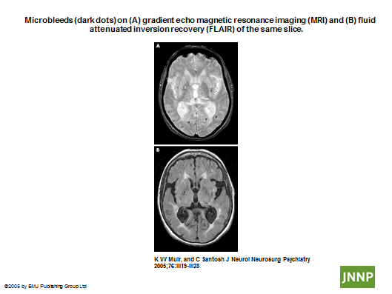
MRI scans (microbleeds)
Gradient echo MRI
FLAIR MRI
Notes:
Source: https://jnnp.bmj.com/content/76/suppl_3/iii19

Slide 5
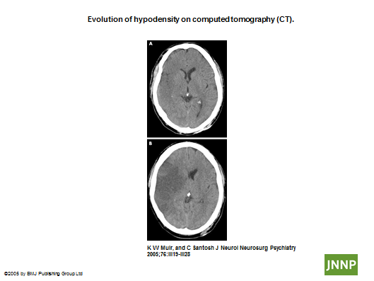
CT scan (hypodensity)
Notes:
Source: https://jnnp.bmj.com/content/76/suppl_3/iii19

Slide 6
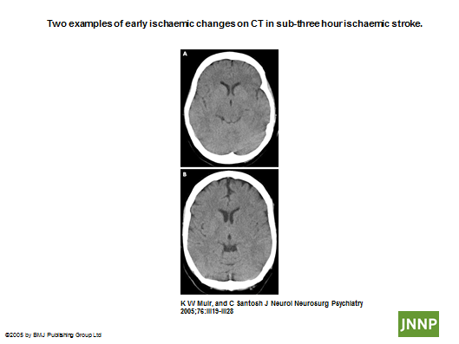
CT scan (ischemic stroke)
Notes:
Source: https://jnnp.bmj.com/content/76/suppl_3/iii19

Slide 7
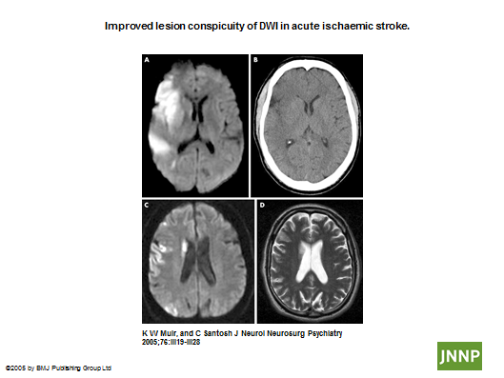
Different types of scan (ischemic stroke)
DWI MRI (more sensitive)
CT (less sensitive)
DWI MRI (more sensitive)
T2 MRI (less sensitive)
Notes:
Source: https://jnnp.bmj.com/content/76/suppl_3/iii19

Slide 8
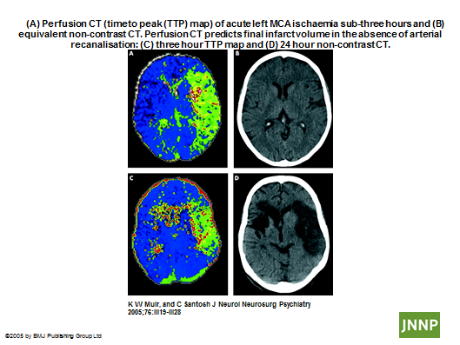
CT scans (ischemic stroke)
Perfusion CT (less than 3 hours)
Non-contrast CT (less than 3 hours)
Perfusion CT (3 hours)
Non-contrast CT (24 hours)
Notes:
Source: https://jnnp.bmj.com/content/76/suppl_3/iii19

Slide 9
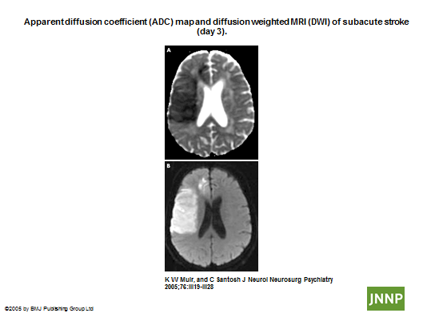
MRI scans (subacute stroke, day 3)
ADC MRI
DWI MRI
Notes:
Source: https://jnnp.bmj.com/content/76/suppl_3/iii19

Slide 10
