Slide 1


DNA Sequencing and Precision Medicine
SUPPORTED BY:

Slide 2
DNA Sequencing and Precision Medicine
Class 1
What is precision medicine?
How does DNA sequencing work?

Slide 3
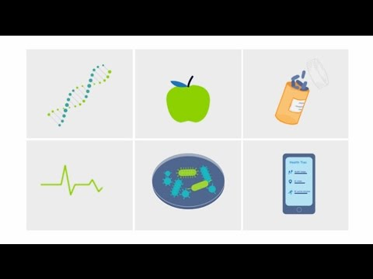
What is precision medicine?

Slide 4
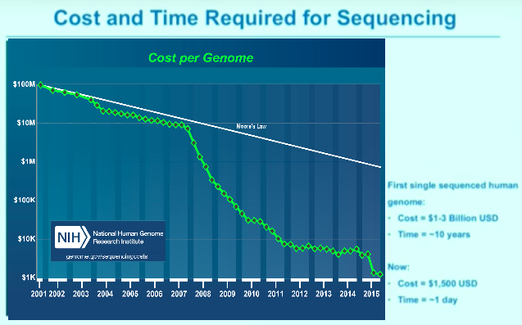
Figure analysis template 1

Slide 5
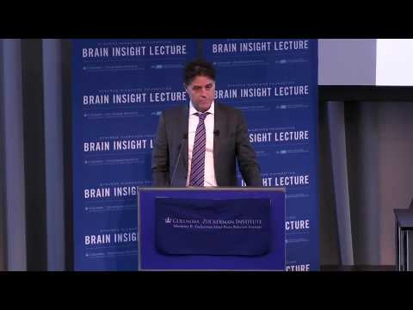
What is a genome?
Notes:
Play from 8:38 - 11:14

Slide 6
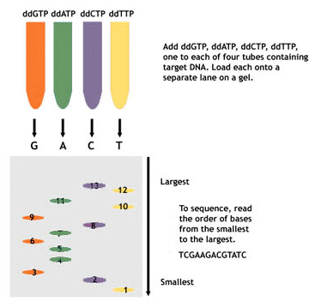
Sequencing activity 1
Introduction
Sanger Sequencing is a DNA sequencing technique developed by Frederick Sanger in 1977
This activity will model the concepts behind Sanger Sequencing
“Next Gen” sequencing uses the same techniques as Sanger Sequencing but powerful computer algorithms allow multiple sequences to be processed at the same time

Slide 7
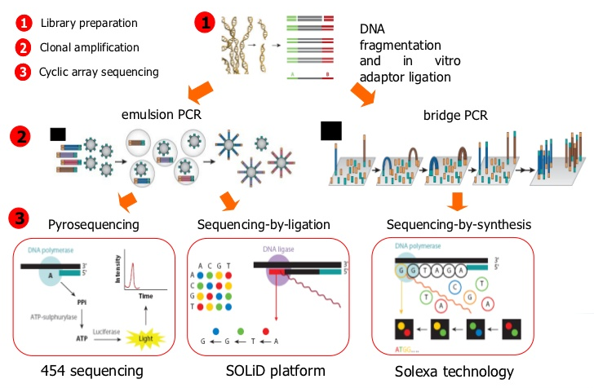
Next-generation DNA sequencing

Slide 8
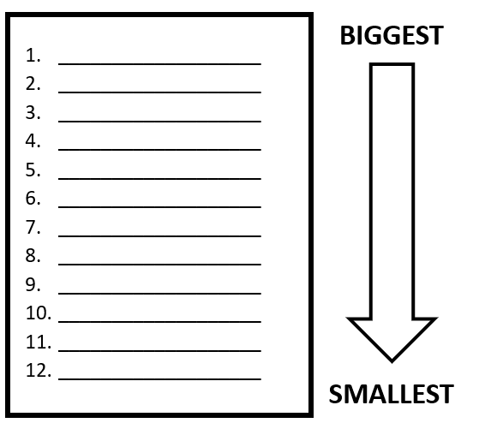
Sequencing activity 1
Step 1
Sanger DNA Sequencing separates pieces of DNA by size
Arrange your DNA pieces by size from biggest to smallest

Slide 9
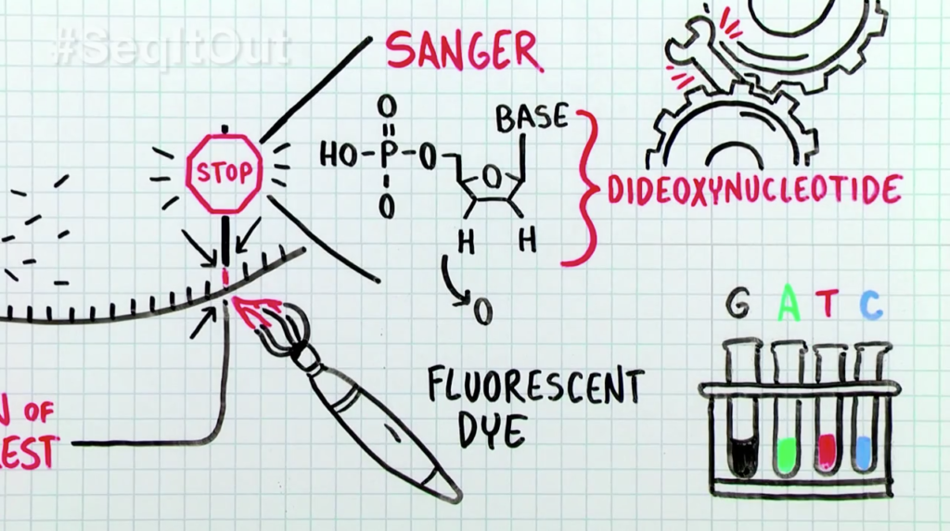
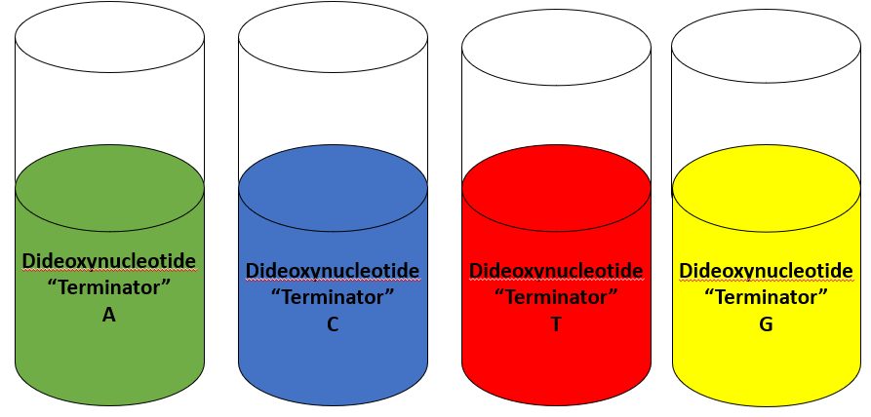
Sequencing activity 1
Step 2
Sanger DNA Sequencing makes different sized copies of parts of the DNA you are trying to sequence
This is done by using special “Terminator” bases called Dideoxynucleotides
Dideoxynucleotide “Terminators” STOP the copying of DNA pieces at a particular letter, for example, A
Place the DNA pieces in the Dideoxynucleotide “Terminator” tube that would have produced them
Notes:
Image credit: Thermo Fisher’s #SeqItOut series: https://www.thermofisher.com/blog/behindthebench/how-does-sanger-sequencing-work/

Slide 10

Dideoxynucleotide “Terminator” examples
A)
C)
T)
G)

Slide 11
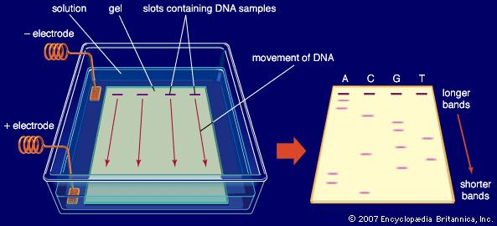
Sequencing activity 1
Step 3
After the dideoxynucleotide “terminators” make different sized pieces of DNA, they are separated using electrophoresis
Electrophoresis uses electrical charges to move DNA pieces through a gel and separate them by size
Starting at the top, smaller pieces go farther down than larger pieces
Arrange the DNA pieces by size AND by dideoxynucleotide “terminator” by using 4 lanes

Slide 12
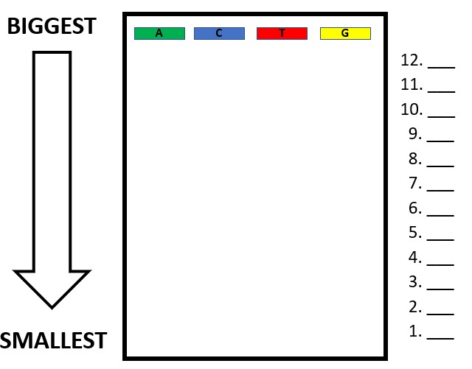
Sequencing activity 1
Step 4
Starting at the bottom, write the letter of the lane that smallest DNA piece is in. As you work your way to the top, you are writing the sequence of the DNA!

Slide 13

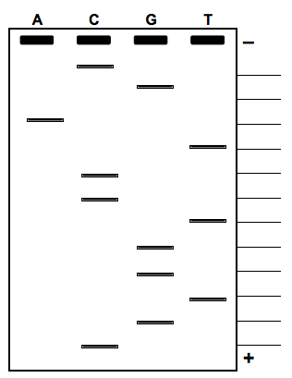
Sequencing activity 1
Step 5
DNA is too small to see like we do in this activity
What we would really see is a band (stripe) that is made of thousands of copies of DNA that are exactly the same
Write the DNA sequence on your student sheet

Slide 14
What can sequencing a genome teach us about disease?
Notes:
Play from 11:14 - 12:30

Slide 15
DNA Sequencing and Precision Medicine
Class 2
How can DNA Sequencing aid the understanding and treatment of diseases?
Who should get their genomes sequenced?

Slide 16

Cara Greene: Good Morning America
Notes:
(B) Confocal image of YFP-immunostaining shows unilateral ChR2 expression at OFC injection site. Scale bar, 500 μm.
Review how localization of viral injection and fiber-optic implant. ChR2 (green) is expressed in ventromedial OFC. Fiber-optic implant is placed into VMS to stimulate ChR2 in axon terminals projecting from OFC.
Timeline for chronic stimulation of OFC-VMS projections: after habituation to the tethering procedure for 7 days (T1 to T7), mice underwent the stimulation protocol.

Slide 17
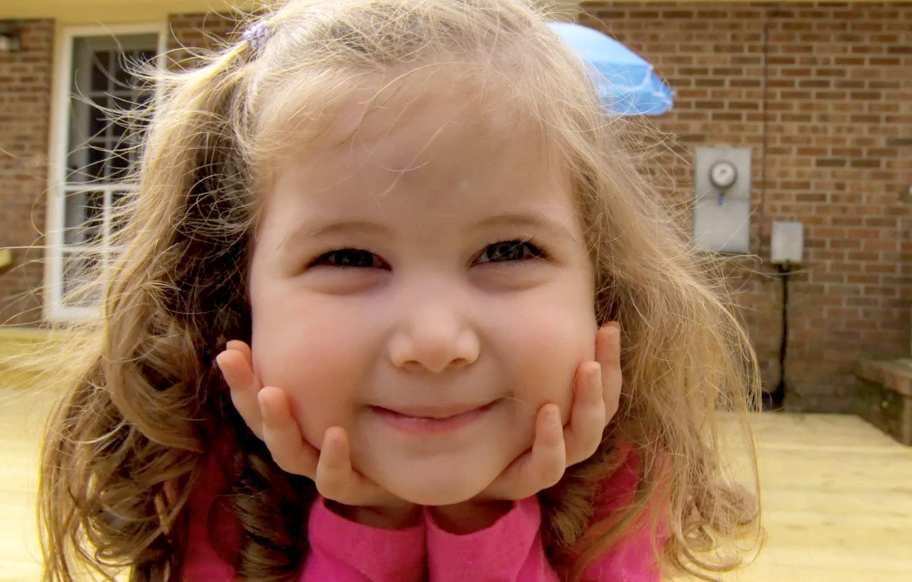
Sequencing activity 2
Part 1
Imagine that the DNA we sequenced last class was from Cara Greene’s SLC52A2 gene
This gene codes for a protein that helps transport vitamin B so it can be used by the body
Your table group will be assigned the imaginary results of the Sanger Sequencing of an imaginary patient who is suffering from an unknown genetic disorder
Using what you learned last time, determine the sequence of this piece of DNA

Slide 18
Cara Greene
Notes:
Play from 14:28 - 17:38

Slide 19
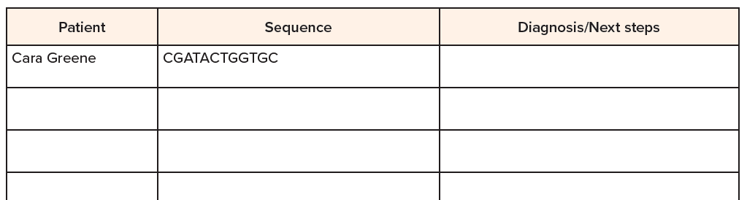
Sequencing activity 2
Part 2
When you have finished sequencing your DNA, enter your sequence into the class data table

Slide 20
Sequencing activity 2
Part 2
Compare patient DNA sequences to Cara Greene’s DNA. Can you make a positive diagnosis of BVVLS? Can you rule out BVVLS? What are the next steps for this patient?

Slide 21
Who should be sequenced?
Notes:
Play from 24:30 - 26:39

Slide 22
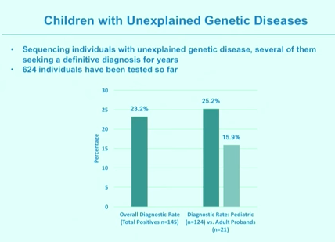
Figure analysis template 1

Slide 23
Should everyone be sequenced?
Notes:
Play from 1:04:00 - 1:06:00

