Slide 1


Obsessive-compulsive disorder
SUPPORTED BY:

Slide 2
How do scientists use model organisms to learn about human behaviors and disease?
Bell Ringer activity:
Complete table with desk partner
Enter top priority into Socrative
https://b.socrative.com/login/student/

Slide 3
How do scientists use model organisms to learn about human behaviors and disease?
What do you know about obsessive compulsive disorder (OCD)? Give examples, explain what you think a day in the shoes of a patient would look like, etc.
How do you know what you know about OCD?
What additional information do you think you need to help treat patients with OCD?

Slide 4
Our paper for today
Ahmari et. al (2013). Repeated Cortico-Striatal Stimulation Generates Persistent OCD-Like Behavior. Science. 1234-1239.
Notes:
https://www.ncbi.nlm.nih.gov/pmc/articles/PMC3954809/pdf/nihms558062.pdf

Slide 5
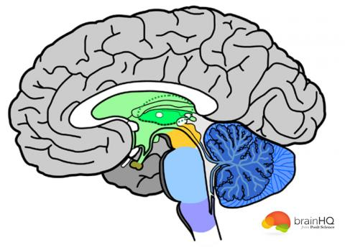
Abstract

Slide 6
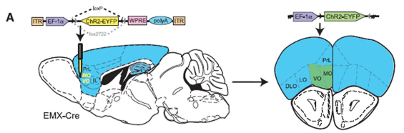
Methods
Notes:
(A) Cre-inducible adenovirus-associated vector (AAV) carrying the gene encoding channel rhodopsin (ChR2) fused to enhanced yellow fluorescent protein (EYFP) [pAAVEf1a-DIO-ChR2 (H134R)-EYFP; referred to as DIO-ChR2] was stereotactically injected into OFC of EMX-Cre transgenic mice to ensure specific ChR2 expression in cortical glutamatergic neurons.

Slide 7
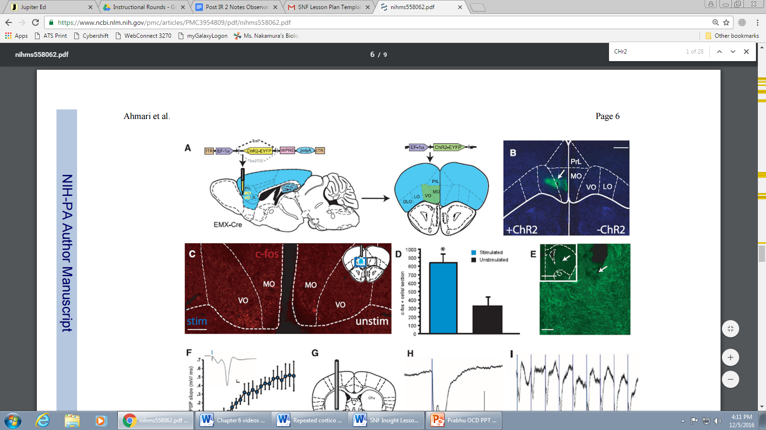
Methods
Notes:
(B) Confocal image of YFP-immunostaining shows unilateral ChR2 expression at OFC injection site. Scale bar, 500 μm.
Review how localization of viral injection and fiber-optic implant. ChR2 (green) is expressed in ventromedial OFC. Fiber-optic implant is placed into VMS to stimulate ChR2 in axon terminals projecting from OFC.
Timeline for chronic stimulation of OFC-VMS projections: after habituation to the tethering procedure for 7 days (T1 to T7), mice underwent the stimulation protocol.

Slide 8
Methods
Notes:
(C) c-Fos immunostaining demonstrates 473-nm light–induced activation of OFC in awake behaving mice through chronic fiber-optic implant. (Inset) Reference coronal section. Blue square, stimulated; black, unstimulated.

Slide 9
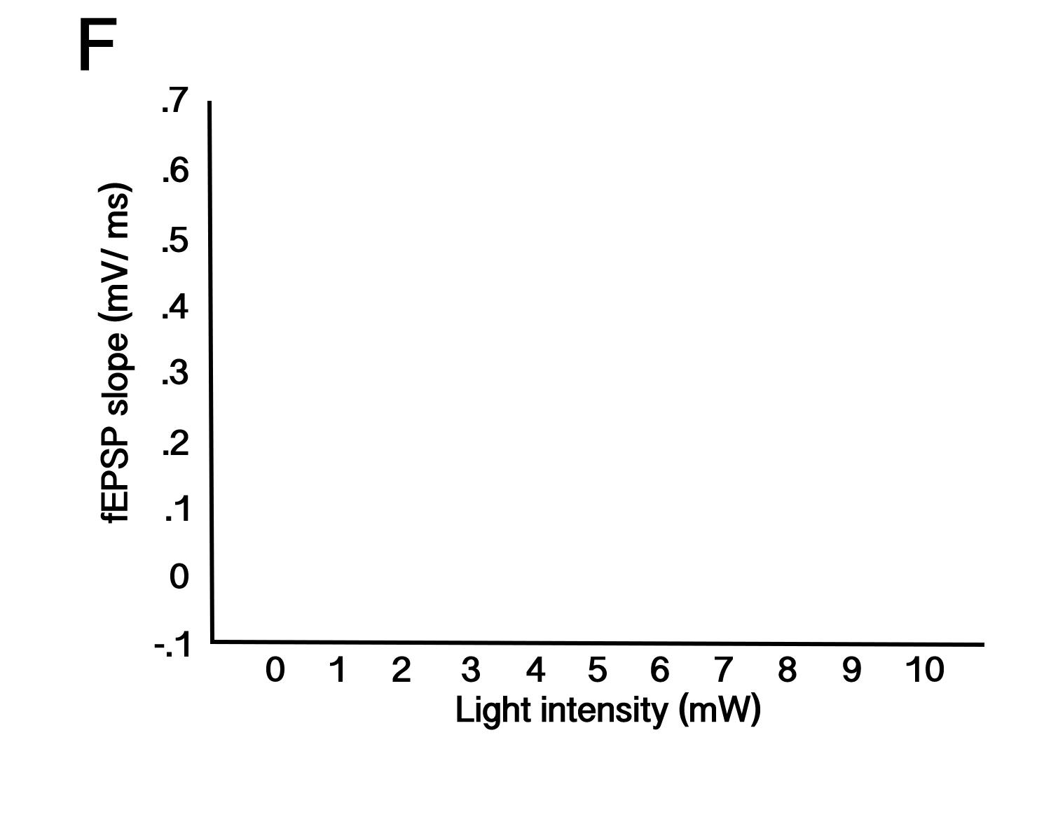
Predicting Results

Slide 10
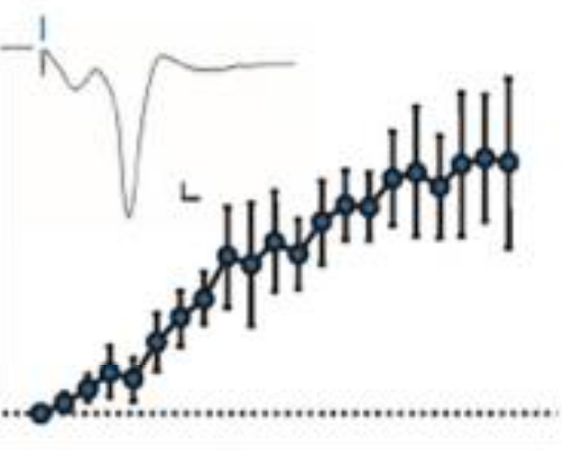
Predicting Results

Slide 11
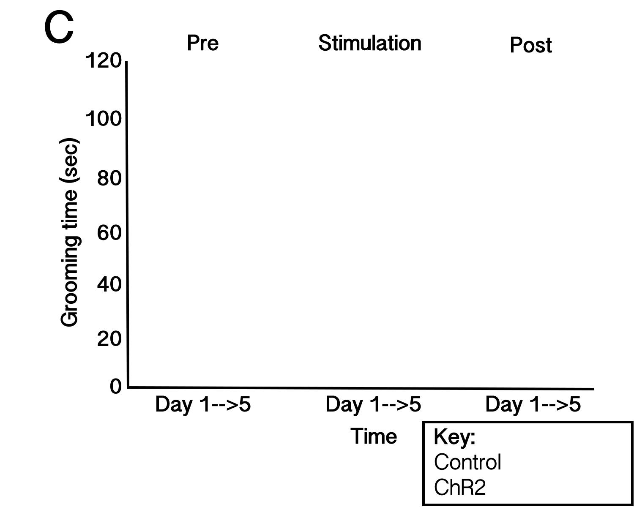
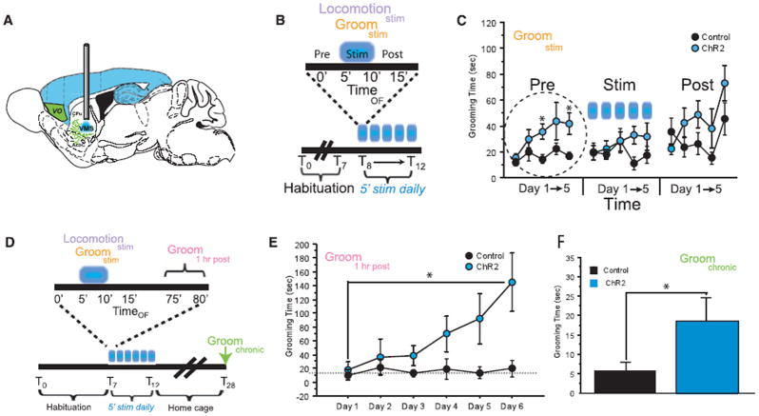
Grooming time
Notes:
Grooming behavior was recorded with digital video and scored by blind raters for 5 min before (Pre), during (Stim), and after (Post) stimulation (Fig. 2B). Whereas acute OFC-VMS stimulation did not produce grooming, a small but significant progress.
Because the prestimulation measurement on days 2 to 5 served as a 24-hour time stamp for effects of stimulation the day before, this suggested that repeated stimulation led to chronic circuit changes that ultimately resulted in sustained, stimulation-independent OCD-like behavior. Although it is possible that stress from handling contributed to the grooming increase in the prestimulation period, stress was minimized by habituation to fiber-optic tethering daily for a week before data collection and was identical for controls and ChR2+ mice. To resolve the time-course of the grooming increase, they examined a new cohort an hour after stimulation. An increase in grooming time was noted during the prestimulation period on consecutive days.

Slide 12
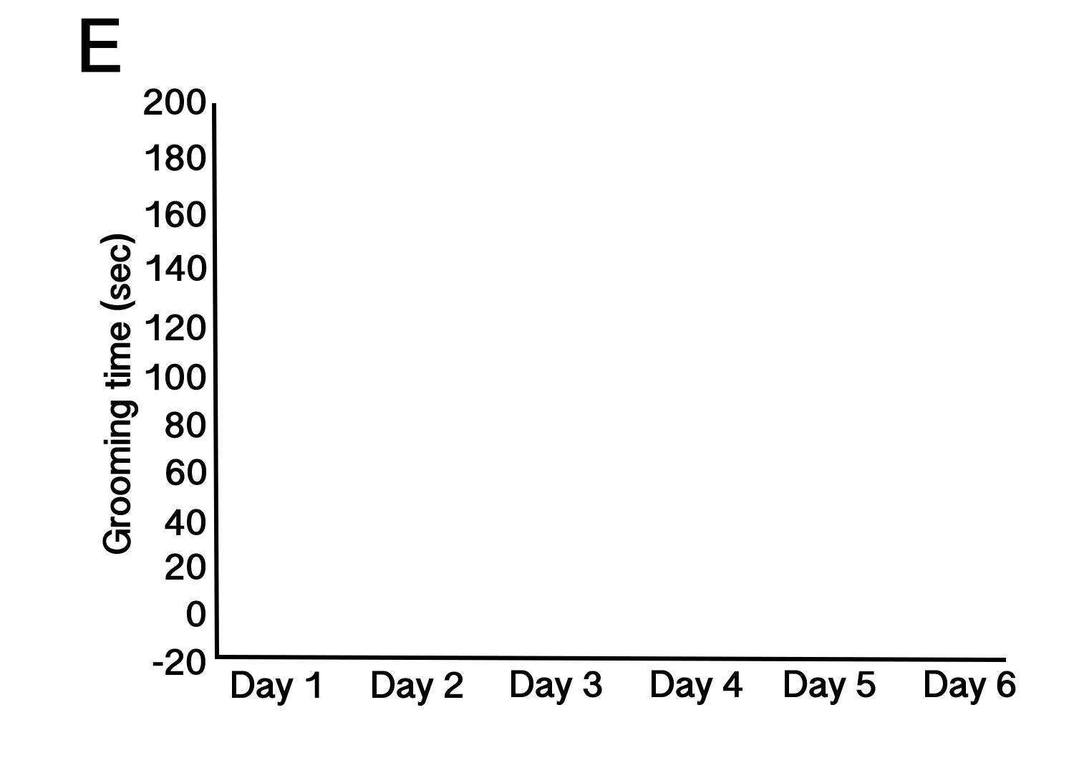
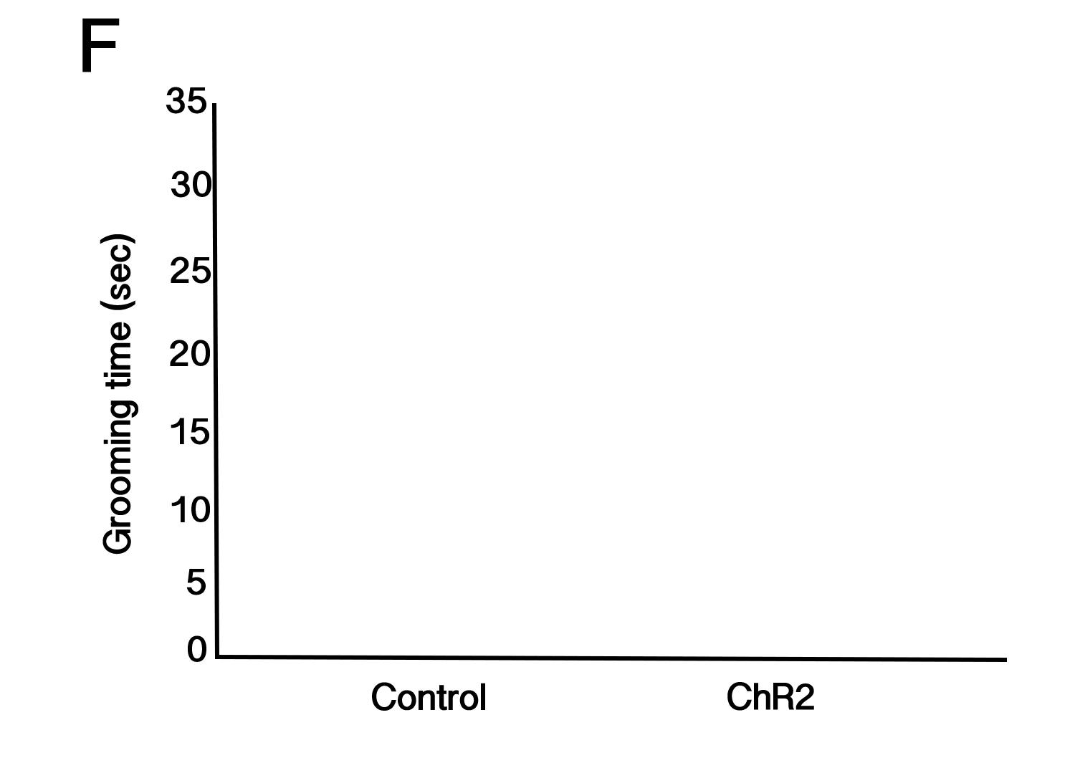
Grooming time
Notes:
They injected DIOChR2 into the left OFC of EMX-Cre mice and implanted fiber-optic probes unilaterally in left VMS (Fig. 2A). After waiting 3 to 4 weeks for surgical recovery and stable viral expression, they habituated mice to the open field and fiber-optic stimulation apparatus. They then repeatedly elevated activity in OFC-VMS projections by stimulating for 5 min at 10Hz for five consecutive days (10 ms, 1 to 5 mW).
These are results 1 hour post stimulation.

Slide 13
Summary
What does this data tell us about OCD?
If you were the scientists, what would you study next? Explain.

Slide 14
Homework
Watch TED video and answer questions posted online.
https://ed.ted.com/lessons/debunking-the-myths-of-ocd-natascha-m-santos

