Slide 1
Our Sense of Touch
Let’s use data to analyze our sense of touch.

Slide 2

Warm Up:
Let’s debunk some myths about our brains and our senses!
Indicate whether you believe the following 10 statements on your paper is true or false.

Slide 3
Warm Up:
Indicate whether you believe the statement is true or false?
Everyone experiences basic senses.
TRUE.
Everyone has basic senses that they can feel. These basic senses help us survive, navigate, and explore the world around us.

Slide 4
Warm Up:
Indicate whether you believe the statement is true or false?
2) We have 5 senses.
FALSE.
While traditionally categorized as five, humans possess more than five senses, including balance, temperature, and pain.

Slide 5
Warm Up:
Indicate whether you believe the statement is true or false?
3) Brain regions control specific behaviors.
FALSE.
Different brain regions work in conjunction, and complex functions are not localized to one area.

Slide 6
Warm Up:
Indicate whether you believe the statement is true or false?
4) The brain itself does not have pain receptors.
TRUE.
The brain cannot feel pain. Headaches and other pain sensations are interpreted by the brain but are not felt within the brain itself. Surgery can be done on the brain while you are awake!

Slide 7
Warm Up:
Indicate whether you believe the statement is true or false?
5) The brain generates with electrical energy.
TRUE.
The brain operates through electrical signals, and it can generate enough electricity to power a lightbulb.

Slide 8
Warm Up:
Indicate whether you believe the statement is true or false?
6) Our brain and senses are fully developed by age ten.
FALSE.
Brain development continues well beyond childhood, extending through adolescence and into adulthood. New neural pathways are formed and strengthened throughout life

Slide 9
Warm Up:
Indicate whether you believe the statement is true or false?
7) The communication from our senses to our brain can travel at speeds of up to 120 meters per second.
TRUE.
That’s 328 feet per second! Think how fast you quickly feel things just by touch and how quickly we can react to our sense and surroundings.

Slide 10
Warm Up:
Indicate whether you believe the statement is true or false?
8) Brain size determines intelligence.
FALSE.
The size of the brain is not an indicator of intelligence. Sperm whales have one of the largest brains, larger than humans, but they are not more intelligent.

Slide 11
Warm Up:
Indicate whether you believe the statement is true or false?
9) Some people are ‘left brained’ & some are ‘right brained’
FALSE.
While the brain is divided into two hemispheres, they work together in a coordinated fashion. Neither side of the brain dominates the other side as some personality tests will oversimplify and say.

Slide 12
Warm Up:
Indicate whether you believe the statement is true or false?
10) Everyone experiences touch the same way.
FALSE.
Our brain receives and interprets the information in different ways.

Slide 13
Our Sense of Touch
Today we will be doing an experiment to see how our bodies get information through the sense of touch.
We will be answering the statistical question of which part of our body is the most sensitive by looking at the average measurements of the smallest distance when we can detect two or one points on the caliper. We will also look into how diverse our sense of touch is in the 7th grade.
Before we begin, let’s watch a video to see how we can use a caliper and how our brain receives and send information about touch.

Slide 14

How does our brain receive information from touch?
https://www.youtube.com/watch?v=LTX91k7RFzg
Notes:
Start at 0.19

Slide 15
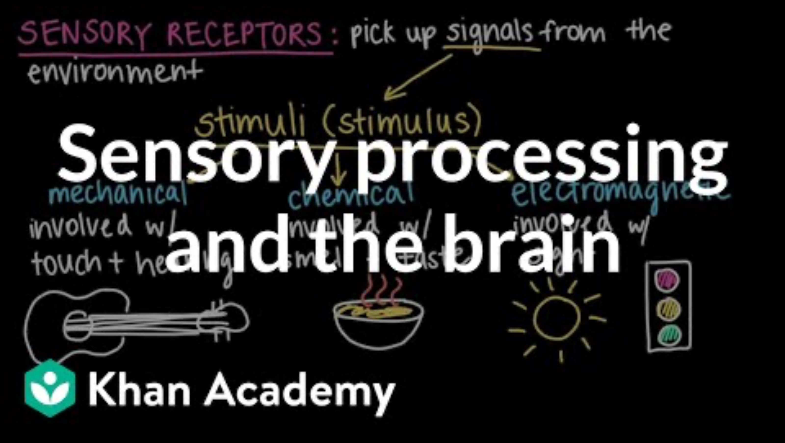
The nervous system and how it works
http://www.youtube.com/watch?v=fMrz3L9bMsI

Slide 16
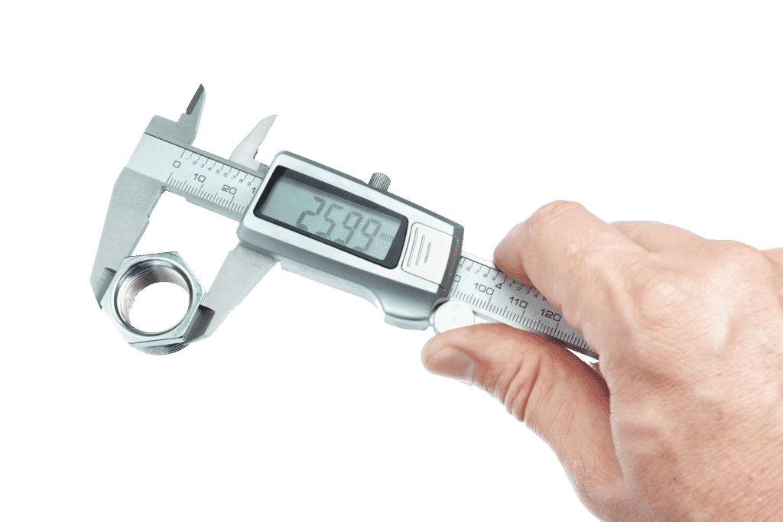
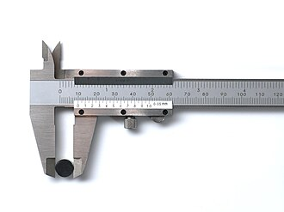
What is a Caliper?
A caliper is a measurement tool used to measure the thickness, length, diameter, or depth of an object.

Slide 17
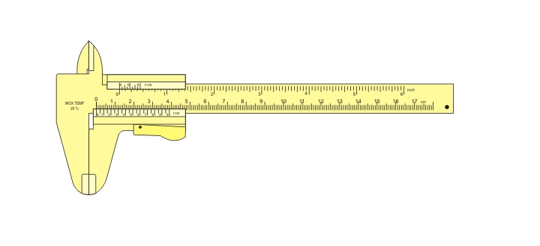
Using a Caliper
Adjust the distance of the two points and find the measurement.
Notes:
https://www.youtube.com/watch?v=A1DNh2jSowE

Slide 18

https://www.youtube.com/watch?v=A1DNh2jSowE

Slide 19
The Experiment
Questions
Which part of our body is the most sensitive (finger, palm, arm)?
How diverse is our sense of touch in the 7th grade and what does that mean?
Predictions
I think the most sensitive part of the body is the _______________.
I think the least sensitive part of the body is the _______________.
I think the sense of touch in the 7th grade will be / will not be diverse.

Slide 20
Procedure
We will be experimenting on the 1st finger, palm, and arm of our body.
The subject will close his/her eyes.
The tester will place the caliper on the subject’s body part (starting with 50 mm apart) and ask how many points the subject feels.
    If the subject says two points, move the distance 10 mm smaller.
    If the subject says one point for the first time, move the two points apart only 1 or 2 mm at a time until they say two points.
Continue this process for the rest of the body parts and record the result on the Data Sheet.
Switch roles until everyone at the table is recorded.

Slide 21
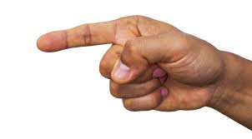

Data Collection & Observations
Body Part: First Finger | Distance for two point of discrimination (mm)
Participant 1: ________________________
Participant 2: ________________________
Participant 3: ________________________
Participant 4: ________________________
Average distance of sensing two points on the finger: _______________________

Slide 22
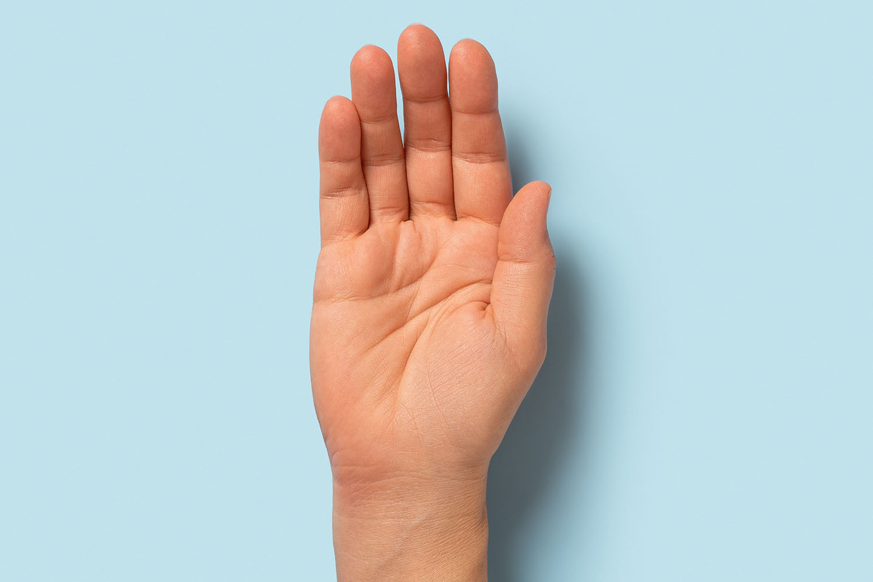
Data Collection & Observations
Body Part: Palm | Distance for two point of discrimination (mm)
Participant 1: ________________________
Participant 2: ________________________
Participant 3: ________________________
Participant 4: ________________________
Average distance of sensing two points on the palm: _______________________

Slide 23
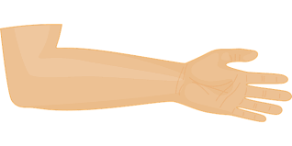
Data Collection & Observations
Body Part: Arm | Distance for two point of discrimination (mm)
Participant 1: ________________________
Participant 2: ________________________
Participant 3: ________________________
Participant 4: ________________________
Average distance of sensing two points on the forearm: _______________________

Slide 24
How to Find Average
Average is the same thing as mean.
Add up the data and divide by the number of data you have.
If you have 4 people in your group, you will divide your sum by 4, if you have 5 people in your group you will divide by 5.
Body Part: Arm | Distance for two point of discrimination
Participant 1: ________________________
Participant 2: ________________________
Participant 3: ________________________
Participant 4: ________________________
Average distance of sensing two points on the forearm: _______________________

Slide 25
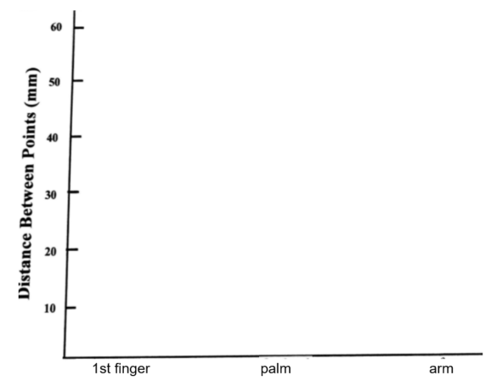

Graphs
Graph the average as a bar graph
Graph the data as a dot plot

Slide 26
Analysis
Based on the averages, which body part is best at telling that two points are touching them even when the points are very close together?
Which skin areas do you think have more receptors, areas that have small two-point distances, or large two points distances? Why do you think so?
Which brain area do you think is larger, one receiving information from skin with lots of receptors, or from skin with a few receptors?
How does the image to the right of our sensory part of our brain support your claim in the question above?
What does the information about the participants' averages tell us about how diverse 7th graders perceive touch?

Slide 27
Reflection
The diversity of our brains (and how it receives and interpret information differently) is called neurodiversity. What other questions can we explore about neurodiversity?
Does this bring to mind any scenarios where you saw a student react a different way from the way you would react to something?
Is there any way we can make this study better?
List 3 findings you learned from today’s experiment. Were you surprised by anything you found?

