Slide 1
Social Media & Me

Slide 2
Agenda
Announcements
SEL Check In
Do Now
Mini Lesson: What is Social Media?
Evaluating Risks
Exit Ticket & Closing

Slide 3
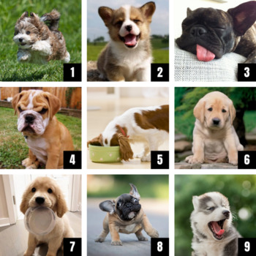
Self Check-In

Slide 4

Do Now
What is the function of this tool?
In what ways can this tool be useful?
In what ways could this tool be dangerous/harmful?

Slide 5

What is Social Media?
Social media are an online platforms where users can share information and connect with virtual communities.

Slide 6

Is it
Social Media?

Slide 7

Is it
Social Media?

Slide 8

Is it
Social Media?

Slide 9
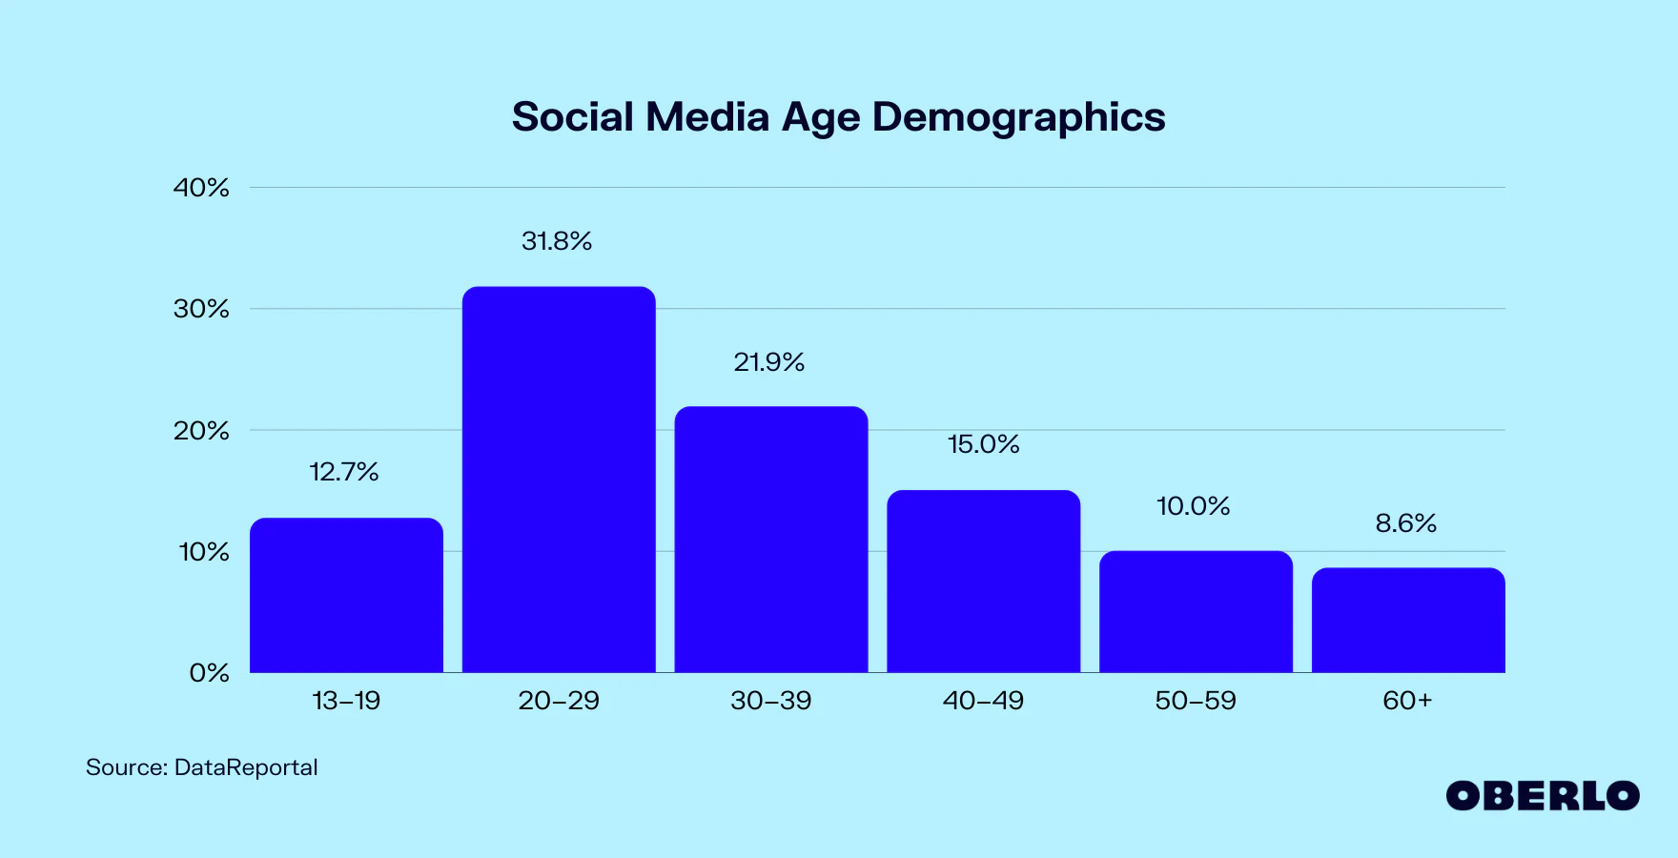
Is it
Social Media?

Slide 10

https://www.youtube.com/watch?v=2SvqoaZzyVs&t=4s
Notes:
https://www.youtube.com/watch?v=2SvqoaZzyVs&t=4s

Slide 11
Reflection
The man’s 5 year old daughter asked to post a picture online.
Social media usage can lead to suicidal thoughts and depression.
What should be the minimum age to use social media?

Slide 12

What do people use social media for?
Work with your table team to come up with as many uses as you can.
Jot down ONE idea per Post-It.
Sort out your ideas into 3 piles:
  Low risk, Medium risk, High risk

Slide 13
LOW RISK
MEDIUM RISK
HIGH RISK
Listen to music
Studying for tests
Playing games
Ordering food (?)
Supervised Shopping
Chatting with people that you know
Watching videos
Chatting in a game (like Roblox)
Looking at images (depends on the type of image)
Posting photos
Cyberbullying
Talking to strangers
Sending/receiving inappropriate photos
Going to inappropriate websites
Sharing personal information (example: address)
Setting viewing access to public
Impersonation
Clicking on unknown links
Addiction to social media
Dark web
Online dating

