Slide 1
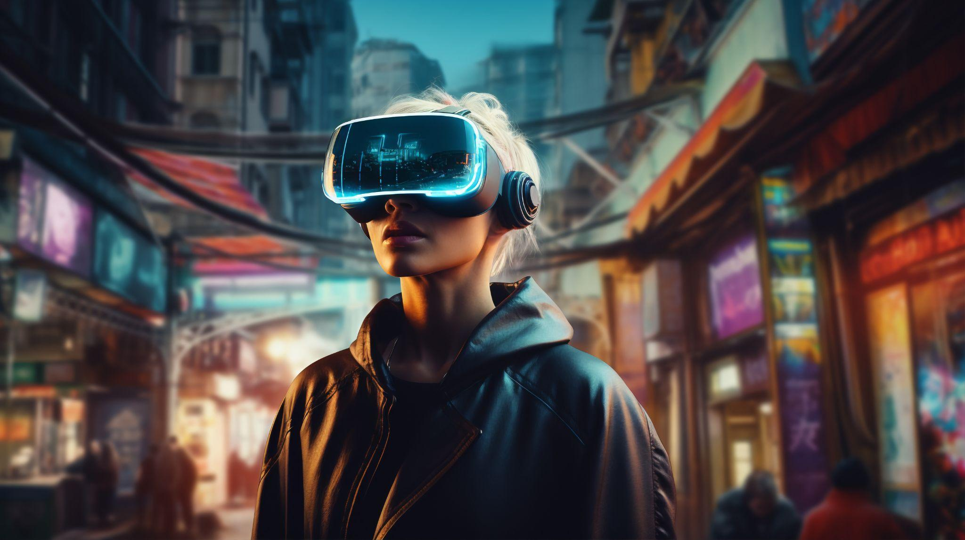
AI Detectives
Who’s the most perceptive among us mere mortals?
Which team will work together and take home the prize?

Slide 2
How it works
Teams
I choose the size: individually or with a partner.
You choose who: any person you’d like.
Scoring
1 point for correct identification
2 points for solid justification using evidence
1 bonus point for follow-up question(s)
Format
4 rounds: images, voice, handwriting, and video
5 examples: clips, recordings, and samples

Slide 3

Round 1
Table 1: Image Detectives
Table 2: Audio Detectives
Table 3: Handwriting Detectives
Table 4: Video Detectives

Slide 4
Round 2
Table 1: Audio Detectives
Table 2: Handwriting Detectives
Table 3: Video Detectives
Table 4: Image Detectives

Slide 5
Round 3
Table 1: Handwriting Detectives
Table 2: Video Detectives
Table 3: Image Detectives
Table 4: Audio Detectives

Slide 6
Round 4
Table 1: Video Detectives
Table 2: Image Detectives
Table 3: Audio Detectives
Table 4: Handwriting Detectives

Slide 7
Round 1
Image Detectives

Slide 8
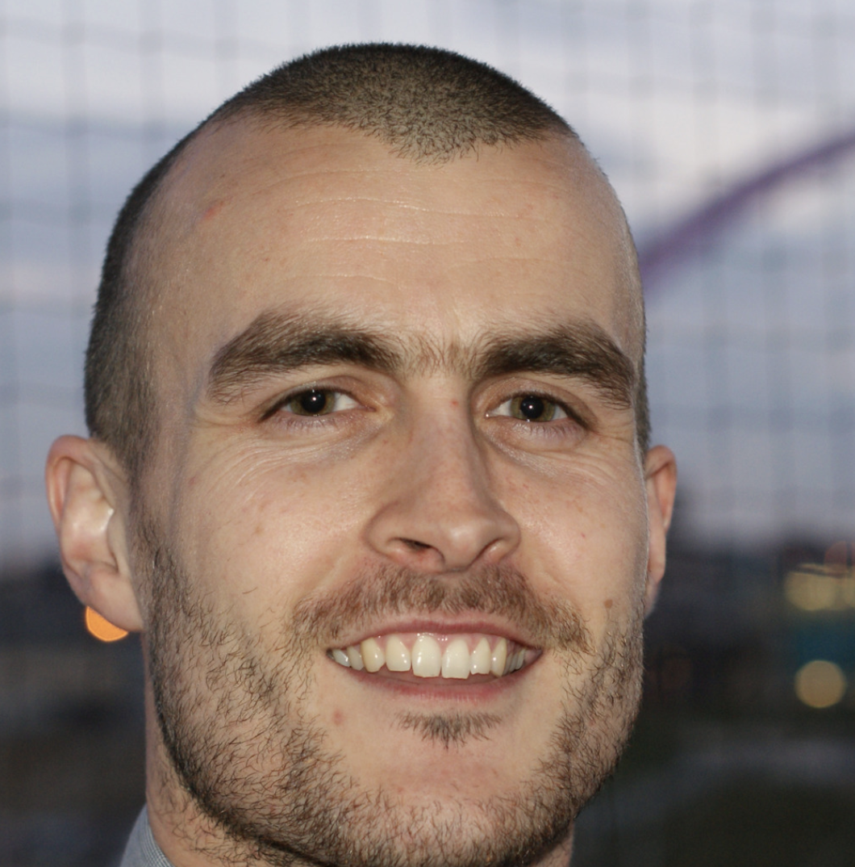
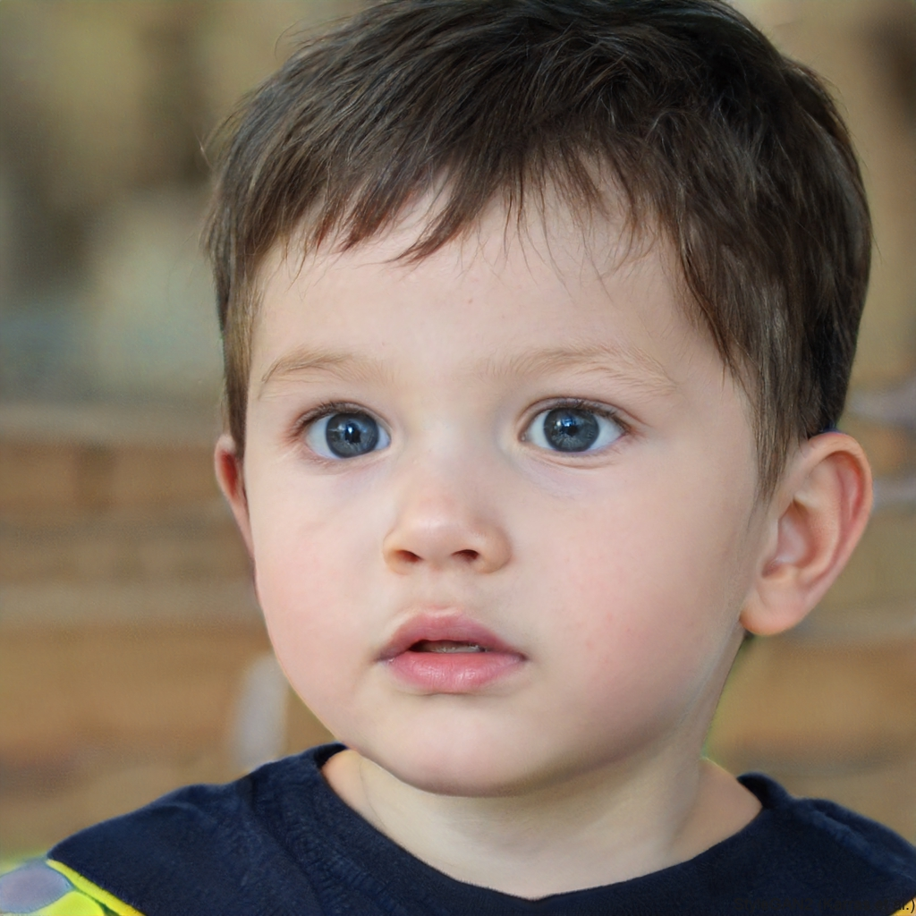
Real or AI?
Example A

Slide 9
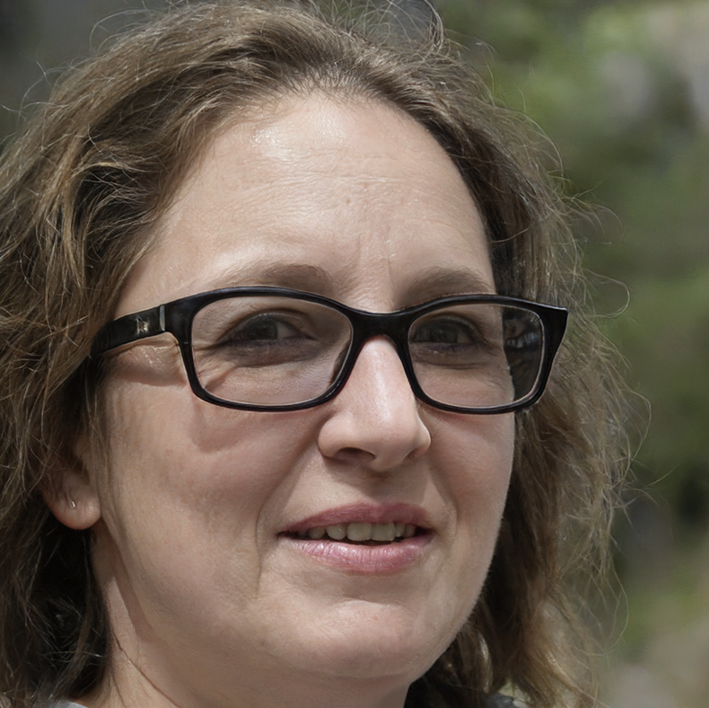
Real or AI?
Example B

Slide 10
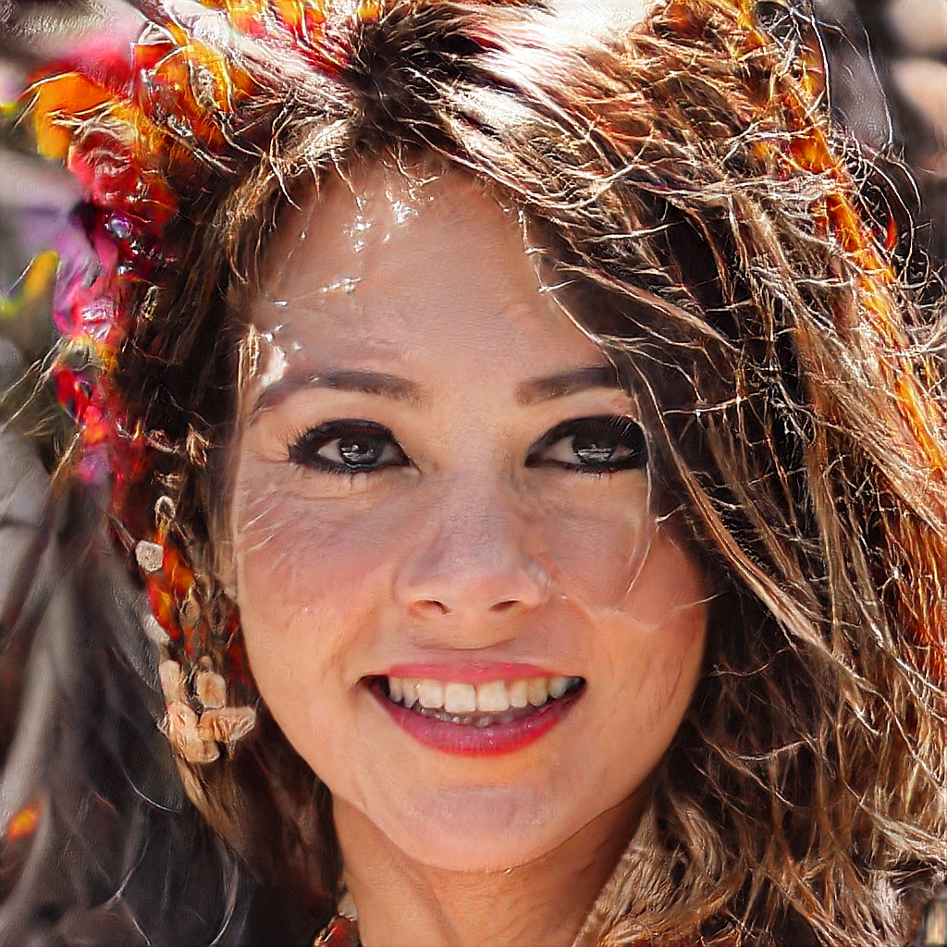
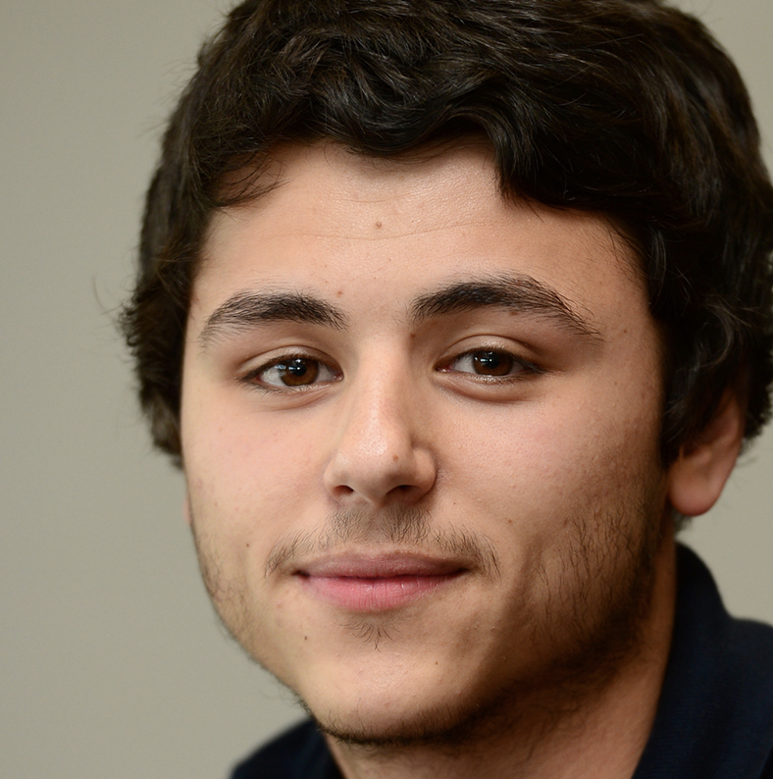
Real or AI?
Example C

Slide 11
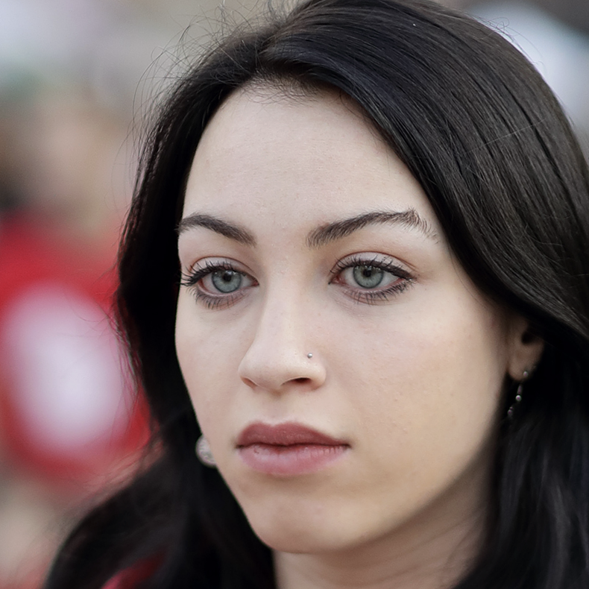
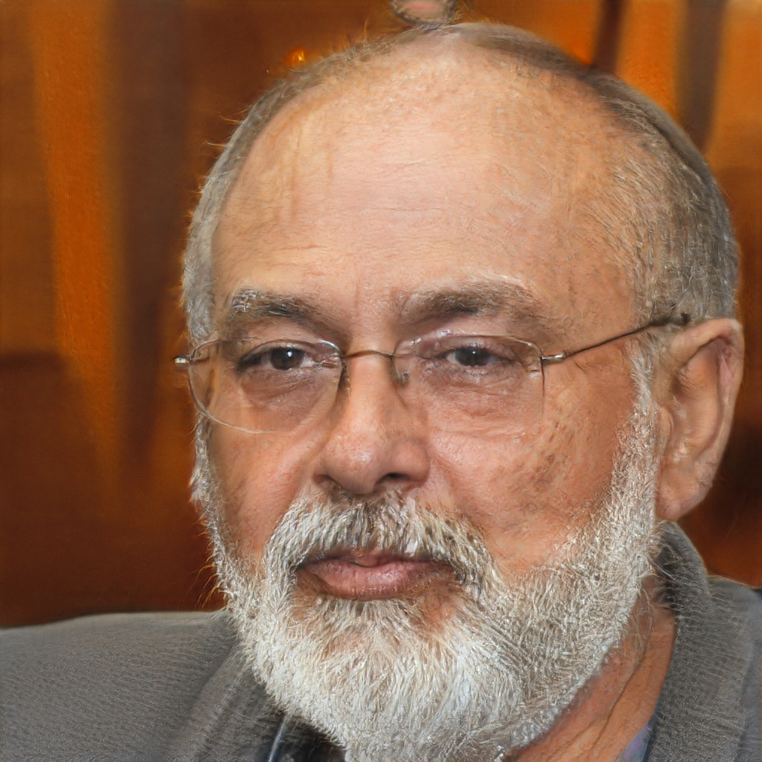
Real or AI?
Example D

Slide 12

Real or AI?
Example E

Slide 13
Round 2
Audio Detectives

Slide 14

Real or AI?
Example A

Slide 15
Real or AI?
Example B

Slide 16
Real or AI?
Example C

Slide 17
Real or AI?
Example D

Slide 18
Real or AI?
Example E

Slide 19
Round 3
Handwriting Detectives

Slide 20
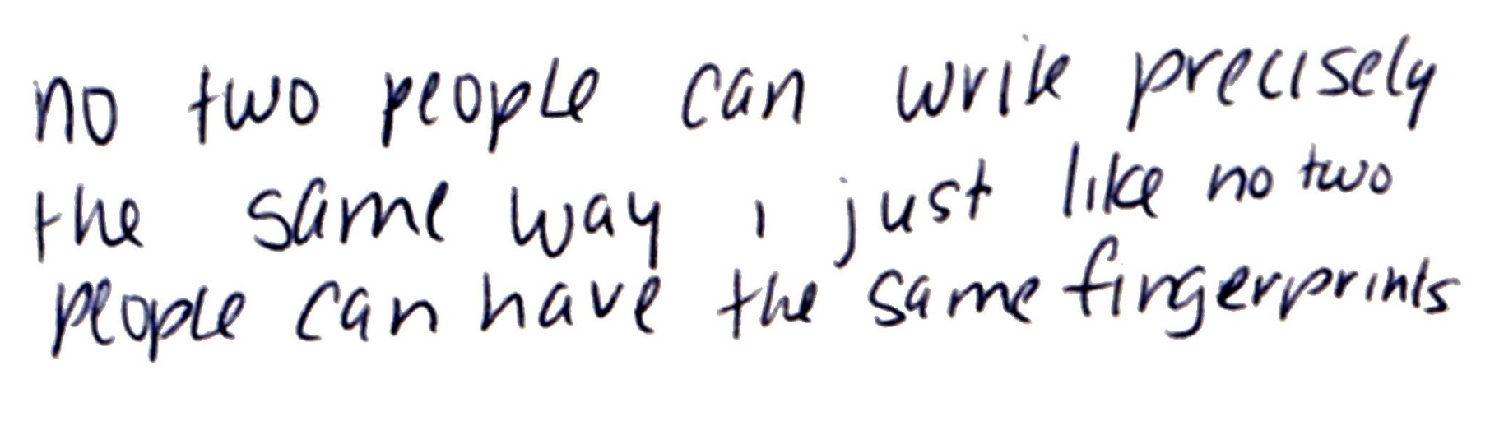
Real or AI?
Example A

Slide 21
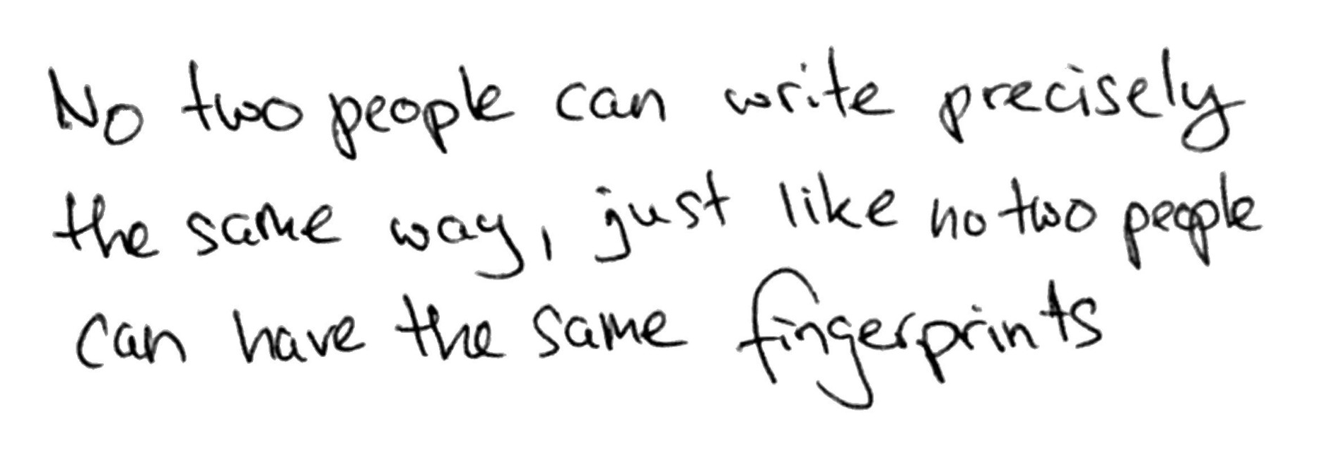
Real or AI?
Example B

Slide 22
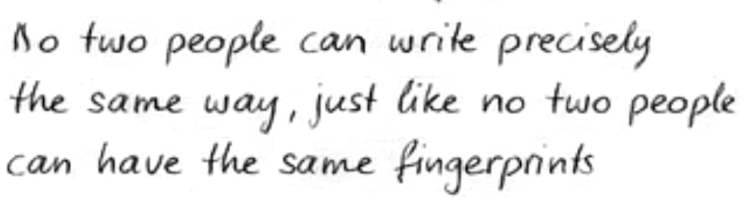
Real or AI?
Example C

Slide 23
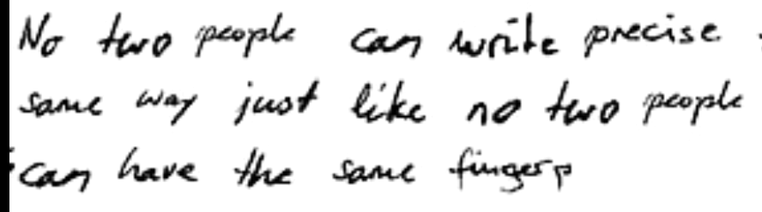
Real or AI?
Example D

Slide 24
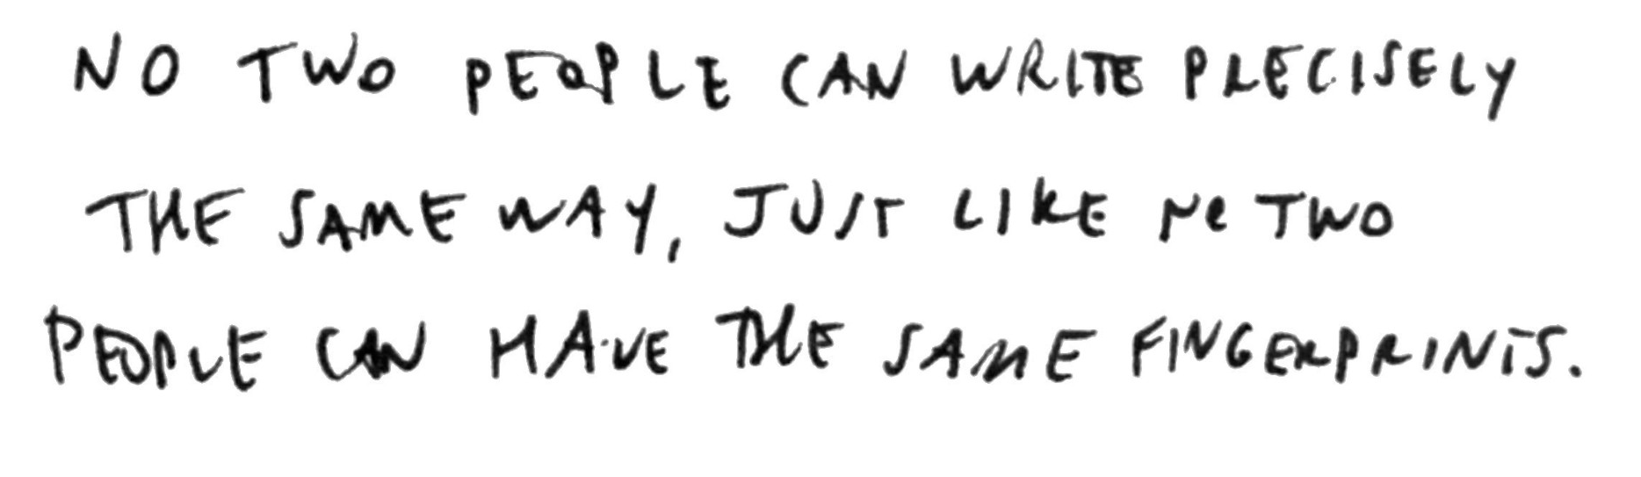
Real or AI?
Example E

Slide 25
Round 4
Video Detectives

Slide 26
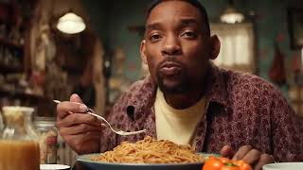
Real or AI?
Example A

Slide 27
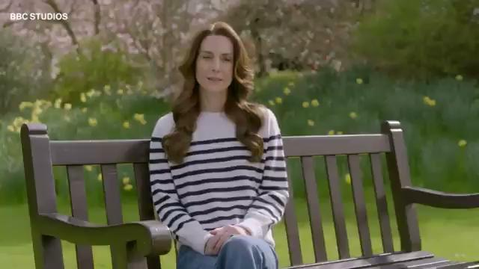
Real or AI?
Example B

Slide 28

Real or AI?
Example C

Slide 29
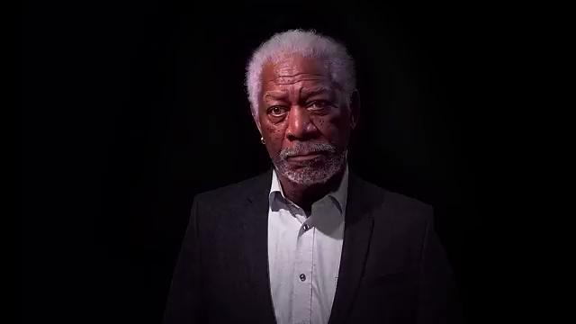
Real or AI?
Example D

Slide 30
Real or AI?
Example E

