Slide 1
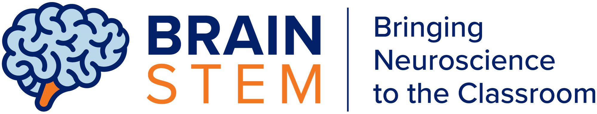

Inside the Brain’s Recognition System:
How We Know We Know Someone
1
SUPPORTED BY:
Notes:
The Stavros Niarchos Brain Insight Lecture
“How We Perceive Ourselves and Others”
By Steven A Siegelbaum, Ph. D. and Jon B Freeman,
Ph.D.

Slide 2
Inside the Brain’s Recognition System
Do Now
Have you ever felt like you knew someone, but forgot where you knew them from?
Write about a time this happened

Slide 3
Inside the Brain’s Recognition System
Learning Objectives
Trace visual information through the brain
Explain faster recognition of familiar faces
Model neuron communication
Analyze contextual memory retrieval

Slide 4
Inside the Brain’s Recognition System
Essential Questions
How does the brain recognize people?
What happens when we know a face but not the context?

Slide 5
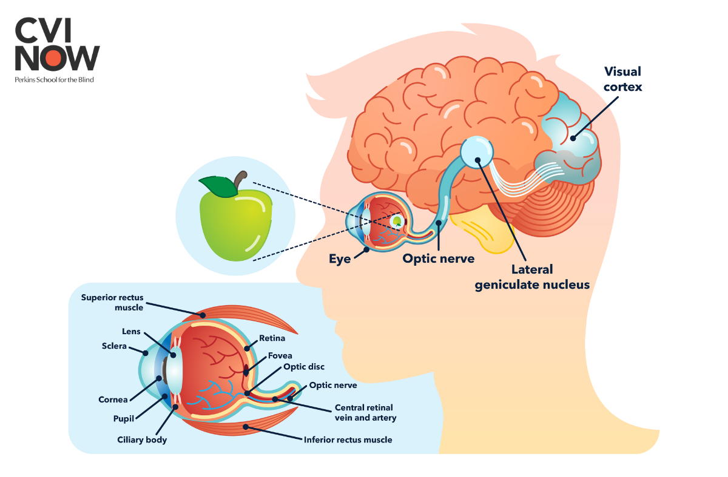
Inside the Brain’s Recognition System
How does vision work?
2 At the back of the eye, the retina converts light to neural signals
4 Visual cortex processes image in brain
1 Light enters the eye (stimulus)
3 Neural signals travel to brain via optic nerve
https://www.perkins.org/the-visual-pathway-from-the-eye-to-the-brain/

Slide 6
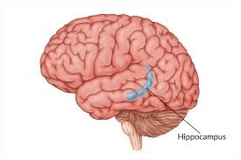
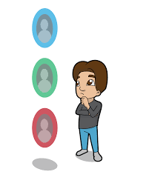
Inside the Brain’s Recognition System
Recognizing someone you see
Hippocampus is the memory center of the brain
It stores memories of people, places, things, and events
Hippocampus is the memory center of the brain
Match found → recognition
No match found → unfamiliar
Image from: Flint Rehab

Slide 7
Inside the Brain’s Recognition System
Activity 1: Reaction Time Lab
View faces for 2 seconds
Press timer when recognition occurs
Record whether you find them familiar vs. unfamiliar
Work silently and independently while you record your data on your worksheet:
Write down the reaction time for each face
Categorize each as familiar, unsure, or unfamiliar
Observe if any patterns emerge

Slide 8
Inside the Brain’s Recognition System
Discuss Results
Were you faster to recognize familiar or unfamiliar faces?
How do you think your experiences influence your reaction time?
What brain areas are involved?

Slide 9
Inside the Brain’s Recognition System
Activity 2: Become the Brain
Each student represents a structure in the brain and visual system (retina, optic nerve, visual cortex, hippocampus, recognition response)
Pass the signal quickly to simulate neural transmission!

Slide 10
Inside the Brain’s Recognition System
Let’s put the neural pathway together!
3. Optic nerve sends signal to brain
5. Image compared to memories stored in hippocampus
1. See someone
2. Retina turns light into neural signals
4. Visual cortex processes image
6. Match found! You recognize the person
Image from: Flint Rehab

Slide 11
Inside the Brain’s Recognition System
Activity 3: Context Matters
Image seeing your coach at the mall or your barista on the subway…
Why might it take you an extra moment to recognize them?

Slide 12
Inside the Brain’s Recognition System
Why Context Confuses Us
When you see someone you know but in a different location or context, you might feel like it takes you longer to recognize them
Your brain sees their face first, then searches for context about how you know them – this mismatch creates a delay!
Real-World Connections: how might this phenomenon apply to your day-to-day social interactions? To using eye-witness memory as court evidence? To artificial intelligence?

Slide 13
Inside the Brain’s Recognition System
Closure Reflection and Exit Ticket
Discuss: When I instantly recognize someone, my brain is…
Answer on your exit ticket:
Explain how information travels from the eyes to the moment of recognition
Why are familiar faces recognized faster than less familiar faces?

