Slide 1


The Science of Soothing: Using Sounds to Find Calm
1
SUPPORTED BY:
Notes:
The Stavros Niarchos Brain Insight Lecture
“Nurturing Growth in a Dynamic World”
By Dima Amso, Ph. D. and Dani Dumitriu,
Ph.D.

Slide 2

The Science of Soothing: Using Sounds to Find Calm
Crying Baby and Caregiver
Why do you think the baby stopped crying?
Notes:
https://www.youtube.com/watch?v=EpA1jqH9UeU

Slide 3




The Science of Soothing: Using Sounds to Find Calm
Understand Soothing Techniques
Let’s look at different techniques that can be used to soothe, including:
Swaddling
Gentle pressure mimics time during pregnancy
Rocking
Connects to vibrations and movement
Shushing/White Noise
Continuous, steady sound with calming properties
Caregiver’s Voice
Familiar and rhythmic, comforting for babies

Slide 4


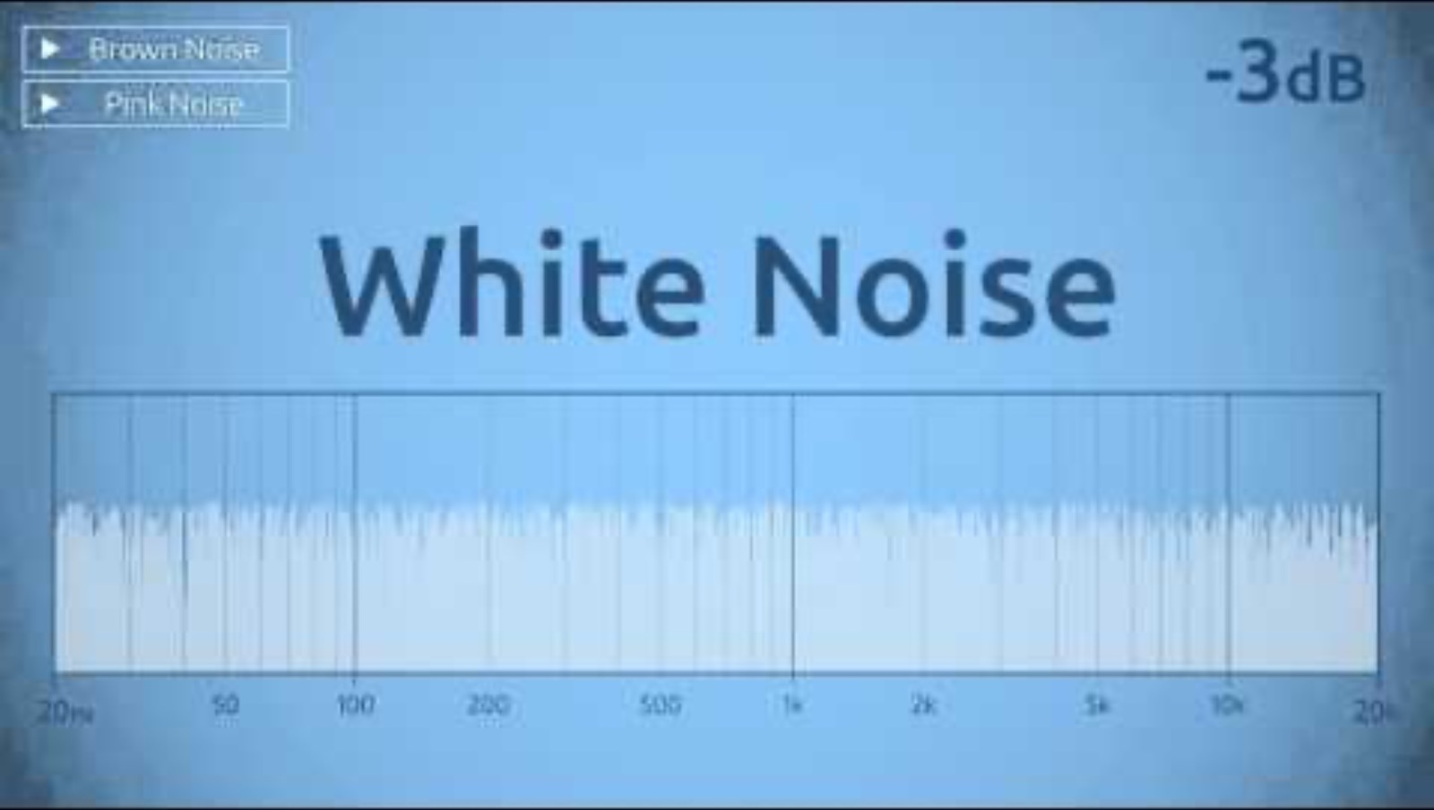

The Science of Soothing: Using Sounds to Find Calm
Sound Clips
Now you’ll listen to a variety of sounds. As you do, think about whether they are high or low in pitch, and whether they are loud or soft, predictable or unpredictable. Reflect and discuss why certain types of sounds might feel calming.
1. Heartbeat
3. Shushing
2. White Noise
4. Shh and white noise
Notes:
https://www.youtube.com/watch?v=gJpT_wHZeF8
https://www.youtube.com/watch?v=IMRj1ombxqY&t=1s
https://www.youtube.com/watch?v=UXBL9SFackM&t=5s
https://www.youtube.com/watch?v=Pi7ZE443vG4

Slide 5
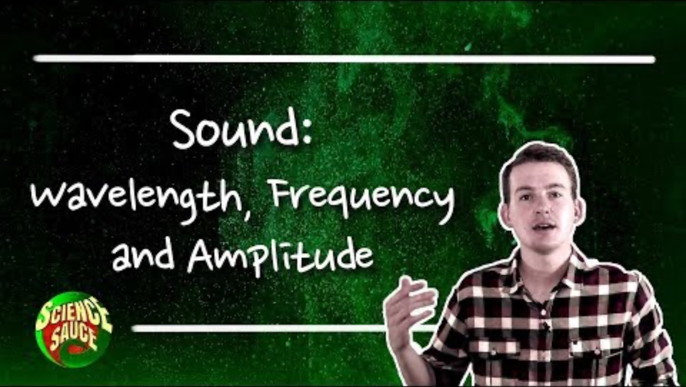
The Science of Soothing: Using Sounds to Find Calm
The Physics of Sound (Discussion & Worksheet Activity)
Now we’re going to explore three key ideas: frequency (pitch), amplitude (volume), and wavelength (the distance between waves). Let’s dive in by watching this video:
Notes:
https://www.youtube.com/watch?v=TsQL-sXZOLc

Slide 6
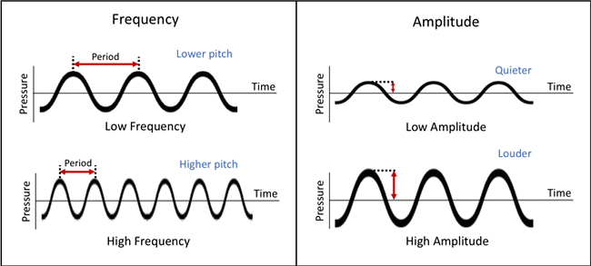
The Science of Soothing: Using Sounds to Find Calm
Here’s a recap to reflect on frequency, amplitude, and wavelength:

Slide 7
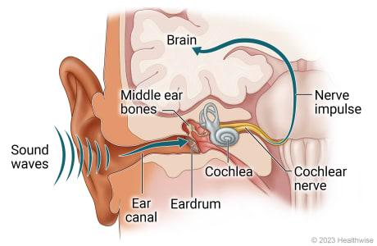
The Science of Soothing: Using Sounds to Find Calm
How do we hear sounds?
Sound waves go into the ear canal and hit the eardrum
The eardrum vibrates and moves tiny bones in the middle ear, which send vibrations to the cochlea
Vibrations move inside the cochlea and create nerve impulses that travel to the brain through the cochlear nerve
The brain interprets these nerve impulses so we can hear sounds!
https://www.columbiadoctors.org/health-library/multimedia/how-sound-waves-reach-brain/
Notes:
https://www.columbiadoctors.org/health-library/multimedia/how-sound-waves-reach-brain/

Slide 8


The Science of Soothing: Using Sounds to Find Calm
Brainstorming
Now you will listen to calming sounds and associate them with relaxation.
Define frequency (pitch), amplitude (volume), and wavelength (distance between waves).
Discuss: What properties of these sounds make them soothing?
Notes:
https://www.youtube.com/watch?v=C-hzP3mOBGY
https://www.youtube.com/watch?v=mxXV7pKD3nk

Slide 9

The Science of Soothing: Using Sounds to Find Calm
Sound Experimentation
Task: Now it’s time for you to use everyday objects (e.g., rubbing fabric, whispering, tapping gently, or playing soft instrumental music) to create different sounds.
Record the sounds using a phone, tablet, or computer.

Slide 10
The Science of Soothing: Using Sounds to Find Calm
Presentation & Reflection
It’s time to play your sounds for the class.
Explain why you chose certain sounds and how they relate to the physics of sound.
As a final reflection, find a soothing sound (song, rain, nature sounds) that you might use for their own relaxation in the future.

Slide 11
The Science of Soothing: Using Sounds to Find Calm
Discussion
How does understanding the science of sound help us care for others?
How do caregivers instinctively use physics to soothe babies?
Could these concepts apply to stress relief in adults?

