Slide 1


Evolution & Eyes
‹#›
SUPPORTED BY:
Notes:
The Stavros Niarchos Brain Insight Lecture
“A Clear Vision: How Animals and Robots See
the Physical World”
By Rudy Behnia, Ph. D. and Shuran Song,
Ph.D.

Slide 2
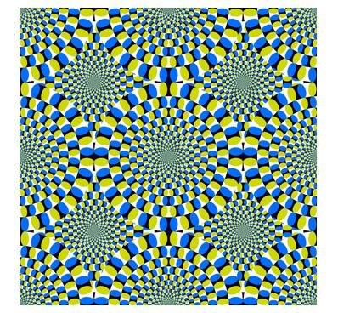

Evolution & Eyes
Warm Up
Are the pinwheels moving in this image?
2. How many colors are present in this image?

Slide 3
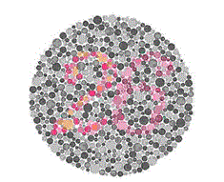

Evolution & Eyes
Warm Up
3. How many black dots are in this image?
4. What number do you see inside the circle?

Slide 4
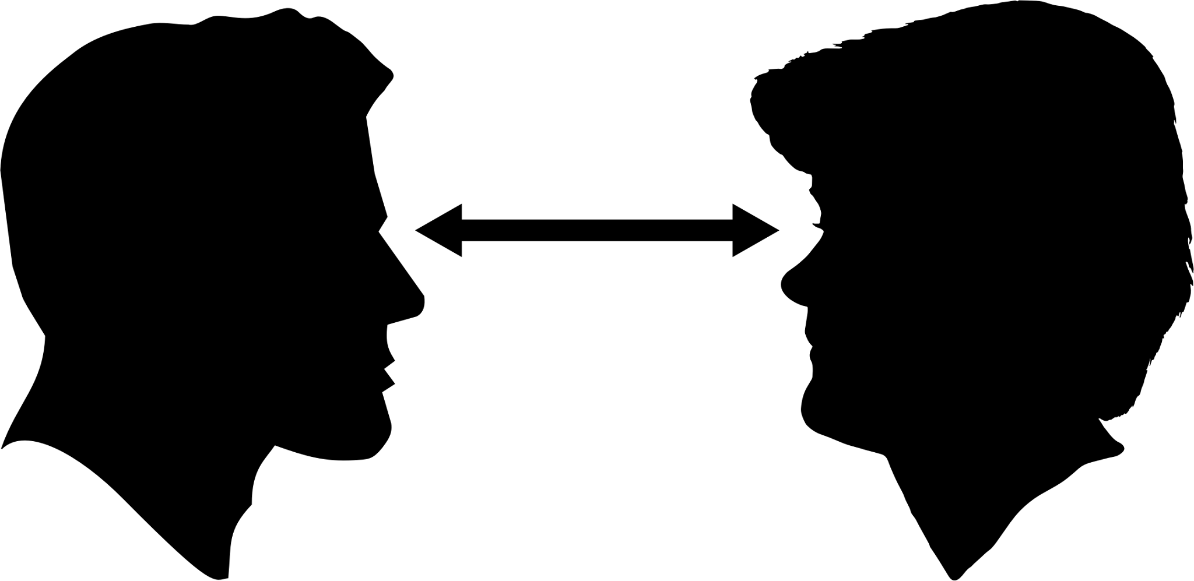

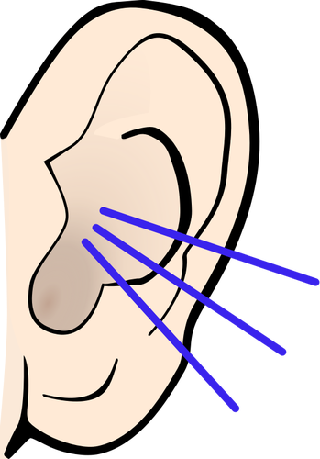
Evolution & Eyes
II. Turn and Talk
Question:
Why do you think each of the images from the warm-up produced an optical illusion?
Hint: Think about the structure and function of our eyes.
Directions:
Turn your whole body to face your partner and make eye contact
One partner shares while the other partner listens
Now the partner who listened first gets to add to the conversation using the accountable talk stems on your desks.
Repeat the first three steps for the time allotted.

Slide 5
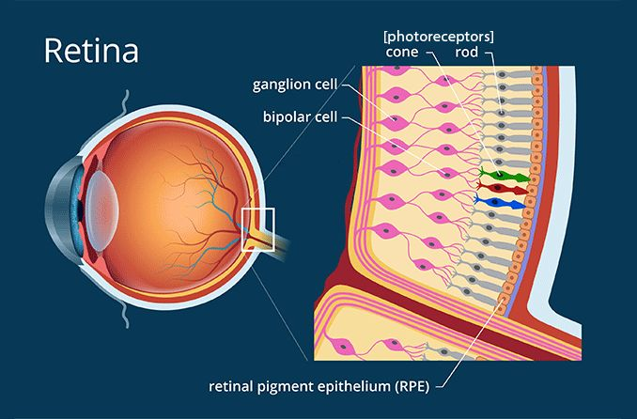
Evolution & Eyes
III. Photoreceptors
The cells in the retina that respond to light. These specialized cells detect light and convert it into signals that are sent to the brain. The human retina contains approximately 132 million photoreceptors.
Anna Barden, Photoreceptors and Their Function in the Eye, image, All About, accessed August 9, 2024, https://www.allaboutvision.com/eye-care/eye-anatomy/photoreceptors/.

Slide 6
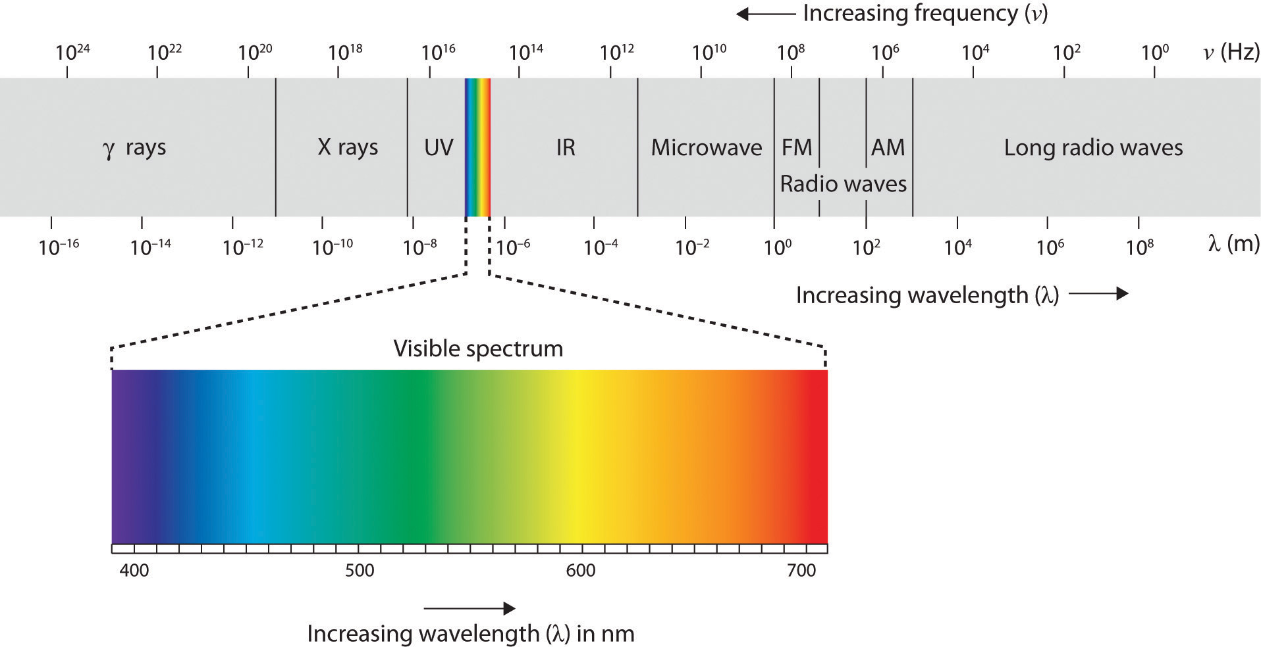
Evolution & Eyes
III. Sensation
Input about the physical world obtained by our sensory receptors. The physiological basis of perception.
For vision, the input is light and the sensory receptors are photoreceptors.
Ireneusz Kubiak, Special Computer Fonts in Electromagnetic Safety of Digital Graphic Standards, image, Research Gate, May 2020, accessed August 9, 2024, https://www.researchgate.net/publica tion/341190106 _Special_computer_fonts_in_electromagnetic_safety_of_digital_graphic_standards_Optical_TEMPEST.

Slide 7
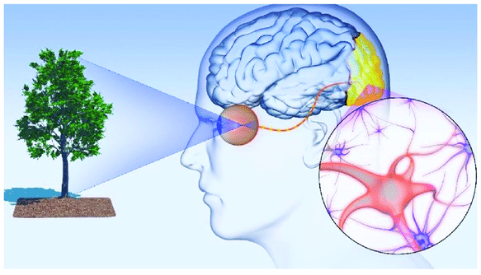
Evolution & Eyes
III. Perception
Perception is the process by which the brain selects, organizes, and interprets sensations. Perception of the same senses may vary from one person to another because each person’s brain interprets sensations differently based on that individual’s learning, memory, emotions, and expectations.
Wei Deng et al., Schematic Illustration of the Human Visual-Perception Process, image, Nature, December 13, 2019, accessed August 9, 2024, https://www.nature.com/articles/s41427-019-0182-2.

Slide 8
Evolution & Eyes
IV. Think, Ink, Link Protocol
Group members each read one paragraph (Paragraph 1, Paragraph 2, Paragraph 3, or Paragraph 4) of the divided text.
Think & Ink: Read and annotate your assigned paragraph. Then, answer the discussion question for your assigned paragraph using specific, relevant, and sufficient evidence from the text.
Link: Discuss your assigned paragraph and response with your classmates. Listen and take notes on your classmates’ assigned paragraphs.

Slide 9
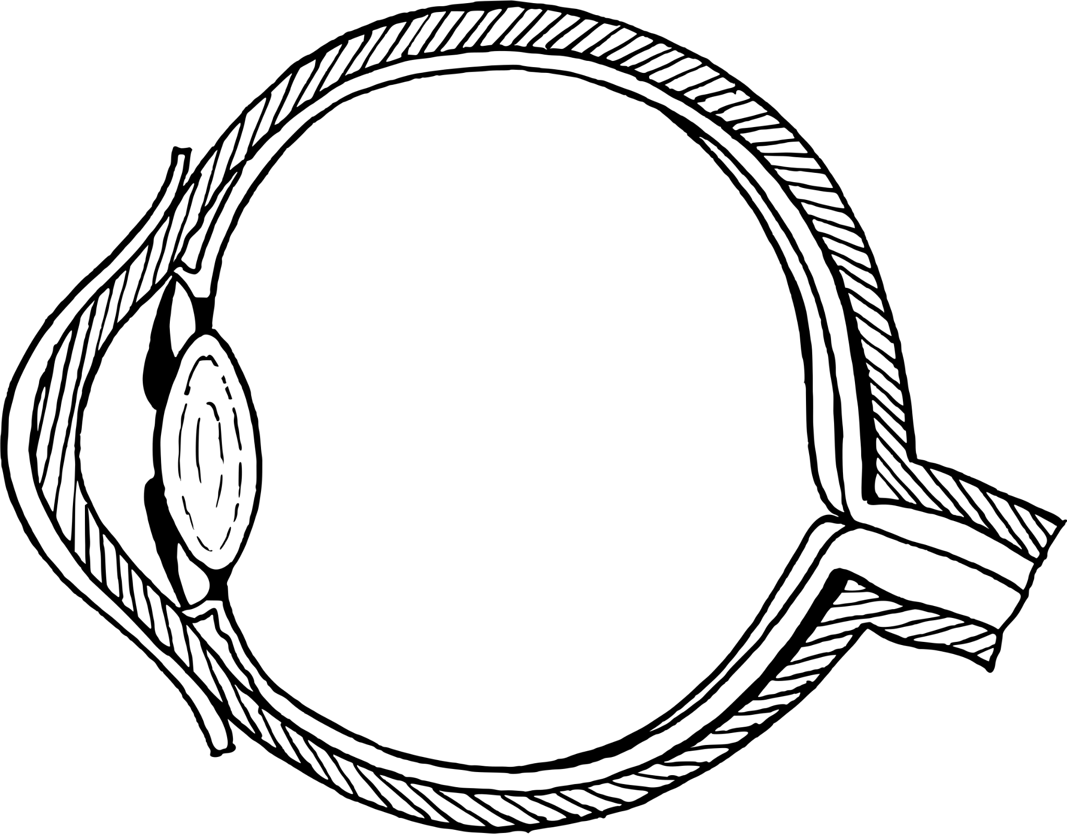
Evolution & Eyes
V. Exit Ticket: Parts of the Human Eye

Slide 10
Evolution & Eyes
Lens: Clear, curved structure in the eye that bends light and focuses it for the retina.
V. Exit Ticket: Parts of the Human Eye
Optic Nerve: Transmits sensory information for vision from the eye to the brain. The brain processes those signals and uses them to construct the picture you see.
Cornea: Clear dome of tissue at the front of the eye that refracts light through the lens.
Retina: Layer of nervous tissue that covers two-thirds of the back of the eyeball. When it is stimulated by light it sends visual-sensory information to the rest of the brain. The retina is an extension of the central nervous system and connected to the brain through the optic nerve.

Slide 11
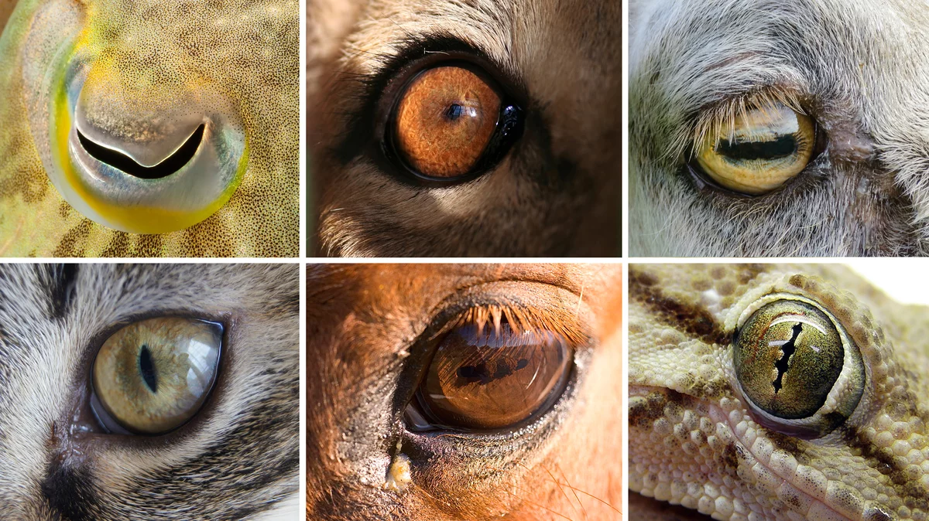
Evolution & Eyes
Warm-Up: which eye belongs to what animal?
Nell Greenfieldboyce, Eye Shapes Of the Animal World Hint at Differences in Our Lifestyles, image, NPR, August 7, 2015, accessed April 17, 2024, https://www.npr.org/ sections/health-shots/2015/08/07/430149677/ eye-shapes-of-the-animal-world-hint-at-differences-in-our-lifestyles.
1. | 2. | 3.
4. | 5. | 6.

Slide 12
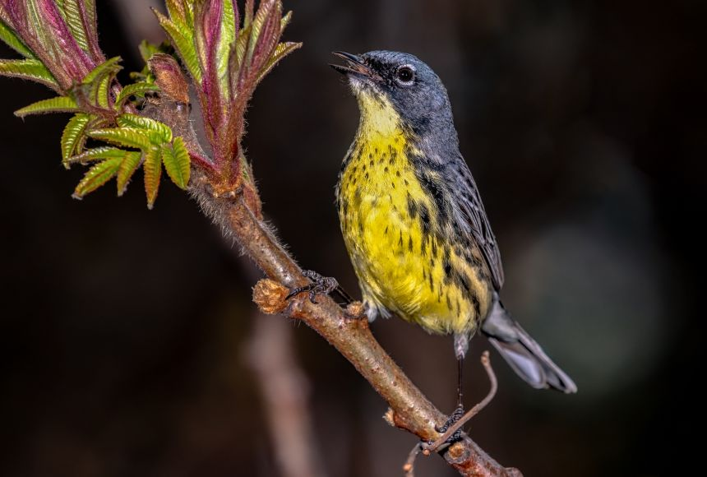
Evolution & Eyes
II. Niche
Describes the role a species plays in its community
Encompasses both the physical and environmental conditions the species requires as well as the interactions the species has with other species.
Jeff Rzepka, Kirtland's Warbler, photograph, National Geographic, accessed April 17, 2024, https://education .nationalgeographic.org/resource/niche/.
Example: Kirtland’s warbler nests only among young North American jack pine trees that require periodic wildfires for their seeds to germinate (physical and environmental conditions). The Kirtland’s warbler has a parasitic relationship with the brown-headed cowbird. The brown-headed cowbird lays its eggs in the Kirtland’s warbler’s nest, so the Kirtland’s warbler raises the brown-headed cowbird’s offspring, often to the detriment of the Kirtland’s warbler’s own offspring (interactions with other species).

Slide 13
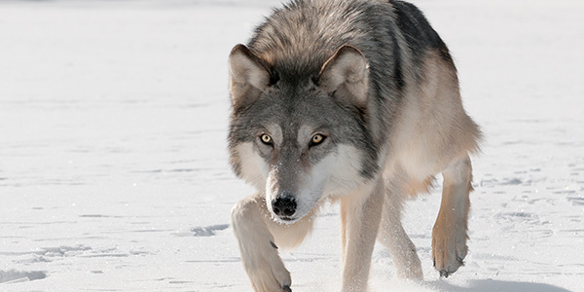
Evolution & Eyes
II. Predator
A biological interaction where one animal, the predator, kills and eats another animal, its prey.
Predators are either carnivores (only eat other animals) or omnivores (eat both plants and other animals).
Gray Wolf, photograph, accessed August 9, 2024, https://www.nwf.org/Educational-Resources/Wildlife-Guide/Mammals/Gray-Wolf.
Example: Wolves are considered apex predators because they occupy the top of the food chain and are not hunted or eaten by other species within the food chain. They play a vital role in the health of their ecosystems by controlling prey populations.

Slide 14
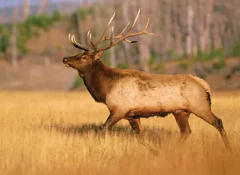
Evolution & Eyes
II. Prey
An animal that is hunted or killed by another animal for food.
Prey can be carnivores (only eat other animals), omnivores (eat both plants and other animals), or herbivores (eat only plants).
A Male American Elk (Cervus Elaphus Canadensis) in Yellowstone National Park, Wyoming, U.S., June 23, 2024, photograph, accessed August 9, 2024, https://www.britannica.com/animal/elk-mammal.
Example: Elk are preyed upon by at least 15 different species, including wolves, bears, mountain lions, coyotes, and bobcats. While healthy adult elk are less likely to be targeted, calves and sick or injured elk are more vulnerable.

Slide 15
Evolution & Eyes
III. Jigsaw Activity
Begin the activity in your lettered group (A, B, C, or D). Each person needs to read their text silently and independently and respond to the text’s corresponding questions.
In your lettered groups, discuss your responses with your group members to deepen your understanding or reconsider your position.
Transition to your numbered groups (1, 2, 3, 4, 5, 6, 7, or 8). Discuss each text with your group members to learn about how the structure and function of each organisms’ eyes are adapted to their niche within their ecosystem.
Answer the questions for each organism’s text based on your discussion with your group members.

Slide 16
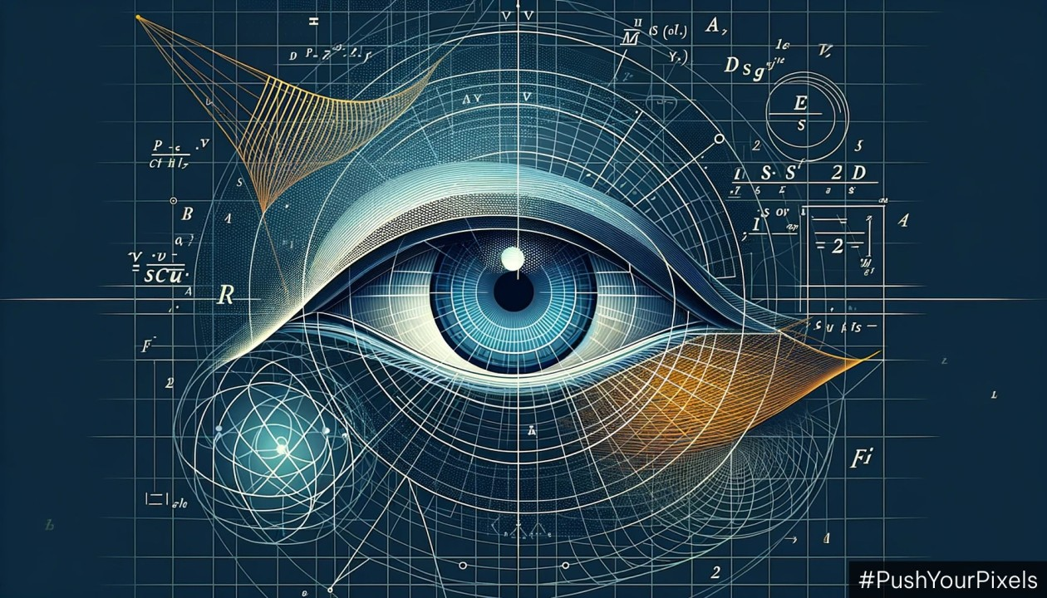
Evolution & Eyes
IV. Create Your Own Eye!
Using what you have learned in yesterday’s lesson and today’s lesson, independently design your own eyeball for an organism of your creation to fit their environment.
Dino Vidakovic, Is eyeballing still viable in modern UX design?, image, PushYourPixels.com, October 26, 2023, accessed August 9, 2024, https://pushyourpixels.com/articles/is-eyeballing-still-viable-in-modern-ux-design.

Slide 17
Evolution & Eyes
V. Exit Ticket: Regents Question
Independently answer the Regents-based multiple-choice questions on your worksheet and justify your answer using evidence from yesterday’s lesson and today’s lesson in the space provided.

