Slide 1


Exploring Epigenetics through Art
‹#›
SUPPORTED BY:
Notes:
Based on Stavros Niarchos Foundation Brain Insight Lecture:

Slide 2
Structure and Function of the Placenta during Fetal Development
Exploring Epigenetics through Art

Slide 3
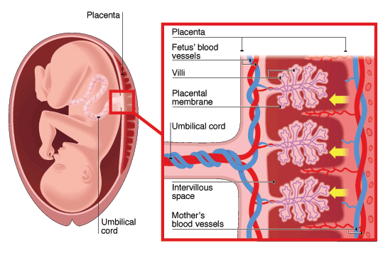
Exploring Epigenetics through Art
Warm Up
Observe the diagram below. Write 3 observations, 3 conclusions, and 3 questions you have about the diagram.
See | Think | Wonder
Exchange of Materials between Foetal and Maternal Blood. Image. BioNinja. Accessed March 11, 2024. https://old-ib. bioninja. com.au/higher-level/topic-11-animal-physiology/114- sexual-reproduction/placenta.html.

Slide 4
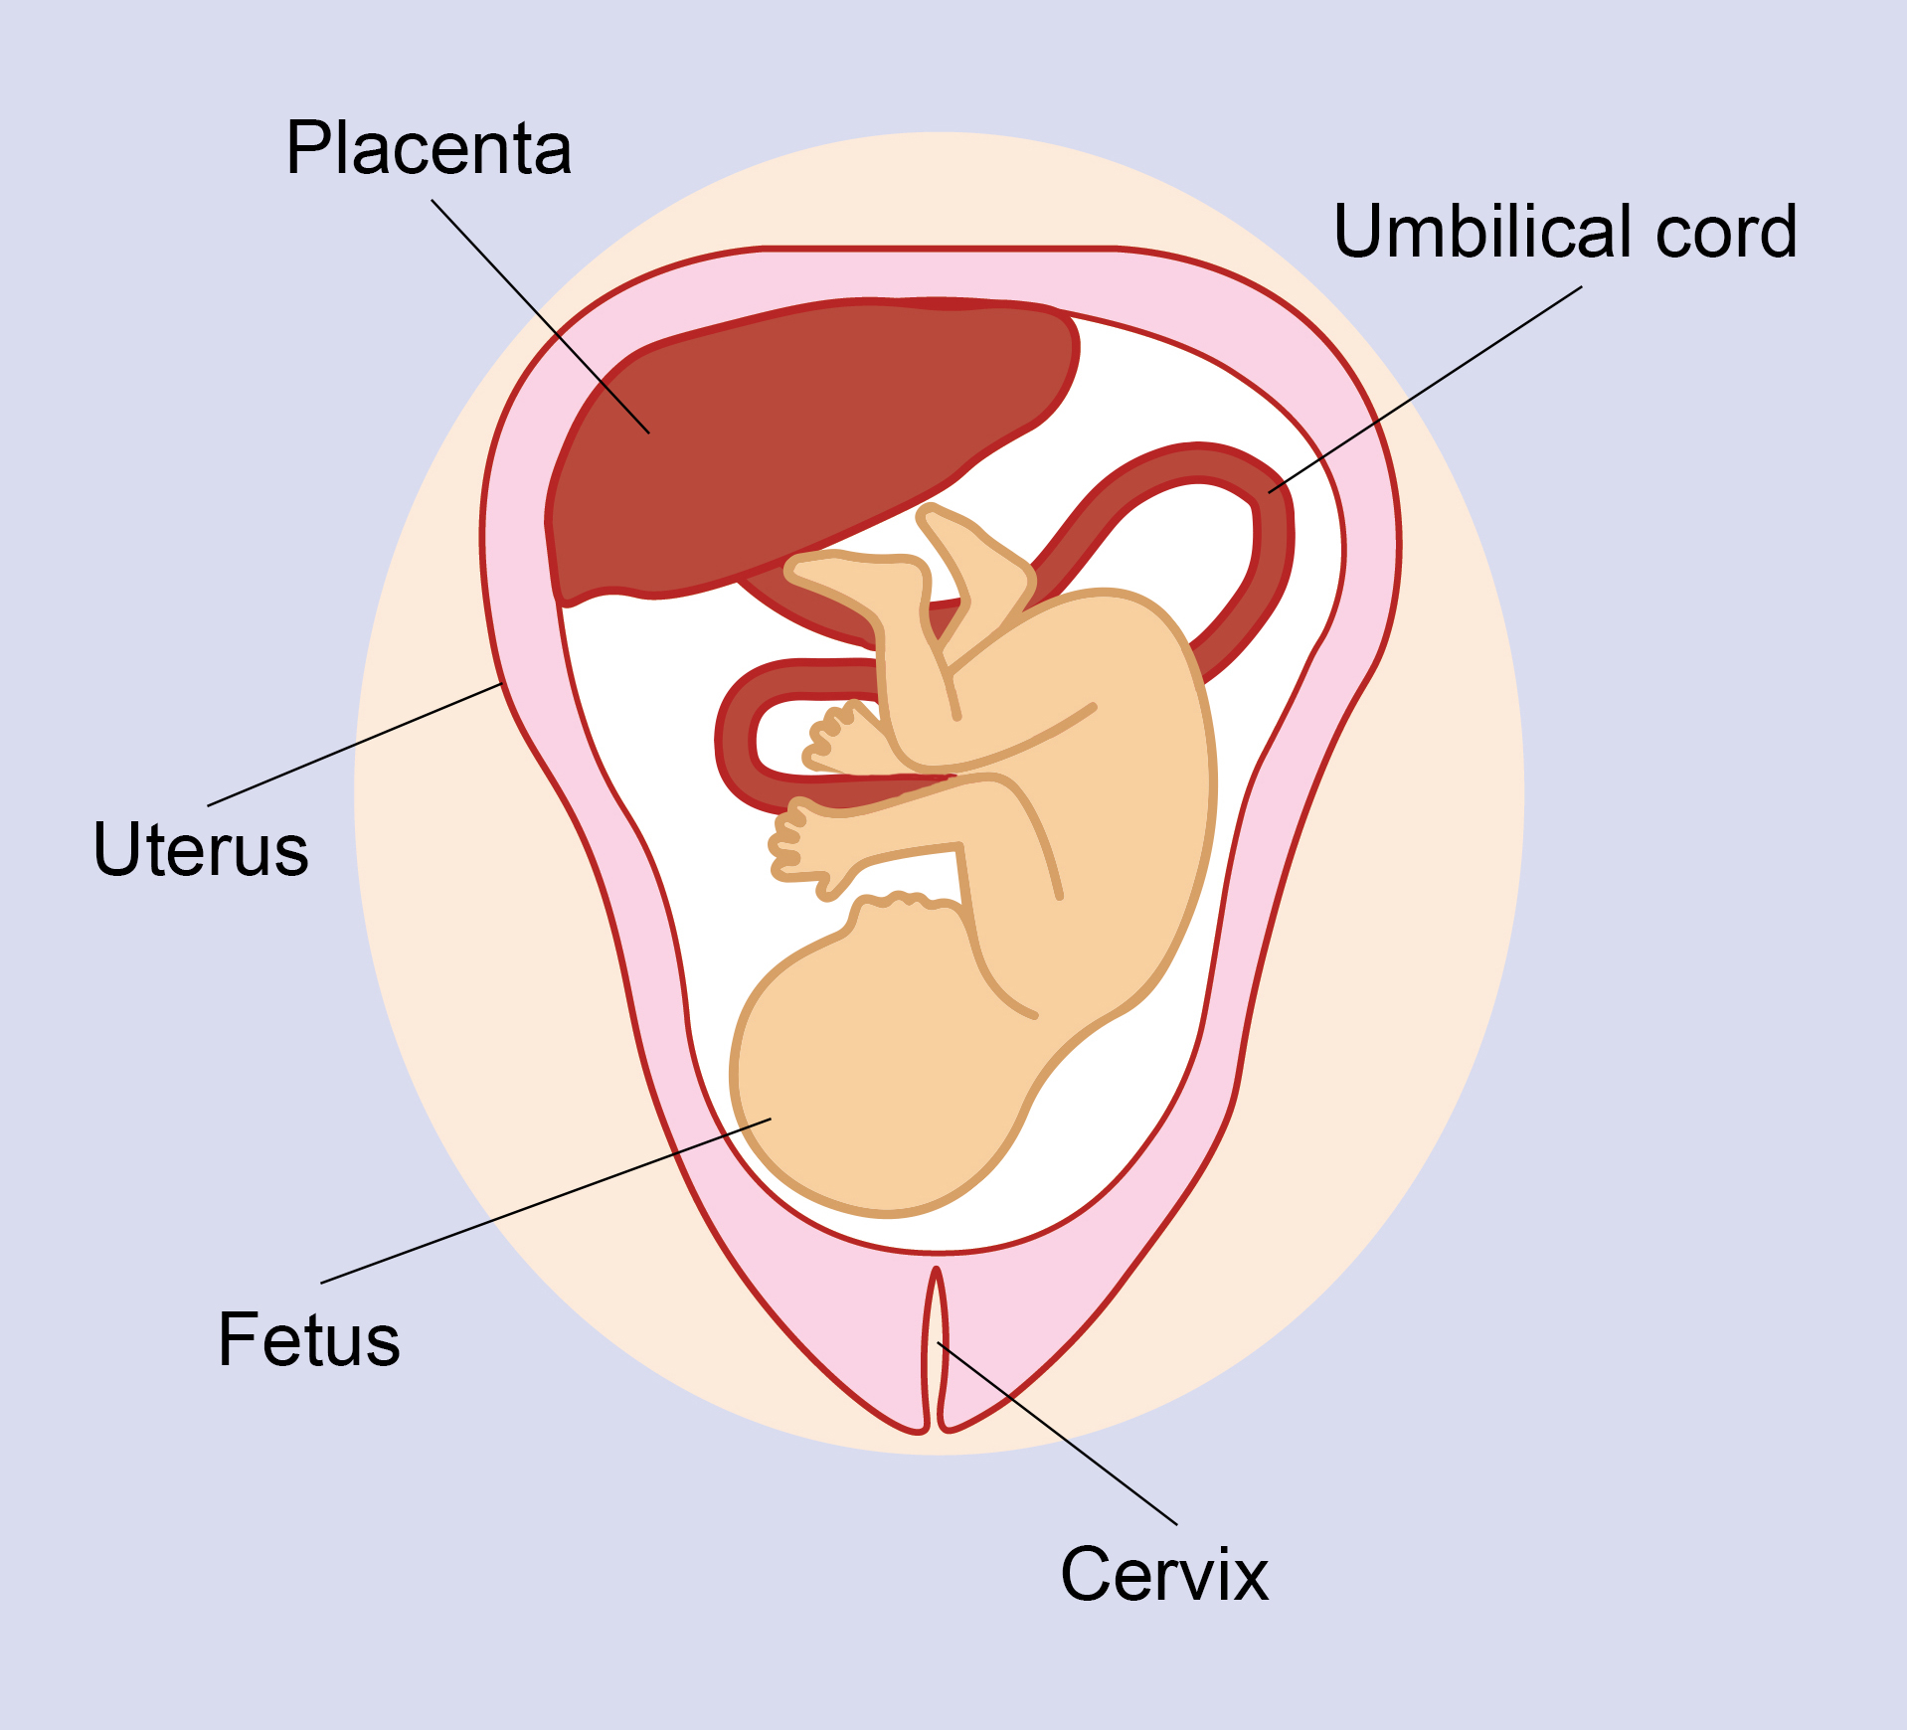
Exploring Epigenetics through Art
Placenta
A temporary organ that forms in the uterus during pregnancy. It attaches to the uterine wall and connects to the fetus through the umbilical cord.
Provides oxygen and nutrients to the fetus and removes waste products produced by the fetus.
Illustration of Normal Placental Location during Pregnancy. Image. Pregnancy Birth & Baby. July 2022. https://www.preg nancybirthbaby.org.au/about-the-placenta.

Slide 5
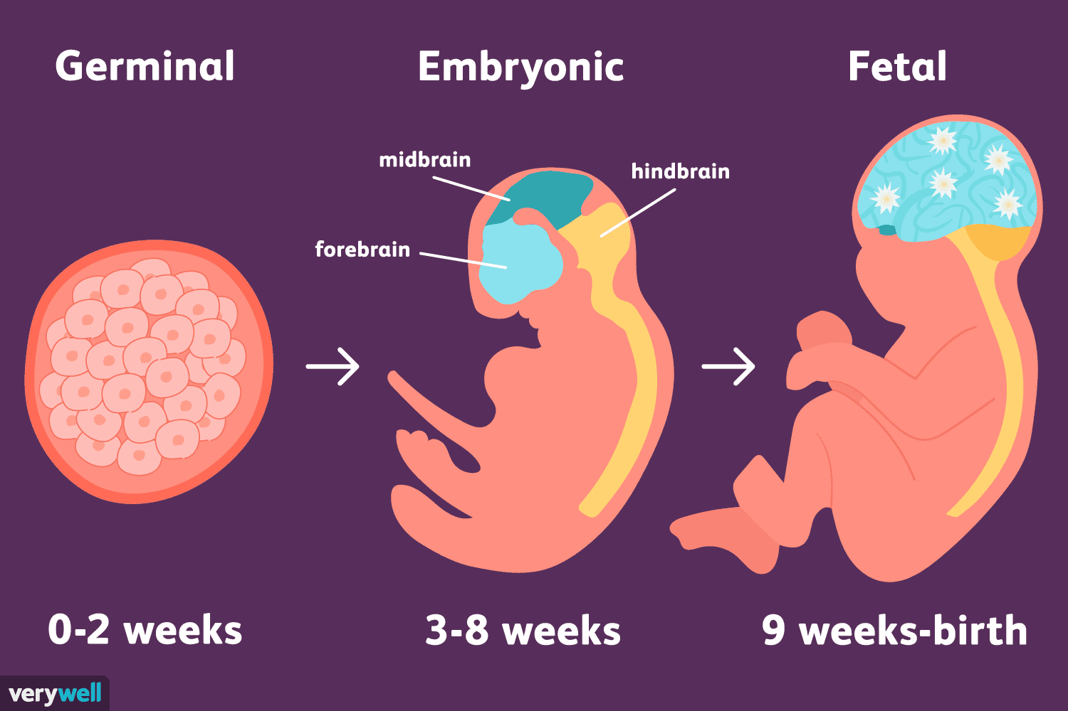
Exploring Epigenetics through Art
Fetus
Offspring of a human or other mammal in the stages of prenatal development that follow the embryo stage (in humans taken as beginning eight weeks after conception).
Stages of Prenatal Development. Image. Biology Online. October 3, 2023. https://www.biologyonline.com/dictionary/fetus.

Slide 6
Exploring Epigenetics through Art
Part I. Think, Ink, Link Protocol
Group members each read one paragraph (Paragraph 1, Paragraph 2, Paragraph 3, or Paragraph 4) of the divided text.
Think & Ink: Read and annotate your assigned paragraph. Then, answer the discussion question for your assigned paragraph using specific, relevant, and sufficient evidence from the text.
Link: Discuss your assigned paragraph and response with your classmates. Listen and take notes on your classmates’ assigned paragraphs.

Slide 7
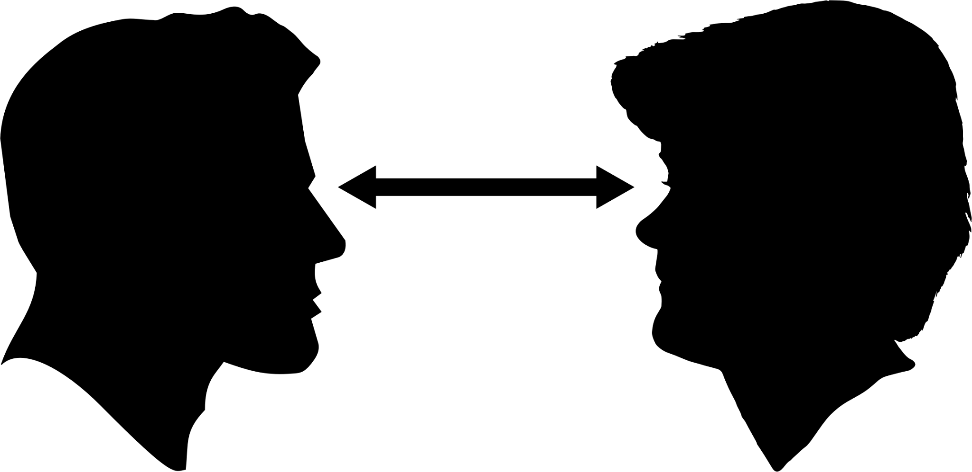

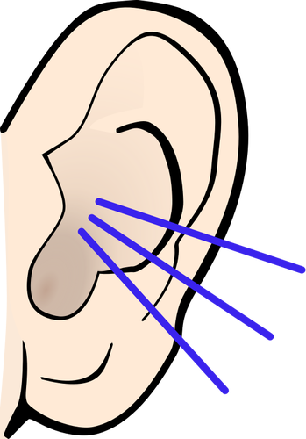
Exploring Epigenetics through Art
Part II. Turn and Talk
Turn your whole body to face your partner and make eye contact
One partner shares while the other partner listens
Now the partner who listened first gets to add to the conversation using the accountable talk stems on your desks.
Repeat the first three steps for the time allotted.

Slide 8
Exploring Epigenetics through Art
Part III. Exit Ticket
Independently complete the Regents-based short-response questions below using evidence from today’s lesson to support your answer.

Slide 9
Exploring Epigenetics through Art
Epigenetics as Art:
The Effects of Stress and Cannabis Use During Pregnancy on Children’s Neurological Development

Slide 10
Exploring Epigenetics through Art
Warm-Up
Describe the relationship between the pregnant parent, the placenta, and the fetus.
______________________________________________________________________________________________________________________________________________________________________________________________________________.
Explain biological processes are involved in the relationship between the pregnant parent, the placenta, and the fetus.
______________________________________________________________________________________________________________________________________________________________________________________________________________.

Slide 11
Exploring Epigenetics through Art
Gene Expression
The process by which information in a gene is turned into a function.
Mostly occurs via translation of RNA molecules into proteins, which determine our physical traits and characteristics.
Example: The Sox9 gene in European pond turtles is expressed or repressed, depending on the temperature their exposed to as an egg. If the temperature is 25℃, all of the turtles will be born male. If the temperature is 30℃, all the turtles will be born female. Temperatures in between will result in both male and female turtles being born.

Slide 12
Exploring Epigenetics through Art
Epigenetics
The study of how your behaviors and the environment can cause changes in gene expression.
Unlike genetic changes, epigenetic changes do not change your gene sequence, but they can change how your body reads your gene sequence.
Epigenetic changes are thought to be reversible.
Example: AHRR gene is responsible for lung function. In smokers, this gene becomes underactivated from the toxins in cigarette smoke, which causes lower lung function in smokers. After quitting smoking, the AHRR gene in former smokers begins functioning, and therefore expressing, normally again.

Slide 13
Exploring Epigenetics through Art
Part I. Background Information Activity
In your groups…
Make observations about the similarities and differences in the neurodevelopment of children based on their exposure to stress and/or cannabis in utero.
Draw conclusions about why these similarities and differences may exist and how different experiences in utero affect neurodevelopment.

Slide 14
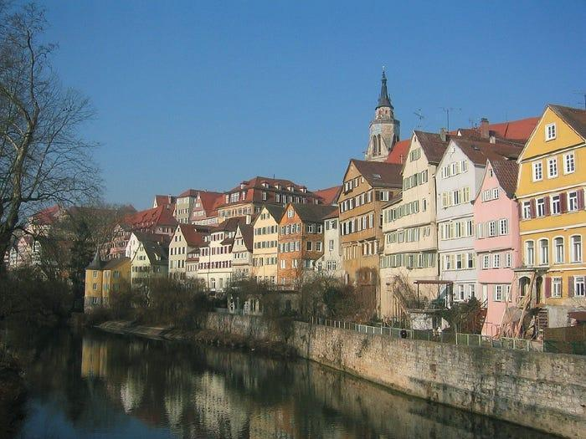
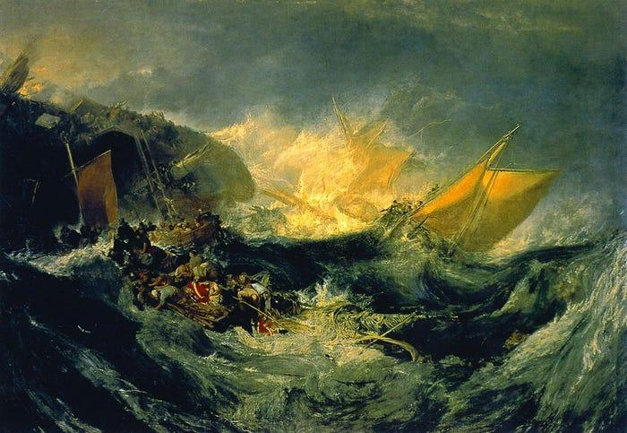
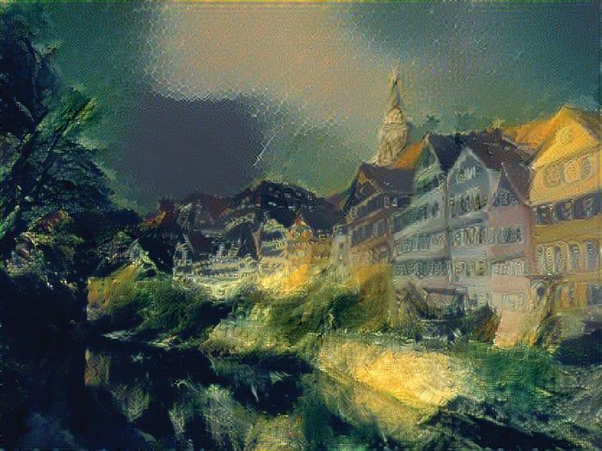
Exploring Epigenetics through Art
Part II. Visual Representation of Stress and Cannabis Use on Gene Expression
Content: the meaning
Our perceptions, thoughts, memories, and actions: a lifelong weave of mental representations. How our minds interpret information based on our previous experiences.
Form: the structure
The dynamic patterned activity across billions of neurons in our brains. The structure of our brains and how our minds gather information.
Gatys, Leon A., Matthias Bettge, and Alexander S. Ecker. "A Neural Algorithm of Artistic Style." Journal of Vision, 2015. https://doi.org/10. 1167/16.12.326.
Turner, Joseph Mallord William. The Shipwreck of the Minotaur. 1805. Oil on canvas. Tate Collective, London, United Kingdom.
Gatys, Leon A., Matthias Bettge, and Alexander S. Ecker. "A Neural Algorithm of Artistic Style." Journal of Vision, 2015. https://doi.org/10. 1167/16.12.326.
Notes:
Pictures found on the lecture slides about form and content by Nikolaus Kriegeskorte

Slide 15
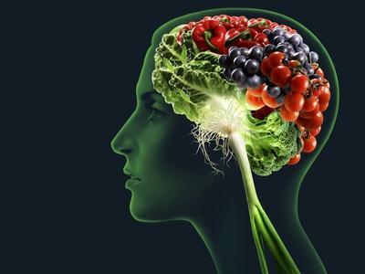
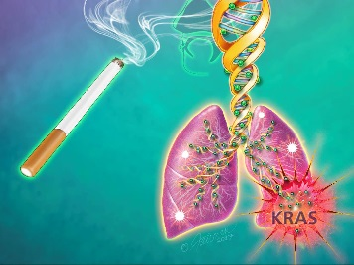
Exploring Epigenetics through Art
Science as Art
What forms are used in this artwork?
What content is being conveyed to the viewer?
What forms are used in this artwork?
What content is being conveyed to the viewer?
SMETEK. Brain Food, Conceptual Image. Image. Art.com. https://www.art .com/products/p22203522637-sa-i7788746/smetek-brain-food-conceptual-image.htm?upi=PZKLX80&PODConfigID=14258388&sOrigID=792113.
Fairman, Jennifer. An Illustration of How Cigarette Smoke Triggers Epigenetic Changes in Airway Cells. Image. Johns Hopkins Medicine. September 11, 2017. https://www.hopkinsmedicine.org/ news/media/releases/epigenetic_changes_from_cigarette_smoke_may_be_first_step_in_lung_cancer_development.

Slide 16
Exploring Epigenetics through Art
Part II. Visual Representation of Stress and Cannabis Use on Gene Expression
In your groups…
Brainstorm what form you will use to illustrate how your given experience during pregnancy affects the neurodevelopment of the fetus.
  Questions to Ask Yourself: What shapes or images do I want to use? What colors? Why?
Brainstorm what content you are wanting the viewer to understand after looking at your artwork.
  Questions to Ask Yourself: What key information do I want the viewer to understand from looking at my artwork? What conclusions might I want my viewer to draw from looking at my artwork?
Create your artwork!

Slide 17
Exploring Epigenetics through Art
Part III. Extended Writing
In your groups…
In a paragraph length response, explain how your art piece represents how stress and cannabis use during pregnancy impacts neurodevelopment.
Make sure to explain how certain colors, imagery, and elements represent changes in genetic expression, including children’s behaviors as they grow and develop.

Slide 18
Exploring Epigenetics through Art
IV. Reflection
Individually…
Reflect on how art can be used to convey information about complex scientific content.

