Slide 1


Implicit Bias and Racism
‹#›
SUPPORTED BY:
Notes:
Based on Stavros Niarchos Foundation Brain Insight Lecture: Changing Behavior to Fight Racism and Bias -Dr. Courtney D. Cogburn
The humanitarian crisis of racism & white toxicity - Dr. Dana E. Crawford

Slide 2
Essential Question:
How can we use questions to create awareness of implicit bias?
Implicit Bias and Racism

Slide 3


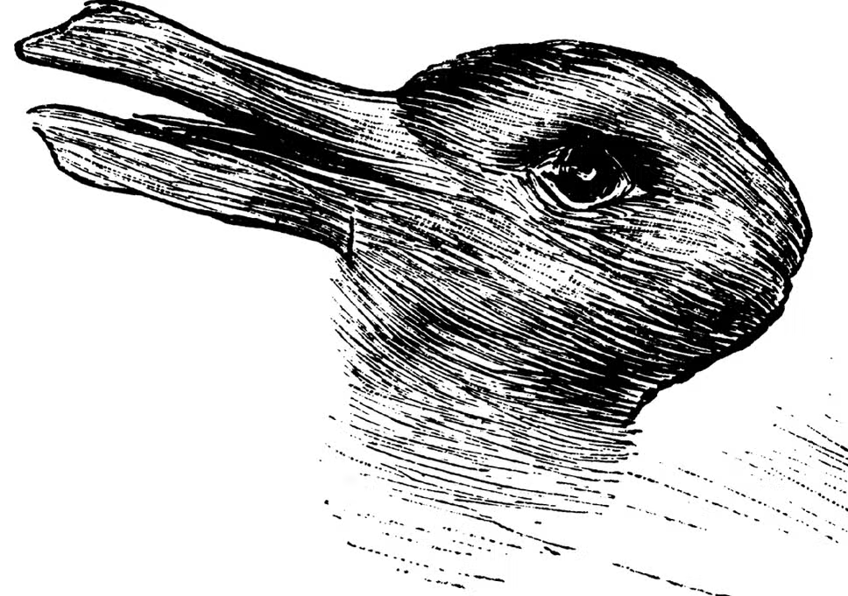
Implicit Bias and Racism
Warm-up: What do you see?
Image #1
Image #2
Image #3
Notes:
Goal is to have students recognize that what we initially see can vary from person to person.

Slide 4
Implicit Bias and Racism
“when we have attitudes towards people or associate stereotypes without our conscious knowledge.”
Source: https://perception.org/research/implicit-bias/
What is implicit bias?

Slide 5
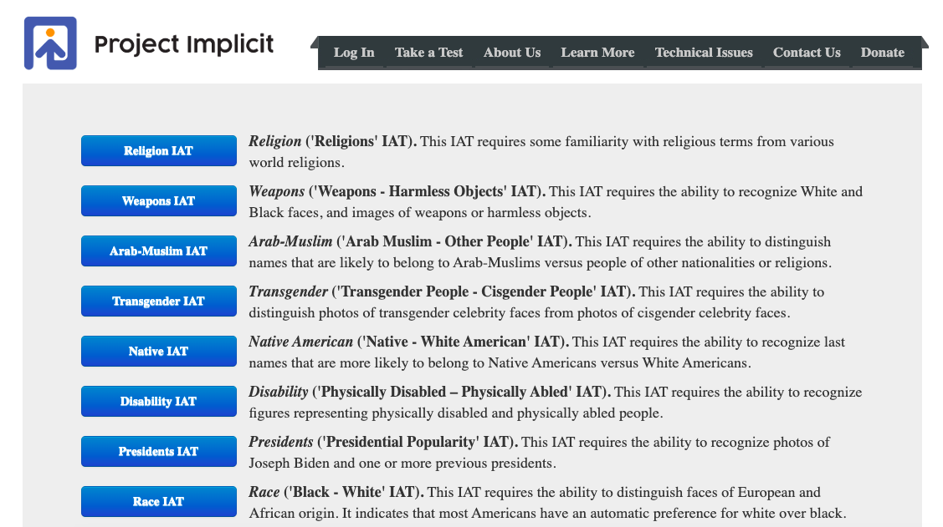
Implicit Bias Test (IAT)
Implicit Bias and Racism
https://implicit.harvard.edu/implicit/selectatest.html
Race IAT

Slide 6
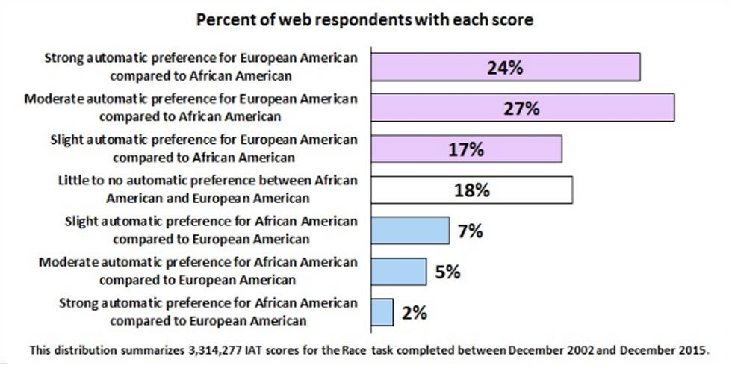
Implicit Bias and Racism
Example of IAT responses (macrodata)
Notes:
Source: https://www.bbc.com/news/magazine-40124781

Slide 7
Implicit Bias and Racism
Question Formulation Technique (QFT)
RULES
Ask as many questions as you can.
Do not stop to discuss, judge, or answer the questions.
Write down every question exactly as it is stated.
Change any statement into a question.
Source: The Question Formulation Technique (QFT) was created by the Right Question Institute (rightquestion.org)
Notes:
Give instructions to think about the rules and let students discuss one of the following:
What might be difficult about following the rules for producing questions?
Which rule might be most difficult to follow?

Slide 8
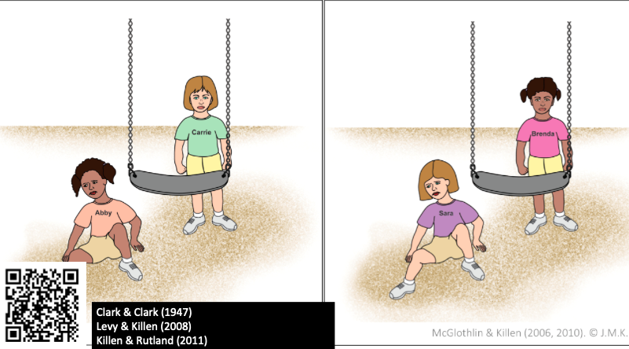
Implicit Bias and Racism
QFocus

Slide 9
Implicit Bias and Racism
Step 1: Generate Questions
Follow the rules
Make a list of questions using the QFocus as the focus for questions
Number each question (1, 2, 3, etc.)

Slide 10
Implicit Bias and Racism
Step 2: Categorize
Categorize questions as closed-ended or open-ended.
Mark closed-ended questions and mark them with a “C.”
Mark open-ended questions and mark them with an “O.”
Closed-ended questions can be answered with yes, no, or with one word.
Open-ended questions require an explanation and cannot be answered with yes, no, or with one word.
Notes:
Discuss the value of each type of question. Identify advantages and disadvantages of closed-ended questions. Identify advantages and disadvantages of open-ended questions.

Slide 11
Implicit Bias and Racism
Step 3: Change from CLOSED to OPEN
Categorize questions as closed-ended or open-ended.
Mark closed-ended questions and mark them with a “C.”
Mark open-ended questions and mark them with an “O.”
Closed-ended questions can be answered with yes, no, or with one word.
Open-ended questions require an explanation and cannot be answered with yes, no, or with one word.

Slide 12
Implicit Bias and Racism
Step 4: Prioritize Questions
Choose three questions that …
You consider most important
Will help with research
Can be used for an experiment
Will guide your reading/writing
Can be answered as you read
Will help you solve a problem
Notes:
Participants should discuss and share why they selected their priority questions and where their priority questions fell in the sequence of their question list. For example, a group may decide to prioritize questions 6, 14, 27 on their list. Prioritization instructions should bring participants back to the central objective. This step helps participants think convergently. For students, prioritization instructions bring them back to teaching objectives and the plan for using student-generated questions. You can prioritize as many questions as you want. In our example, we’ve chosen to prioritize three questions.

Slide 13
Implicit Bias and Racism
Step 5 (Optional): Reflect or Apply
Reflect:
What did you learn?
How can you use what you learned?
Apply:
How could these questions help us investigate our own implicit bias?

Slide 14
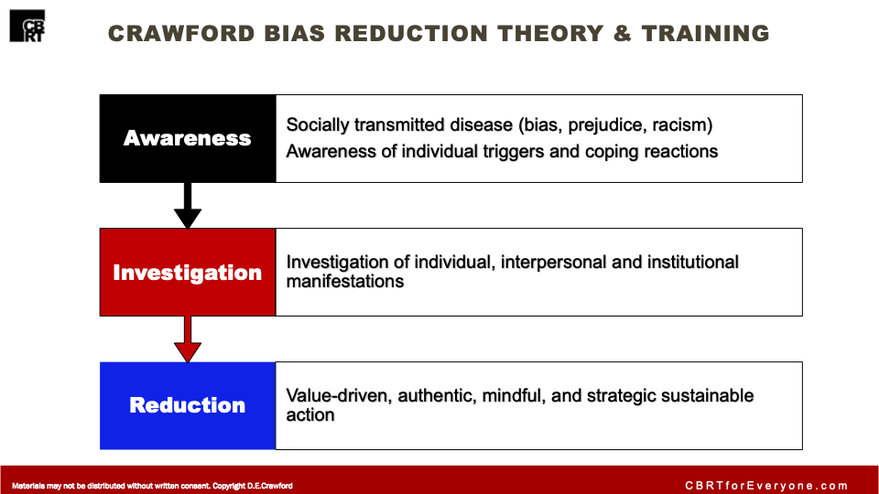
Implicit Bias and Racism
Notes:
This lesson focuses on step 1: AWARENESS in the AIR bias reduction theory

Slide 15
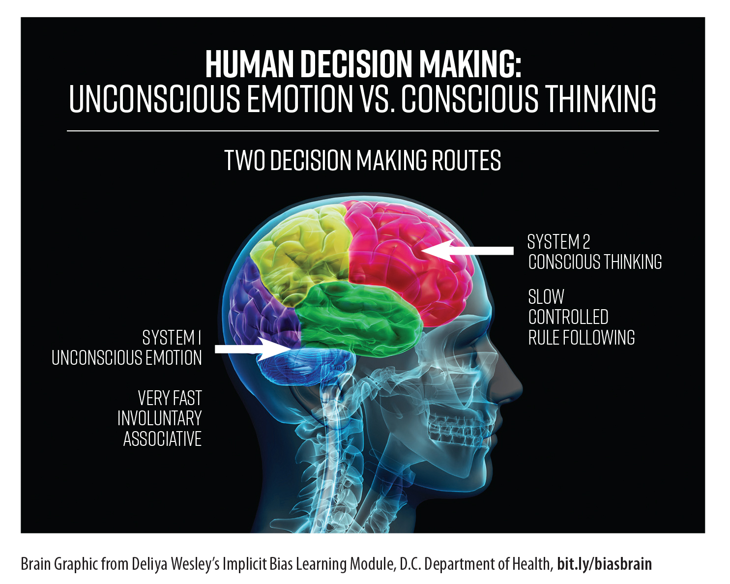
Implicit Bias and Racism
Notes:
Explain to students the idea of thinking fast and slow and how implicit bias shows up in system 1 our unconscious system with fast, involuntary associative parts of the brain. In this lesson the goal is to bring those associations to awareness in system 2 our conscious thinking system.

Slide 16
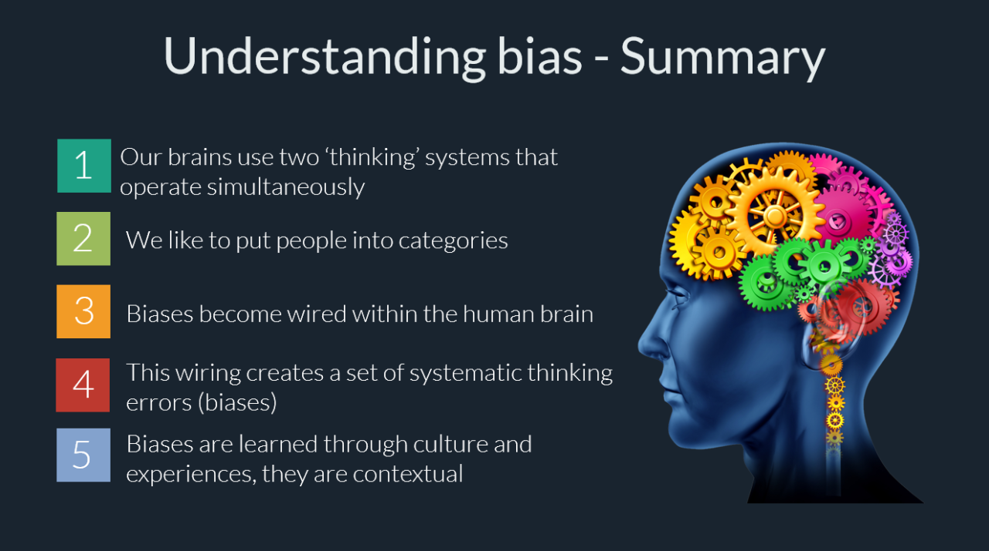
Implicit Bias and Racism
Notes:
Source: https://www.linkedin.com/pulse/unconscious-bias-ebin-john-poovathany/

Slide 17
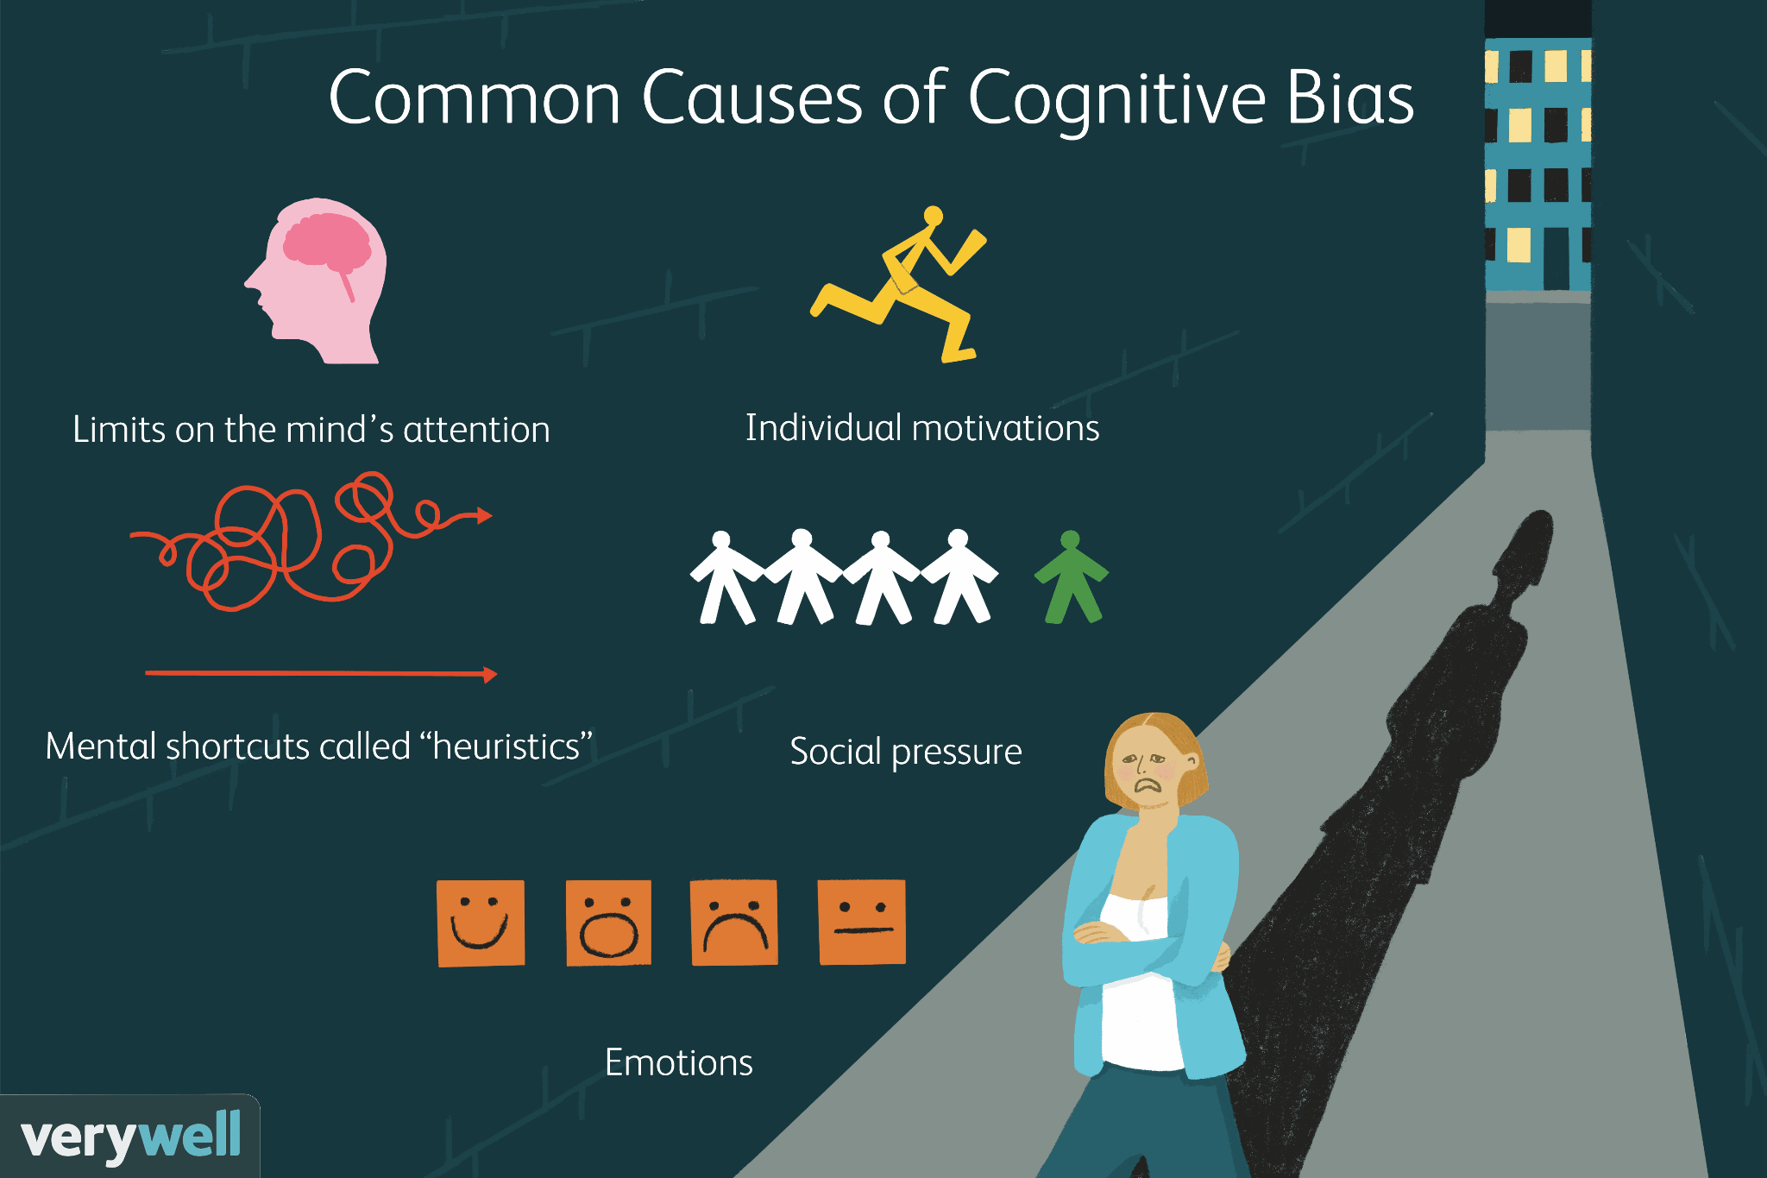
Implicit Bias and Racism
Notes:
Source: https://www.verywellmind.com/what-is-a-cognitive-bias-2794963

Slide 18
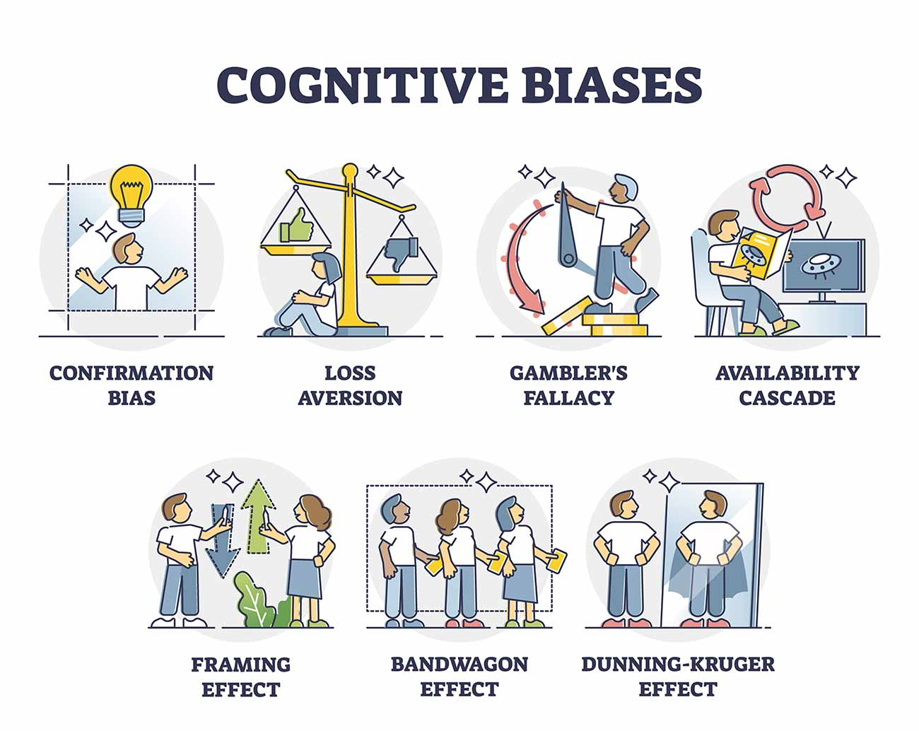
Implicit Bias and Racism
Notes:
Source: https://www.simplypsychology.org/cognitive-bias.html

Slide 19
Implicit Bias and Racism
Closing
What did you learn today?
How does implicit bias work in the brain?
How could the questions you generated help people investigate their own implicit bias?
How could we investigate this more deeply?

Slide 20
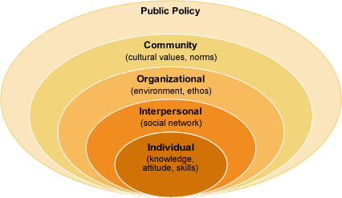
Implicit Bias and Racism
Addressing Implicit Bias
Make goals for individual, interpersonal, and institutional levels and share one goal with partner.

Slide 21
Implicit Bias and Racism
Extension: Develop an Investigation!
How could we use the questions we generated today to make our own investigations on implicit bias?

