Slide 1
Sleep As A Social Justice Issue
1
SUPPORTED BY:
Notes:
Based on: The Stavros Niarchos Brain Insight Lecture, “Sleep Health in the USA: Why Sleep is a Social Justice Issue.” by Dr. Carmela Alcantara
https://youtu.be/i-bYwMIvwXk?t=442

Slide 2
Sleep as a Social Justice Issue: Social Justice is the idea that all people should have equal rights and opportunities.
Sleep As A Social Justice Issue

Slide 3
Sleep As A Social Justice Issue
Sleep Survey Questions
How many hours did you sleep last night?
How many hours do you normally sleep on a weekday night?
How many hours do you normally sleep on a weekend night?
Do you think you get enough sleep?
What are some variables that affect the quality of your sleep?

Slide 4
Sleep As A Social Justice Issue

Slide 5
Sleep As A Social Justice Issue
Why do you think sleep is important?

Slide 6
Sleep As A Social Justice Issue

Slide 7
Sleep As A Social Justice Issue
Using the I² Method to Analyze Graphs and Figures

Slide 8
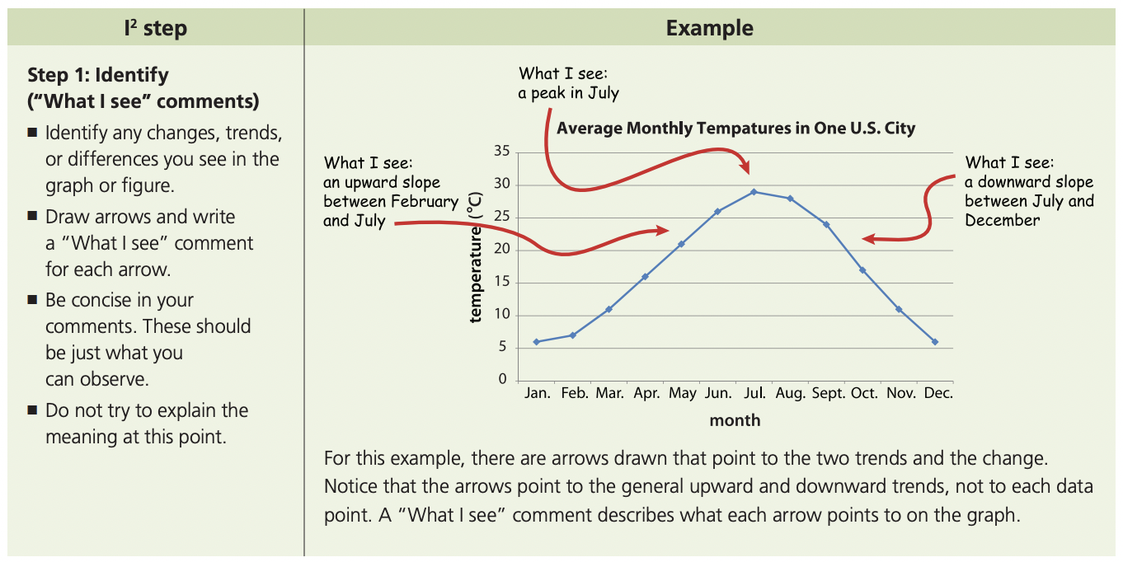
Sleep As A Social Justice Issue
© 2012 BSCS, elearn.bscs.org

Slide 9
Sleep As A Social Justice Issue
Step 1: “What I See”

Slide 10
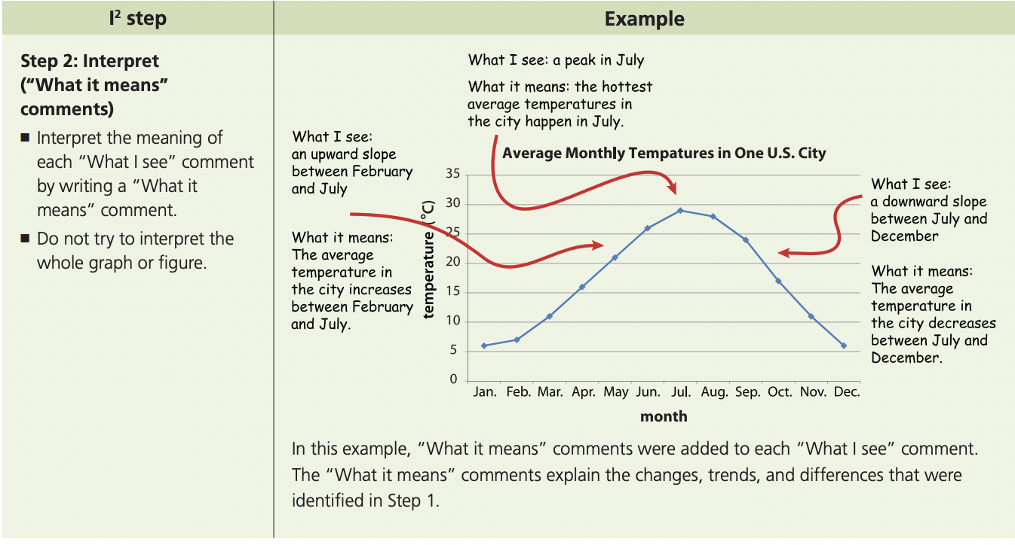
Sleep As A Social Justice Issue
© 2012 BSCS, elearn.bscs.org

Slide 11
Sleep As A Social Justice Issue
Step 2: “What it Means”

Slide 12
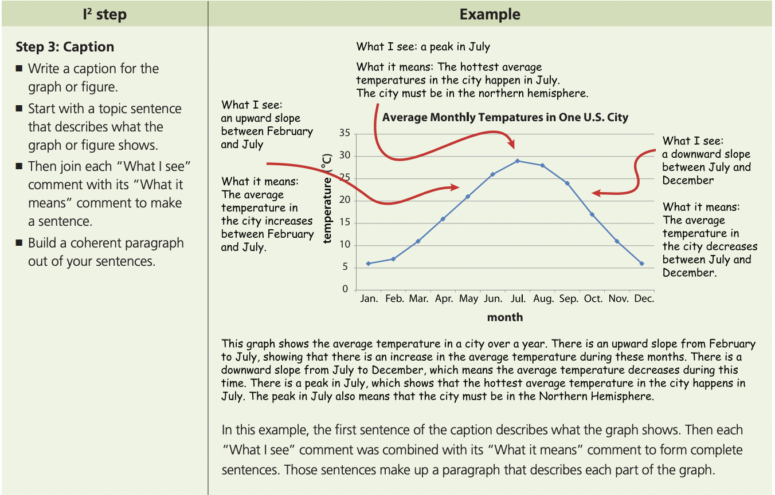
Sleep As A Social Justice Issue
© 2012 BSCS, elearn.bscs.org

Slide 13
Sleep As A Social Justice Issue
Step 3: Caption

Slide 14
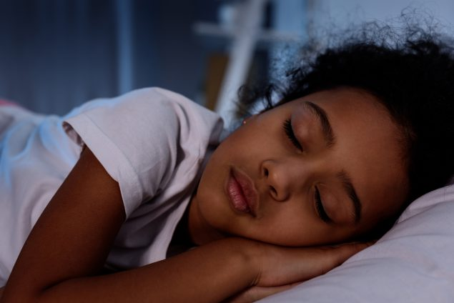
Sleep As A Social Justice Issue
Based on the graph we just analyzed and the results of the survey, are we getting enough sleep?

Slide 15
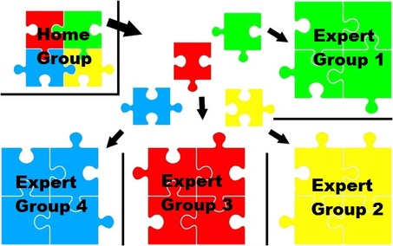
Sleep As A Social Justice Issue
Jigsaw Activity: Sleep Data
Each EXPERT GROUP will be responsible for analyzing a graph
In each TEACHING GROUP, students will share what they learned in the EXPERT GROUP.
Finally, we will synthesize (put together) what we learned from each group in a Turn and Talk and Class Discussion.

Slide 16
Expert Group (15 minutes)
Sleep As A Social Justice Issue
Use the I² Method to Analyze your Graph
What I See
What it Means
Caption
Answer any Additional Questions
Be sure everyone in your group is ready to share the following when they move to the TEACHING GROUP
Most important “What I See”
Most important “What it Means”
Your Caption
Additional questions and answers

Slide 17
Sleep As A Social Justice Issue
Helpful Vocabulary for Expert Groups
MACE (Major Adverse Cardiac Event): Bad health problems related to the heart. Examples include Heart Attack, Stroke, and Death
Ethnic Discrimination: Unfair treatment due to one’s membership in an ethnic group
Acculturation Stress: Mental and emotional stress of adapting to a new culture
Insomnia: Persistent (long-lasting) problems falling asleep and staying asleep
Problem-Solving: Ability to define problem and come up with solutions
Peer Support: Giving and receiving assistance from friends, classmates, etc.
Survival Probability: The percent chance that someone will survive
Chronic Stress: Stress that lasts for a long period of time
“Sleepless”: Less than seven hours of sleep for adults
Social Justice: The idea that opportunities such as education, employment, and health care should be equally accessible to all people in a society

Slide 18
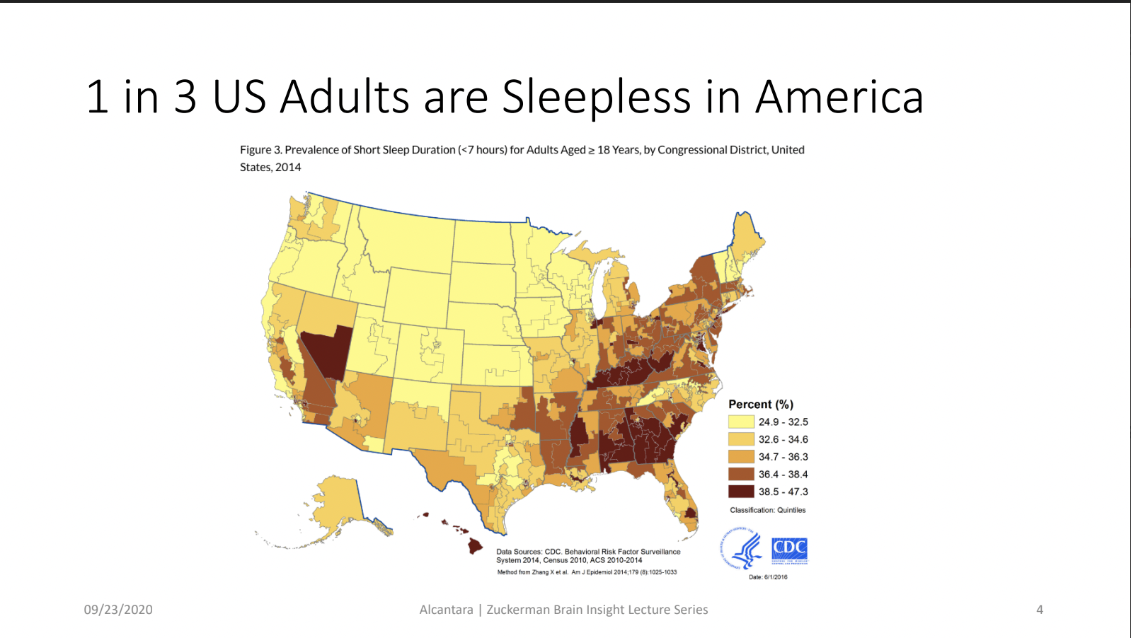
Sleep As A Social Justice Issue
Group #1

Slide 19
Sleep As A Social Justice Issue
Group #2

Slide 20
Sleep As A Social Justice Issue
Group #3

Slide 21
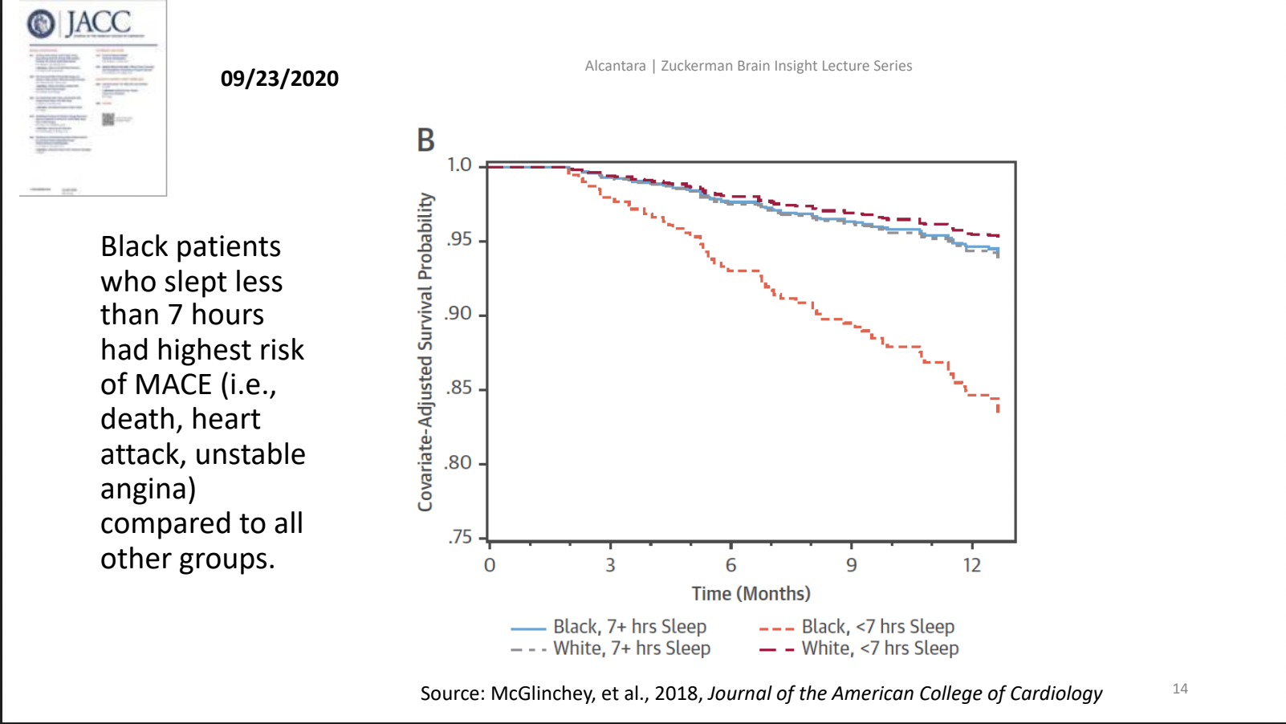
Sleep As A Social Justice Issue
Group #4

Slide 22
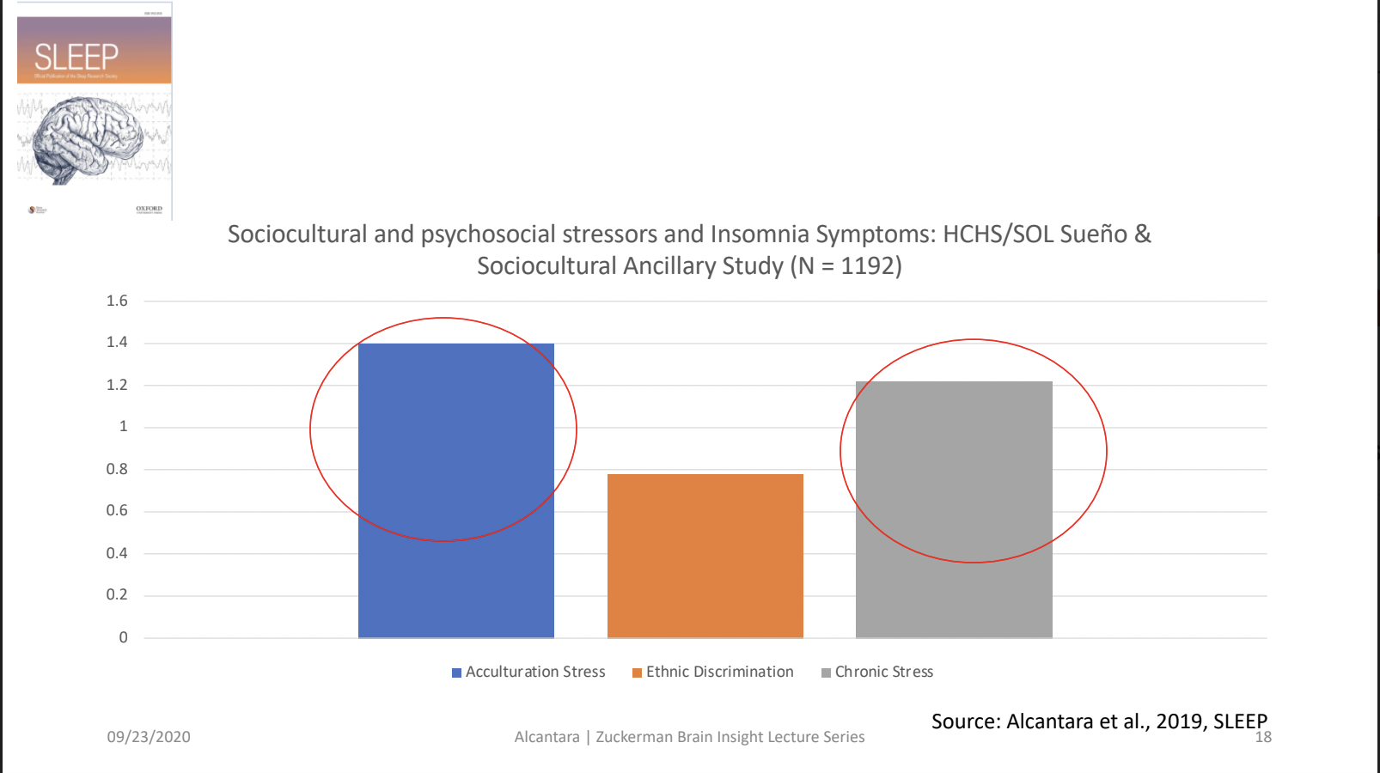
Sleep As A Social Justice Issue
Group #5

Slide 23
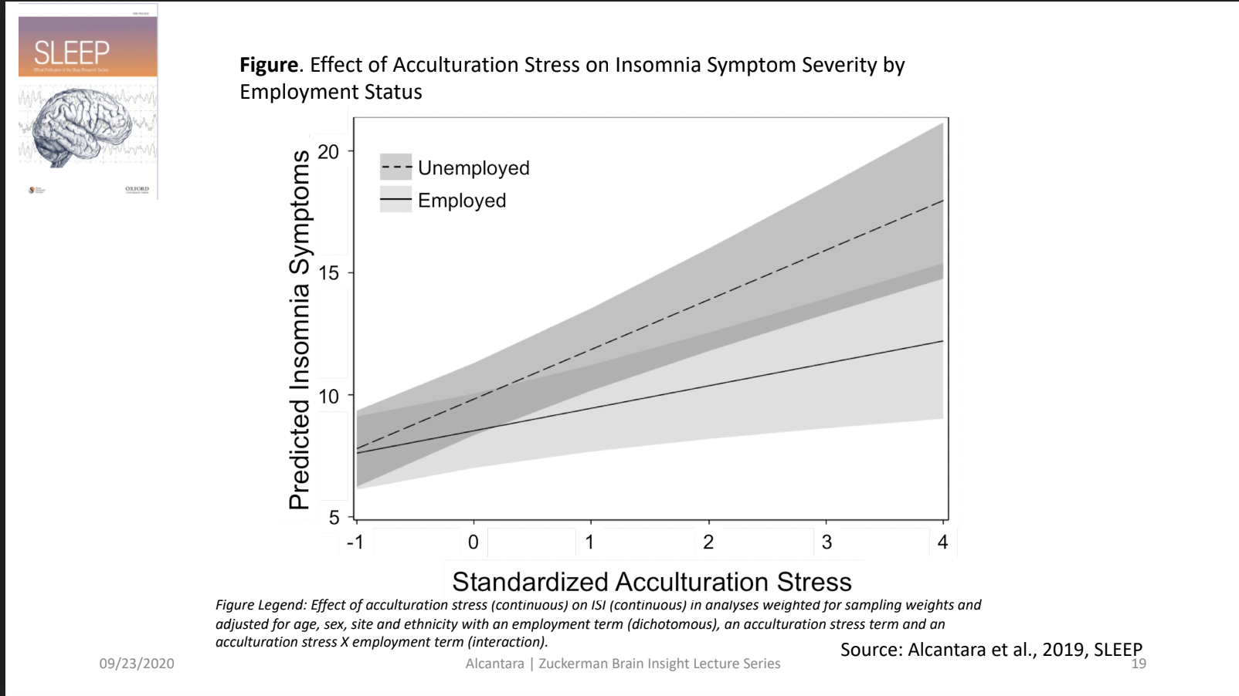
Sleep As A Social Justice Issue
Group #6

Slide 24
Sleep As A Social Justice Issue
Group #7

Slide 25
Sleep As A Social Justice Issue
Teaching Group (10 minutes)
Each student should share the following with the group while showing the graph to the group.
What was your most important “What I See”?
What was your most important “What it Means”?
What was the “Caption” that your group wrote?
What were the Additional Questions and Answers.

Slide 26
Sleep As A Social Justice Issue
Synthesis (putting together): Turn/Talk and Class Discussion
Why is sleep important?
Do you get enough sleep?
Does everyone get enough sleep?
What factors contribute to someone not getting enough sleep?
What are the benefits of a good night’s sleep?
What are the risks of not getting enough sleep?
Closing question: What makes sleep a social justice issue?

