Slide 1
Performance Anxiety
and Coping Mechanisms
1
SUPPORTED BY:
Notes:
Based on: The Stavros Niarchos Brain Insight Lecture, “Performing Our Best When the Pressure Is On.” By Sian Beilock, PhD
Research referenced: https://www.pnas.org/content/116/5/1553

Slide 2
Teacher Notes
Materials: PowerPoint, Projector, Chart Paper, markers, celebrity scenarios printed and cut up
Classroom set-up: Since you will be doing a structured socratic seminar you may want to make sure your classroom is set-up for students to sit in a circle, or a way for students to transition from group setting to a circle setting to have a better whole class conversation
Delete or hide this slide after reading.

Slide 3
Essential Question
How can anxiety or stress be beneficial?

Slide 4
Lesson Agenda
Warm-Up (10 min)
Part 1: Define Anxiety (5-10 min)
Part 2: Thinking more about Anxiety (15-20 min)
Part 3: Background Knowledge (15-20 min)
Part 4: Class Discussion (20-30 min)
Closing (10 min)

Slide 5
Warm-Up
Read your Celebrity Scenario
Identify the different symptoms of anxiety
Think about how you would define “anxiety”
*Be prepared to share out with the class

Slide 6
Part 1: Define Anxiety
As a group come up with one definition of “Anxiety” and write it on your chart paper.
*Be prepared to share your groups definition!
Notes:
*Might want to have students leave some space for some additional definitions to add to their chart

Slide 7
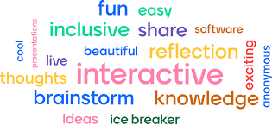
Part 2: Thinking more about Anxiety
Let’s create a word cloud!
Join [Mentimeter/ Poll Everywhere]
What are some of the symptoms of anxiety?

Slide 8
Part 2: Thinking more about Anxiety
Come up with definitions for:
“coping mechanism”
“emotional regulation”
“rejection sensitivity”
“arousal reappraisal”
What kinds of words do you personally use (or have heard) to describe anxiety?
What kinds of words do scientists use?
Back to your chart paper!

Slide 9
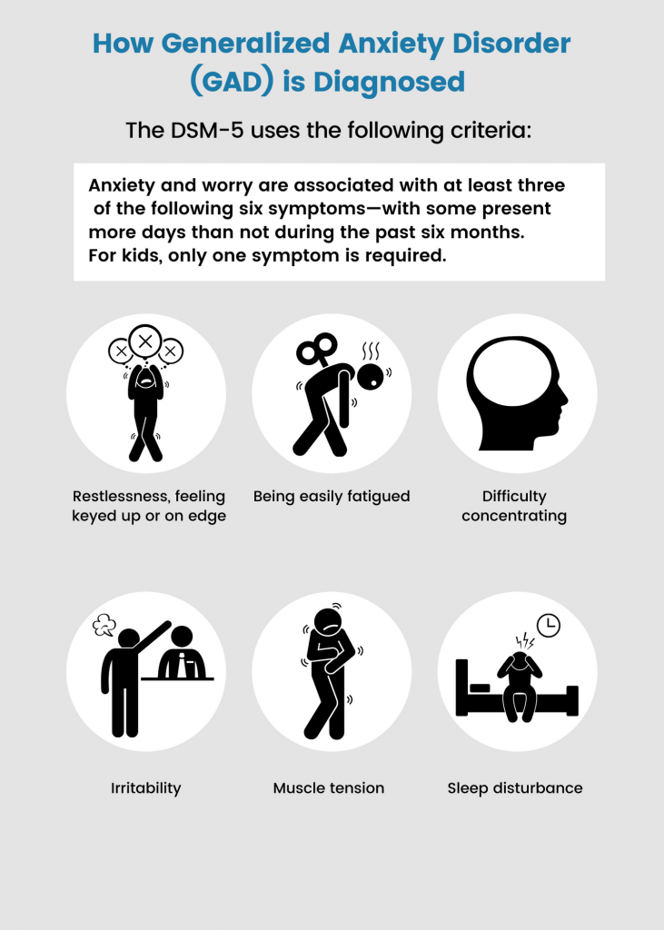
Part 3: Background Knowledge
According to the DSM, the definition of Anxiety:
Excessive anxiety and worry (apprehensive expectation), occurring more days than not for at least 6 months, about a number of events or activities (such as work or school performance).
The anxiety and worry are associated with three or more of the following six symptoms (with at least some symptoms present for more days than not for the past 6 months).
Restlessness or feeling keyed up or on edge
Being easily fatigued
Difficulty concentrating or mind going blank
Irritability
Muscle tension
Sleep disturbance (difficulty falling or staying asleep, or restless unsatisfying sleep)
Notes:
Source: https://www.ncbi.nlm.nih.gov/books/NBK519704/table/ch3.t15/
Source: https://www.psycom.net/anxiety

Slide 10
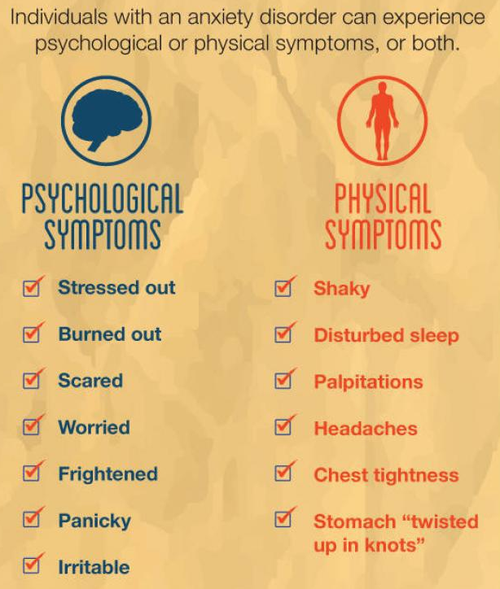
Part 3: Background Knowledge
Physical symptoms of Anxiety
heart rate
breathing rate
fight or flight
discomfort in stomach
sweaty palms
feeling hot
flushed face
tightness in chest
Notes:
Source: https://www.psycom.net/anxiety

Slide 11
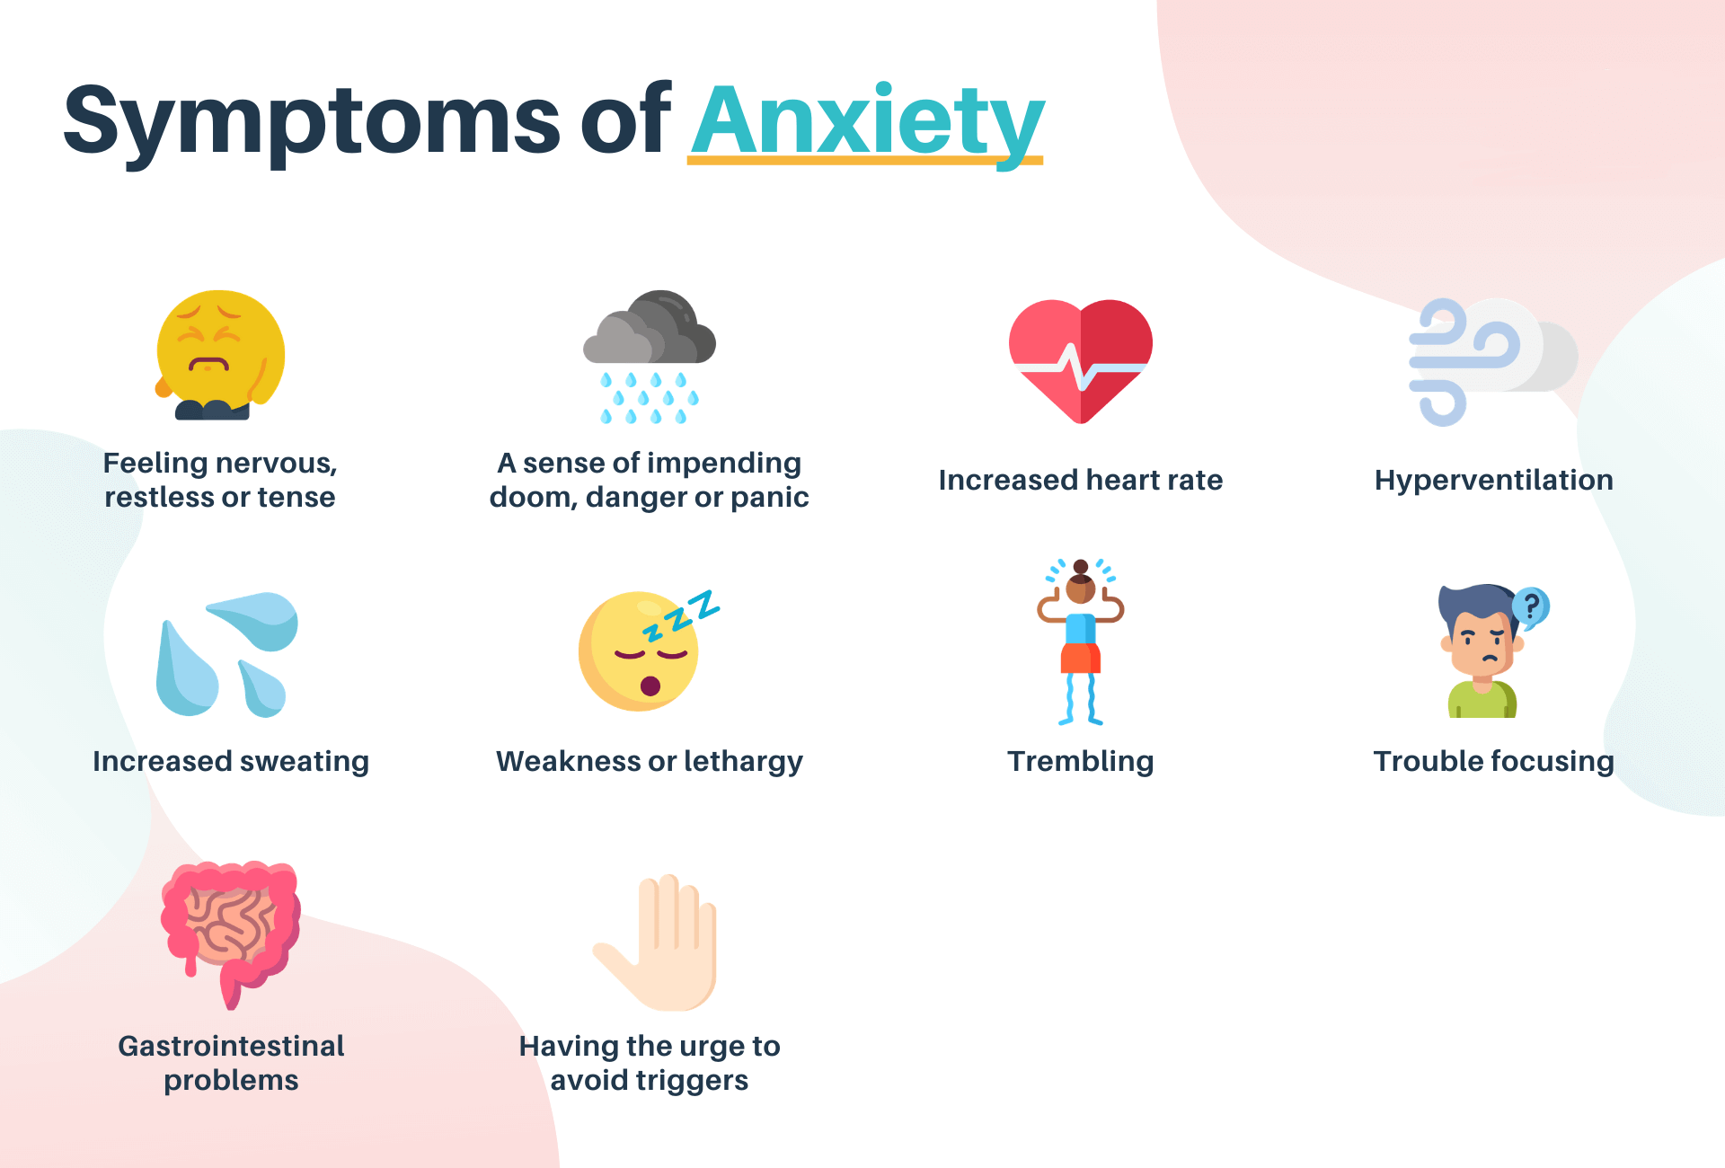
Notes:
Source: https://www.calmsage.com/depression-vs-anxiety/
Alternative image: Source: https://www.verywellmind.com/dsm-5-criteria-for-generalized-anxiety-disorder-1393147

Slide 12
Brain-Insight Lecture Connection (4 min)
Notes:
Note: This is best used for advanced students
Connect to physical symptoms of anxiety
Scientists used fMRI (functional magnetic resonance imagery) to study anxiety around having to solve math problems
Time stamps: 21:40-25:55

Slide 13
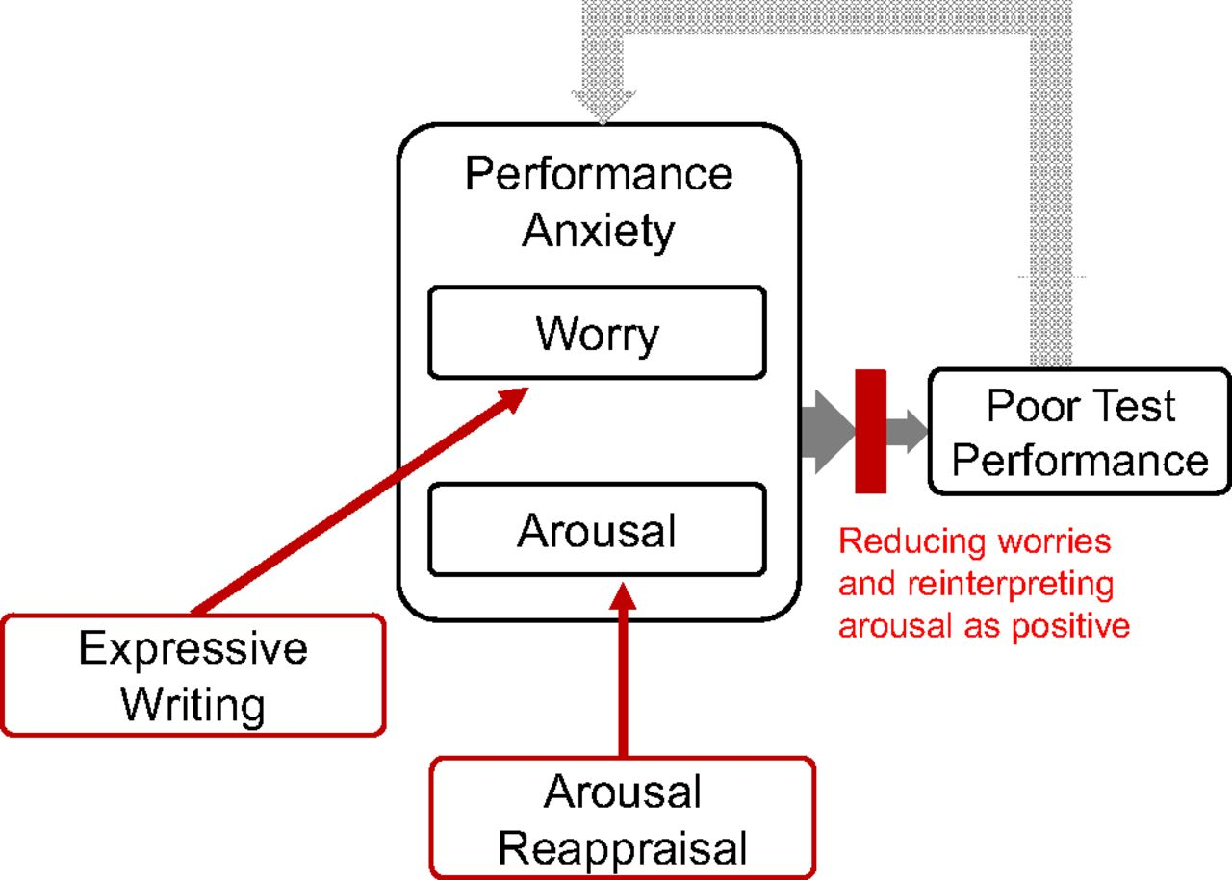
Figure 1. Theoretical model of emotion regulation interventions that address specific components of performance anxiety. Worry and arousal are the two components of performance anxiety. There is a negative cycle between performance anxiety and poor test performance in which each factor reciprocally influences the other. Interventions that target the specific components of performance anxiety can interrupt this cycle of anxiety and poor performance. From Rozsek et al. (2019) PNAS.

Slide 14
Brain-Insight Lecture Connection (6 min)
Notes:
Note: This is best used for advanced students
Healthy coping mechanisms for reappraising anxiety and quieting down the anxious brain
Time stamps: 29:40-35:30

Slide 15
Let’s calm our amygdala...
The methods that were used to help students calm their amygdala included:
“Expressive writing intervention”- which students write freely about their thoughts before a test
“Reappraisal Intervention”- in which students were asked to evaluate if their feelings of stress were helpful for test taking
Notes:
Source: https://www.pnas.org/doi/pdf/10.1073/pnas.1808589116
https://www.pnas.org/doi/10.1073/pnas.1808589116#ref-38
i) an expressive writing intervention in which students wrote freely about their thoughts before the test, (ii) a reappraisal intervention in which students were asked to evaluate their symptoms of stress as helpful for test taking, (iii) an intervention that combines the expressive writing and reappraisal interventions, and (iv) a an active control condition that instructed students to ignore symptoms of their stress and nervousness.
“This writing exercise asked students to answer brief comprehension questions after completing a reading written by scientists that explained that the anxious arousal felt before stressful events is actually meant to be helpful instead of harmful”
The active control condition asked students to ignore their anxiety, which has been shown to be helpful compared with a neutral control condition in prior studies (e.g., ref. 38) and was based on prior research (25). Students in the expressive writing condition received the exact same prompt before each examination whereas students in the reappraisal, combined, and control conditions received different prompts in semester 1 compared with semester 2.

Slide 16
Figure 2. Effects of emotion regulation interventions on examination performance (A), course passing rate (B), and reappraisal of test anxiety (C). Comparisons are between students given any of the three interventions and students given the control exercises. Students are defined as lower- or higher-income based on free or reduced lunch status. Error bars represent ±1 SE of the mean.
From Rozsek et al. (2019) PNAS.
Notes:
Slide best suited for advanced students, especially if teacher incorporates more of the actual research paper into class

Slide 17
Discussion Pre-Write
Take out a piece of paper and answer in the following questions:
Does everyone experience anxiety? Explain.
When you hear stories about people experiencing anxiety or stress what’s one other word that you think about?
What are some of the downsides of anxiety?
What are some of the benefits of anxiety?
How do various coping mechanisms change the individuals response to anxiety?

Slide 18
Part 4: Class Discussion
Structured Socratic Seminar
Sit in a circle. There will be 6 rounds, just respond to each round accordingly!
Round 1: A yes/no question (Does everyone experience anxiety?)
Round 2: One word (When you hear stories about people experiencing anxiety or stress what’s one other word that you think about?)
Round 3: One-three sentences (Why did you choose that word?)
Round 4: Guiding Question 1 (What are some of the downsides of anxiety?)
Round 5: Guiding Question 2 (What are some of the upsides of anxiety?)
Round 6: Open Discussion (Did you experience anxiety during this discussion? What did feel like? Did you use any approaches to reduce your anxiety?)
Optional Round 7: Open Discussion (How do various coping mechanisms change the individual’s response to anxiety?)

Slide 19
Round #1: YES or NO
Does everyone
experience anxiety?

Slide 20
Round #2: ONE WORD
When you hear stories about people experiencing anxiety or stress, what’s one other word that you think about?

Slide 21
Round 3: One to Three Sentences
Why did you choose that word from round 2?

Slide 22
Round #4: Guiding Question
What are some of the downsides of anxiety?

Slide 23
Round #5: Guiding Question
What are some of the
upsides of anxiety?

Slide 24
Round #6: Open Discussion
How do various coping mechanisms change the individual’s response to anxiety?

Slide 25
Optional Round #7: Open Discussion
Did you experience anxiety during this discussion? What did feel like? Did you use any approach to reduce your anxiety?

Slide 26
How can anxiety or stress be beneficial?
Extension: Students create a campaign/PSA that talks about how coping mechanisms could benefit students in their school

Slide 27
Extra materials
The following slides have extra materials in case the teacher wants to tie the lesson to regulation and homeostasis

Slide 28
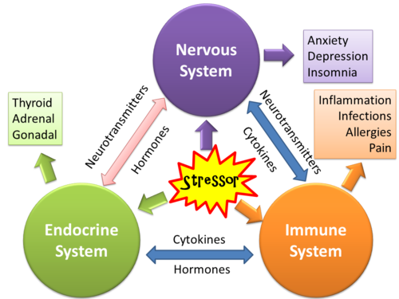
Notes:
Source: https://www.sportsinjurybulletin.com/painful-truths-the-physical-impacts-of-emotional-stress/
Other interesting links: https://www.nature.com/articles/s41574-019-0298-z

Slide 29
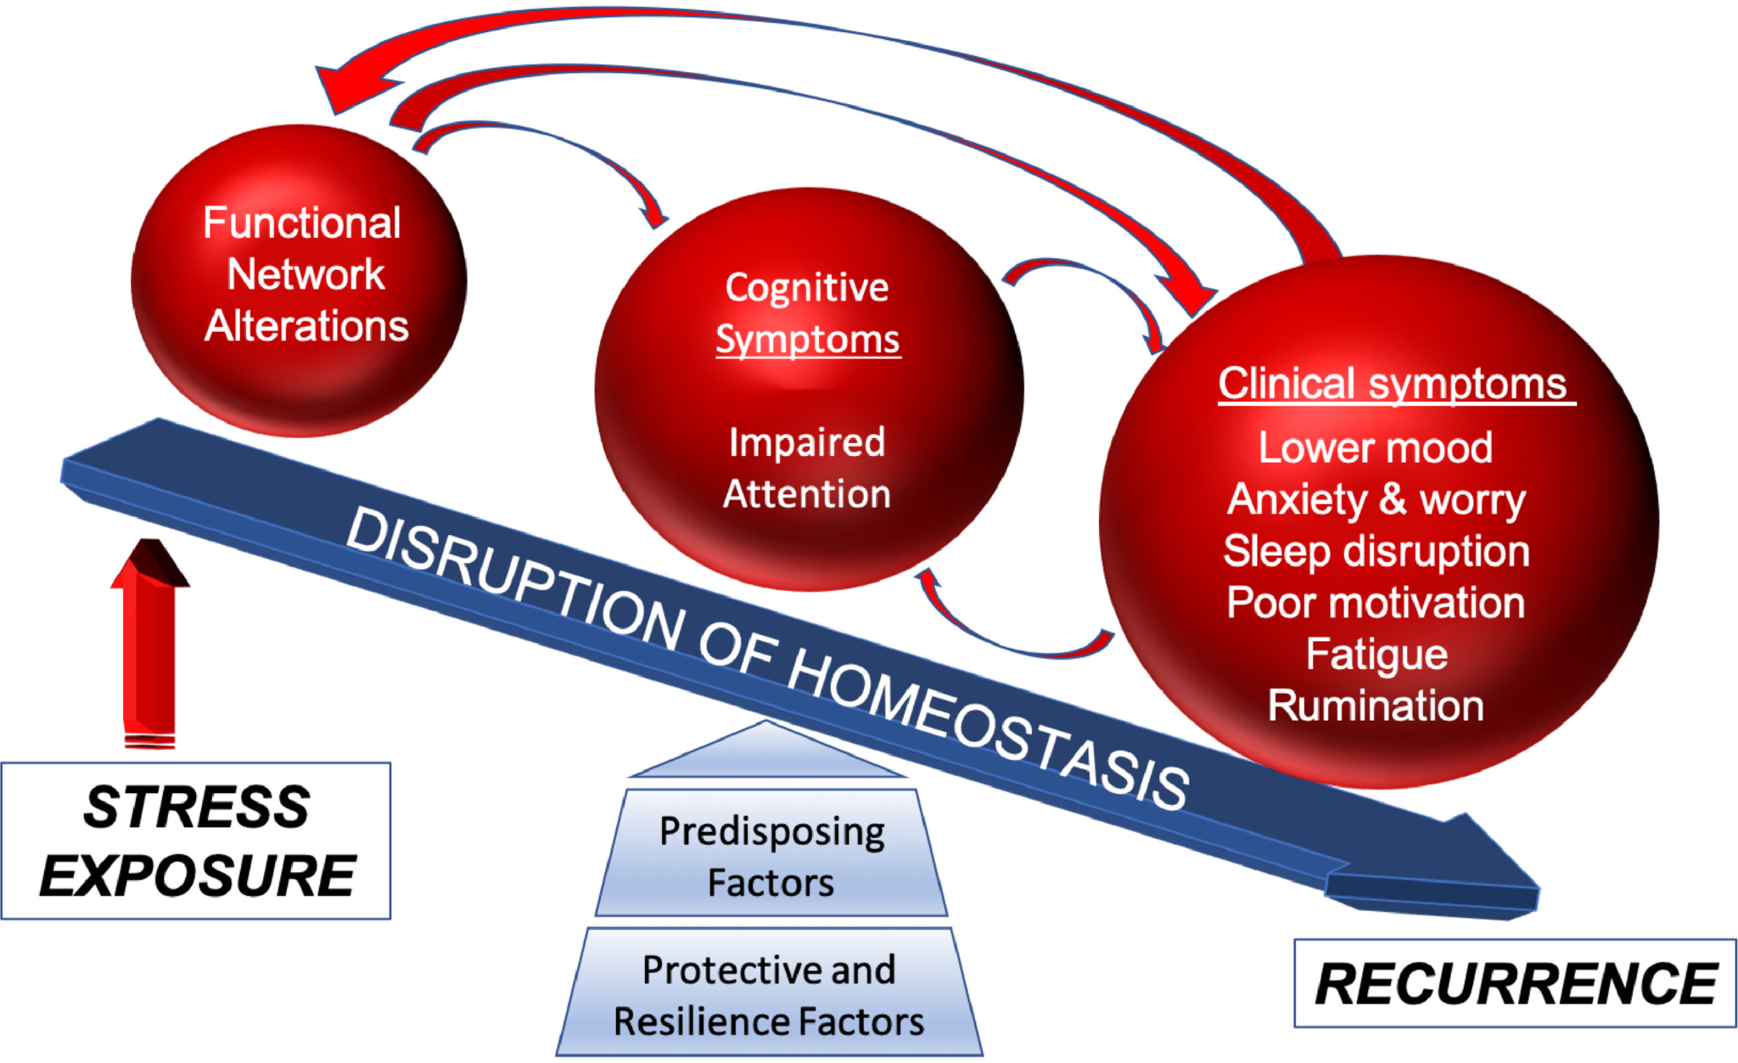
Notes:
Source: https://www.ajgponline.org/article/S1064-7481(19)30461-0/fulltext

Slide 30
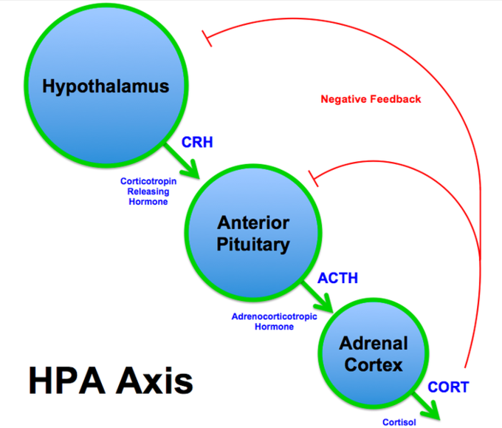

Slide 31
Feedback Mechanisms & Homeostasis
Moderate levels of cortisol are always present in the body to perform several regulatory functions. Among several things, it controls the sleep/wake cycle, moderates blood sugar, regulates blood pressure, and monitors metabolism.
When under stress from a perceived danger, the body increases the amount of cortisol to prepare for “fight-or-flight.” Blood pressure and pulse rate increase, metabolism changes, and glucose levels rise to provide additional energy to muscles. After the danger passes, cortisol levels decrease, and body systems return to normal. Because of the powerful effects that cortisol can have on the body, high levels are meant to be temporary, giving the body the physical boost it needs to deal with the present danger.
Because no one is immune to the stress associated with living through an extended pandemic, there is a high probability that most of us have elevated amounts of cortisol continually present in our bloodstream. When high levels of cortisol are present for an extended period, mental and physical health concerns arise. The early ones to emerge are anxiety and depression.
Notes:
Source: https://www.learningsciences.com/blog/can-the-brain-teach-and-learn-curriculum-during-a-pandemic/

Slide 32
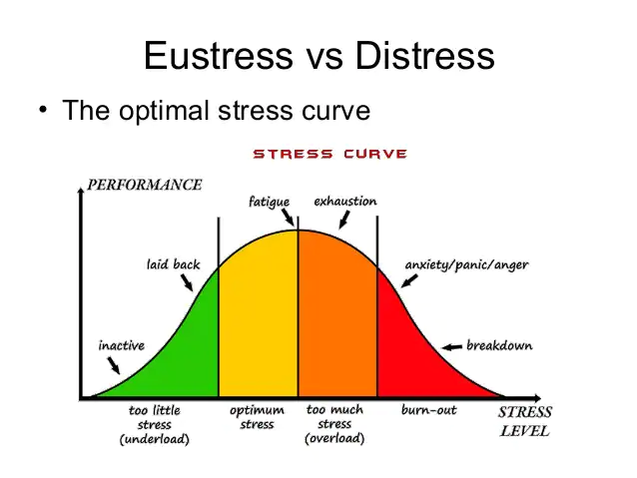

Slide 33
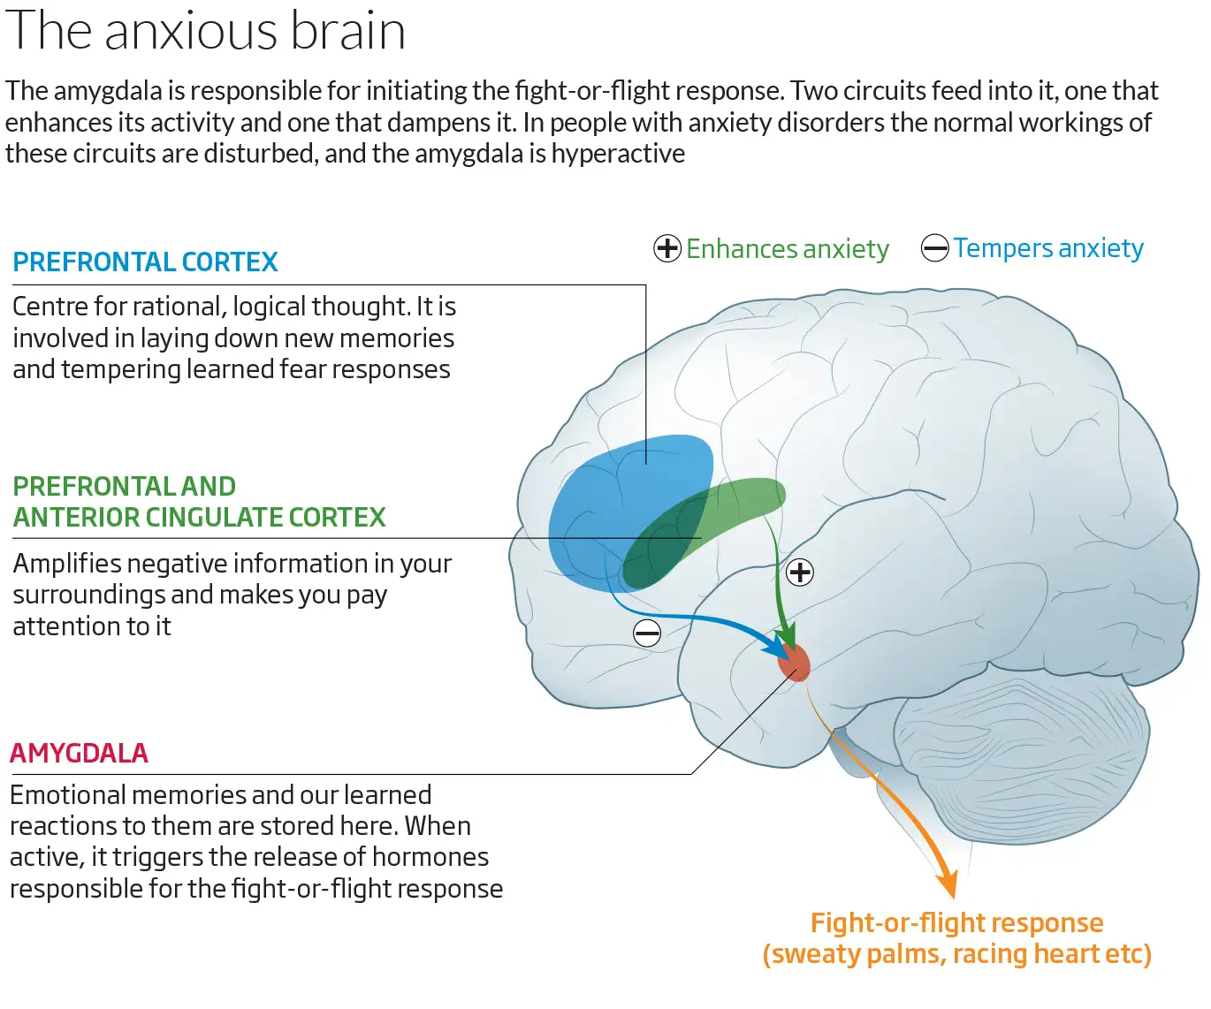
Notes:
Source: https://www.newscientist.com/article/mg23230940-300-why-we-worry-understanding-anxiety-and-how-to-help-it/

Slide 34
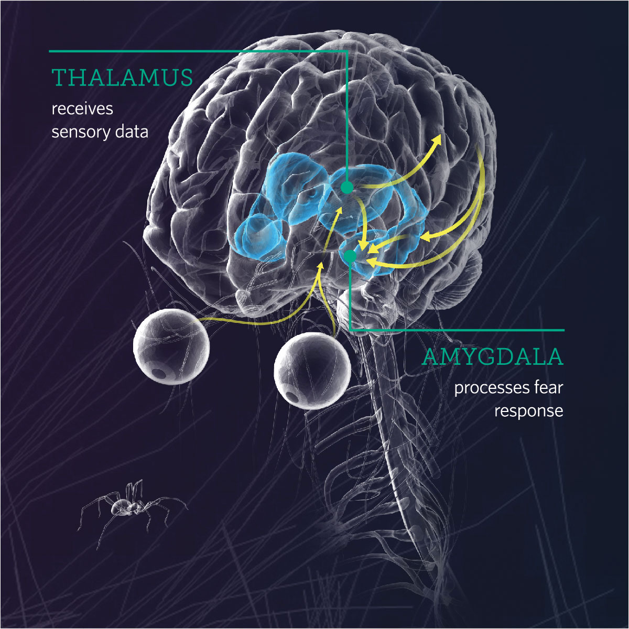
Input (spider → sensory info)
output (response in brain)

